Slide 1
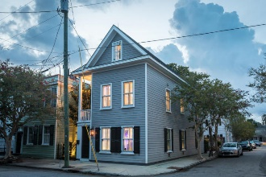
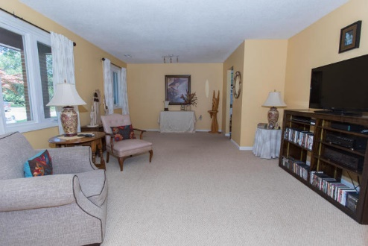
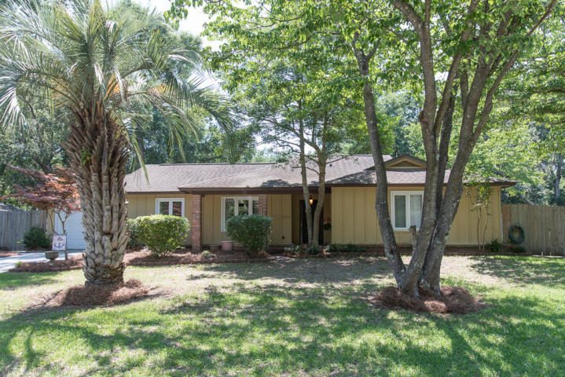
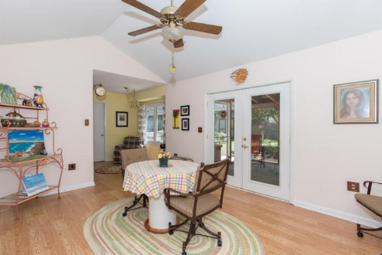
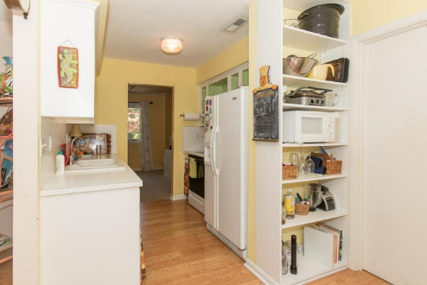
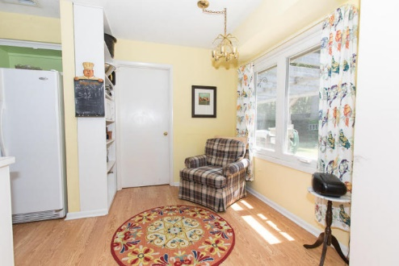

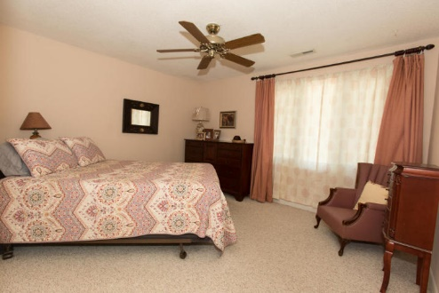
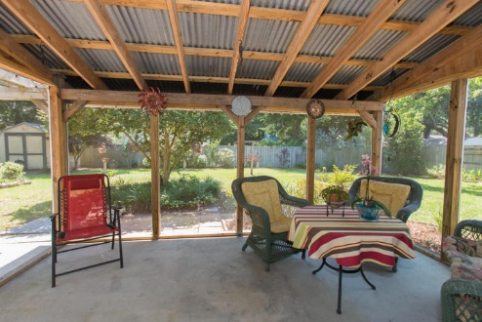
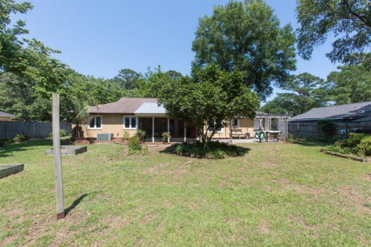

Price Reduced in Quail Run
1346 Bob White Drive
Charleston, SC 29412 · MLS# 18016280 · $312,500
Nice, clean 3 bedroom 2 bath home on James Island!
Updated bathrooms. Newer windows.
Screened in porch overlooking large lot.
Great Location.
Convenient to down town and Folly beach.
Michael Dew
O 843-769-5100
M 843-870-7000
michaeledew@gmail.com
www.michaeldewrealestate.com
AgentOwned Charleston Group
902 Savannah Hwy
Charleston, SC 29407
Real Estate ● Mortgage Insurance ● Business Brokerage

