Slide 1

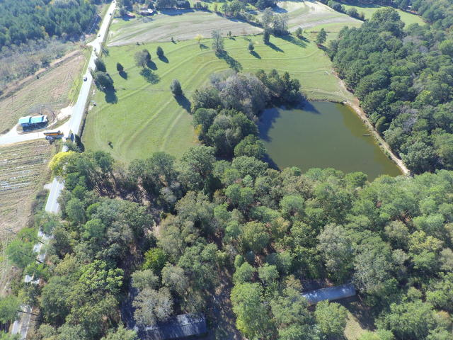
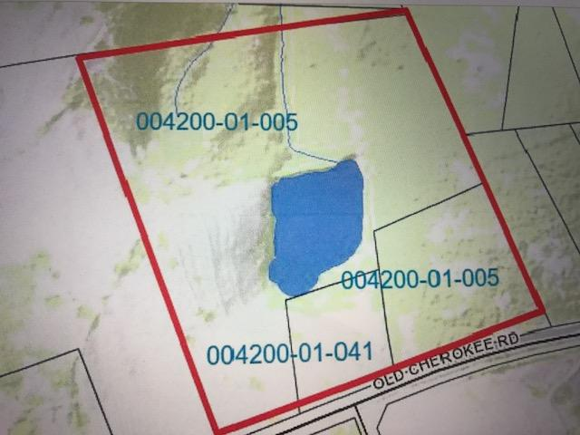
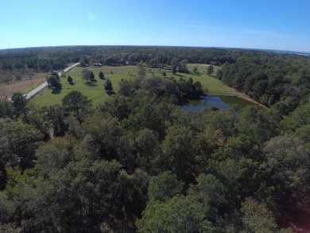
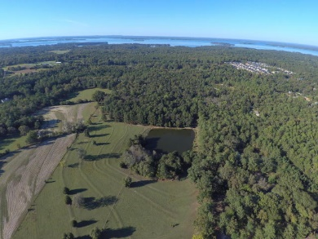
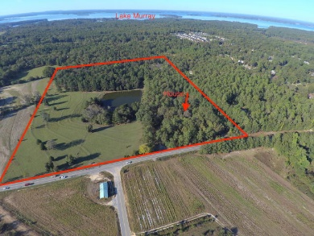
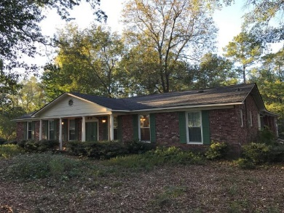
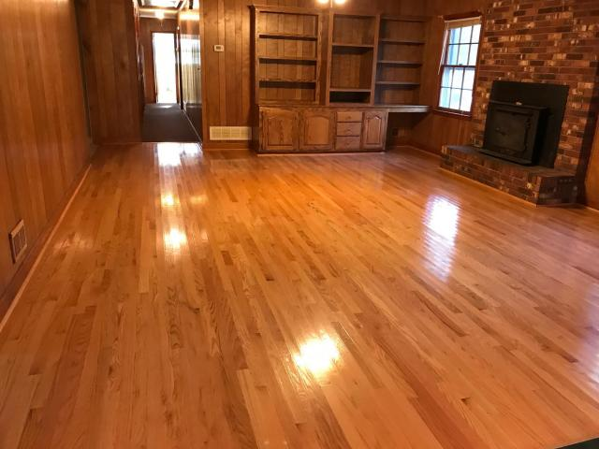
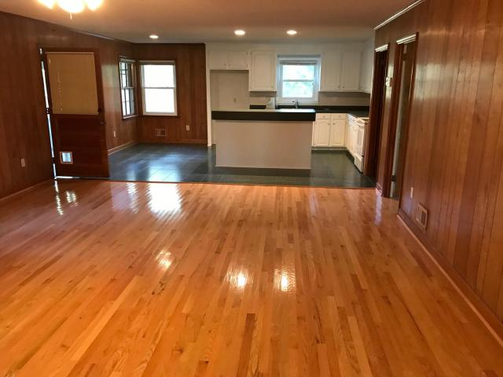
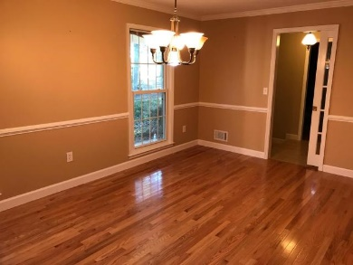


Endless Opportunity & Price Reduced!
1348 Old Cherokee Road
Lexington, SC 29072 · MLS# 17027133 · $1,450,000
25+ Acres
This beautiful 25+ acre property is extremely close to downtown Lexington yet maintains a country feel. It would make an incredible high-end development, or build your dream home on this large estate overlooking the spring fed pond (approx. 2 acres). There is over 1000' of road frontage. This property consist of 3 separate parcels and one of them has a three bedroom/two bath, 2040 s.f. all brick house on it. The house has an attached 3-car carport that is capped with an all brick 400 s.f. utility/play room. There is a nice mix of level land, beautiful rolling hills, mature trees, and large open expanses, and the pond is located near the center of the property. Located in one of the state's best, Lexington School District #1. City water available, and sewer coming soon.
Lee Lindler
Cell (843) 637-0803 | LeeL@NVRealtyGroup.com
NV Realty Group | 1900 Seabrook Island Rd | Johns Island, SC 29455
LeeLindler.NVRealtyGroup.com

