Slide 1
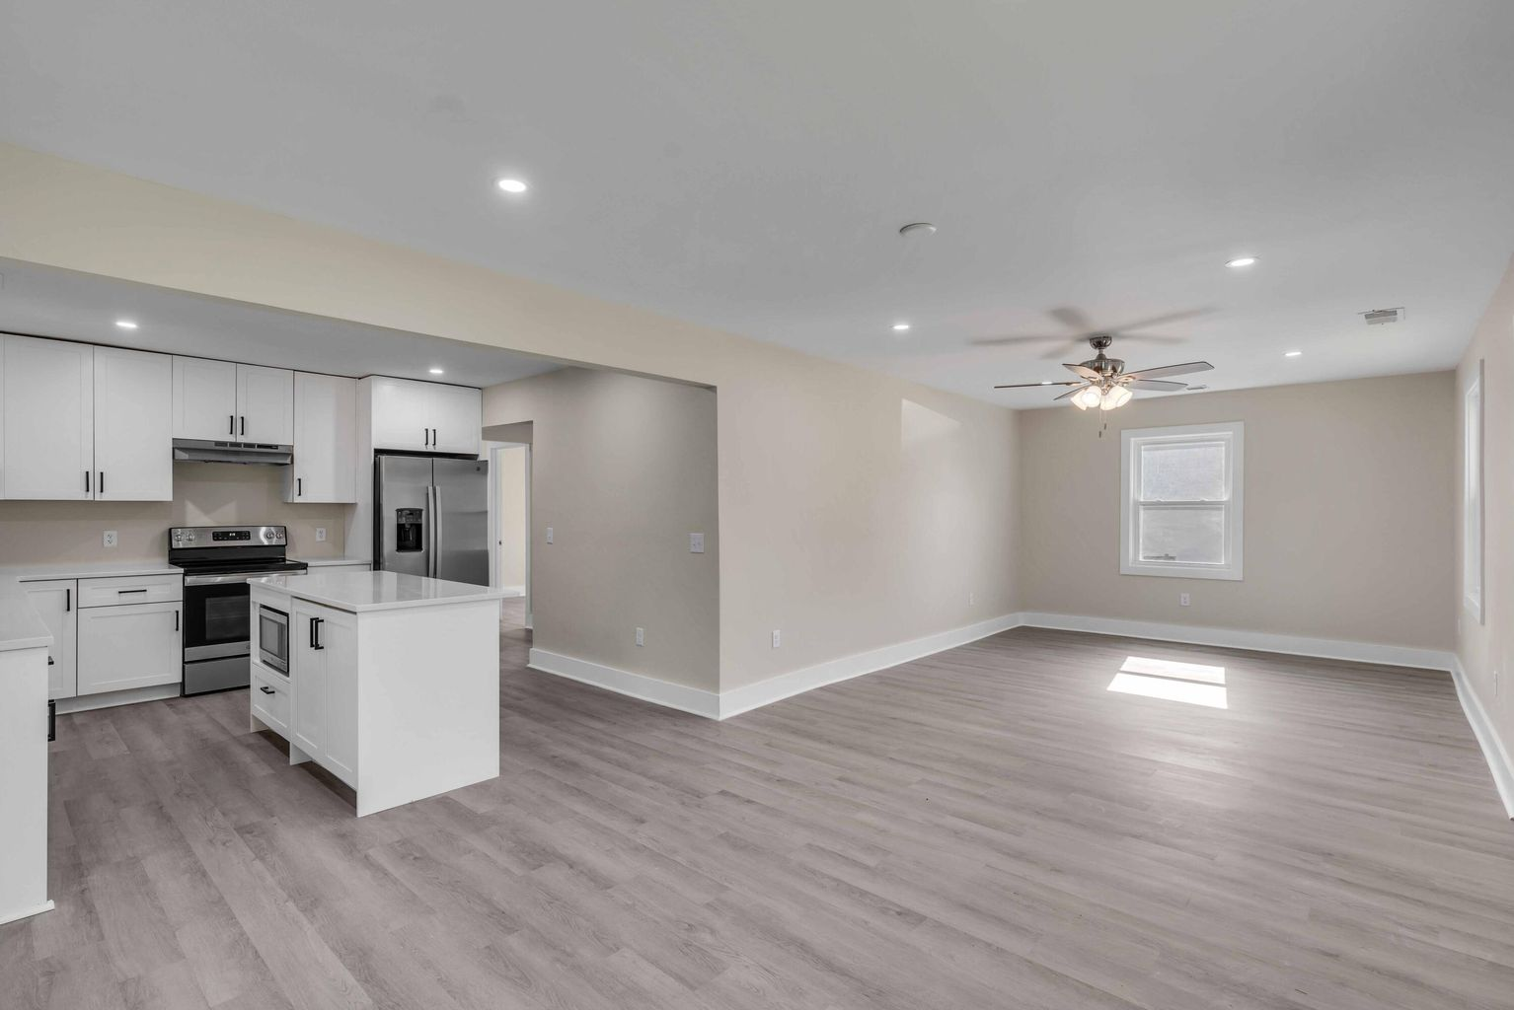
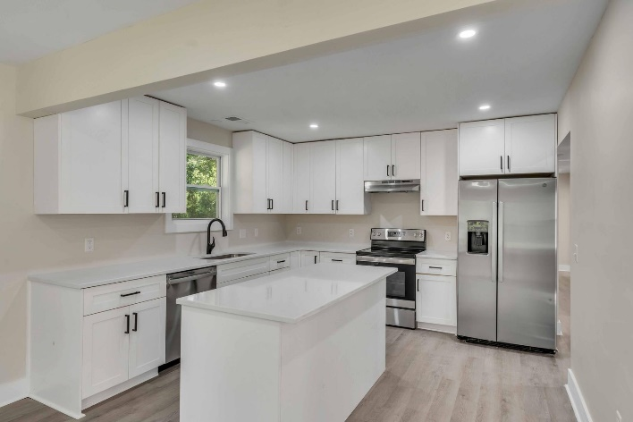
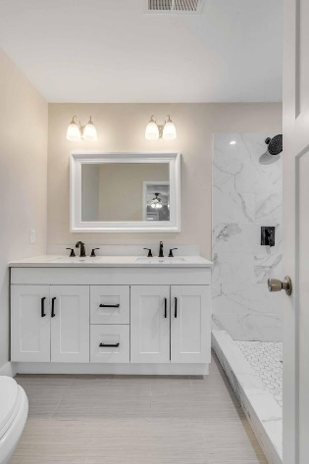
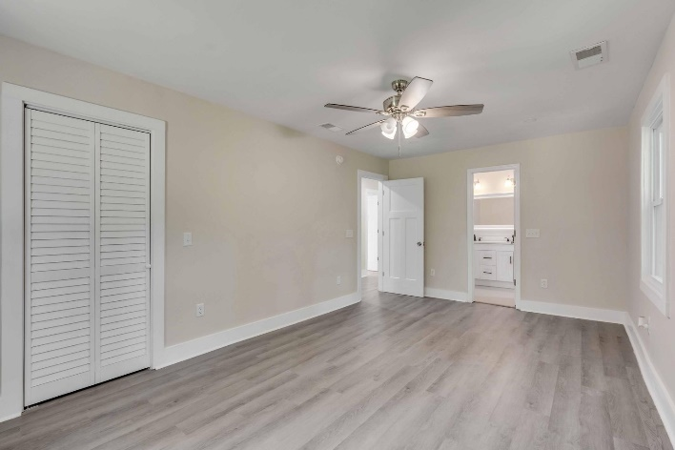
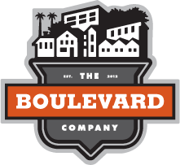

Renovated in Park Circle, Open House Saturday 11-1
1348 Maxwell Street
Park Circle | North Charleston, SC 29405
MLS# 22020096 | $495,000
New everything in this totally renovated Park Circle charmer. Nothing left undone and right in the heart of one of the best neighborhoods in Charleston. Large owners suite with walk in closet and oversized bathroom. New roof, new LVT and tile flooring, new cement board siding, all new kitchen and bathrooms, new tankless hot water heater, new HVAC, etc. Home comes with a transferable termite bond. Massive lot that is very deep and has an old pad out back, would be a perfect spot for an ADU or garage with the proper approvals from city.
Justin Natale
843-437-9739 | jnatale1982@gmail.com
www.theblvdcompany.com
The Boulevard Company, LLC | 806 Johnnie Dodds Blvd Ste 100 | Mt Pleasant, SC 29464

