Slide 1

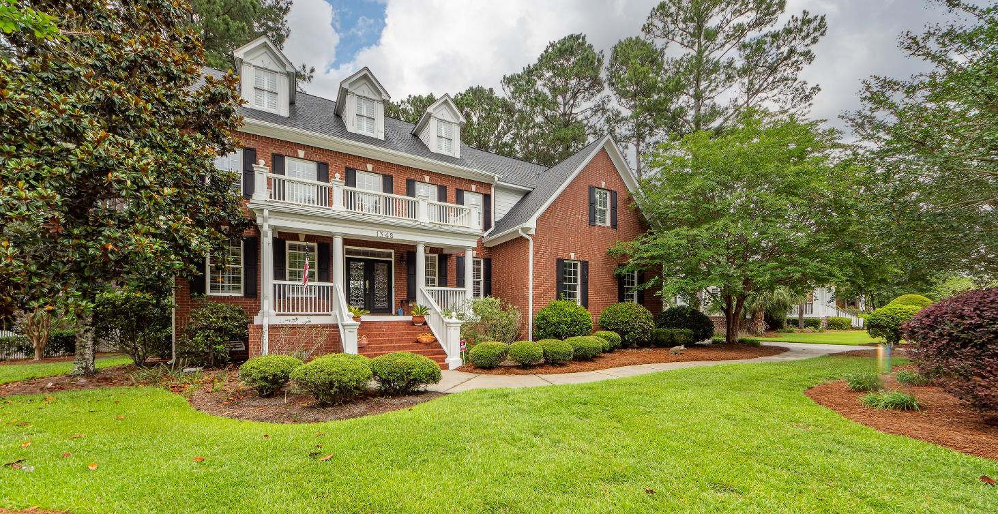
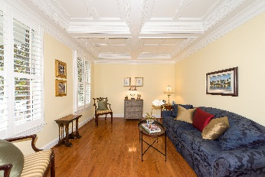
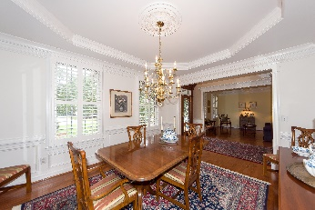
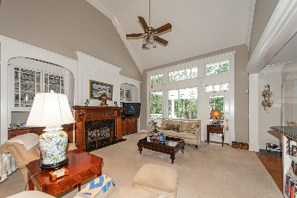
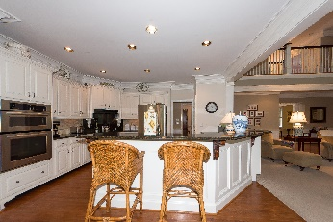
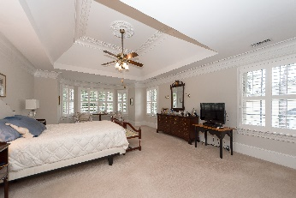
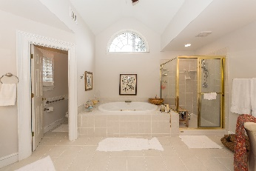
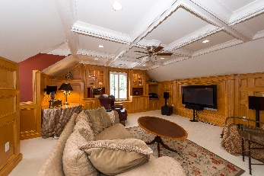
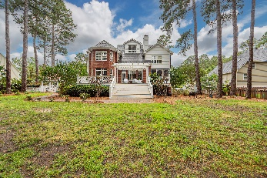


Dunes West Broker Sneak Peek
May 31 from 5p-6:30p
Bring Your Clients
Debbie Himebaugh
(843) 324-6959
dhimebaugh@century21properties.com
debbiehimebaugh.c21.com
1348 White Deer Way | Mt Pleasant | MLS# 22013587 | $1,100,000
Brand New Flooring!
Stately Brick home on a well manicured half acre lot located in one of Mt Pleasant's most prestigious gated Golf/Boating communities. Enter this Georgian style home through the Mahogany elegantly custom trimmed (outside and inside) leaded glass double doors. Large foyer welcomes you, a dining room to your right and living room featuring custom coffered ceiling to your left. All South facing windows have plantation shutters that were designed to allow the windows to be easily pulled down. The kitchen is a Chefs delight with plenty of custom footed cabinets and an eat-in area large enough to seat 8. The screened porch also with custom trim accents opens to a covered pergola custom deck overlooking a spacious yard. Boasting 4 bedrooms and 3 full baths with 2 half baths, 1 on the entry level and second half on the 3rd story. The oversized Owners suite is located on the second level, featuring custom extra wide floor molding and crown molding, open to 5 piece owners bath, his/her sinks, large walk-in shower, oversized tub, owners walkin linen plus overflow closet, step down to the owner tailored closet which is like a full room, flanked by custom built-in armoires, shelving. All additional bedrooms have inner access to a full bath. The 3rd floor is a true masterpiece, from its coffered ceiling, to being heavily trimmed out in Solid Cherry Wood custom built ins, wet bar, desk with file cabinet, large screen TV. In addition this home has an endless hot water system, 3 HVAC units, natural gas line.
Virtual Tour: https://tours.cvh360.com/123070
Century 21 Properties Plus
1090 Park West Blvd; Ste 103
Mount Pleasant, SC 29466

