Slide 1
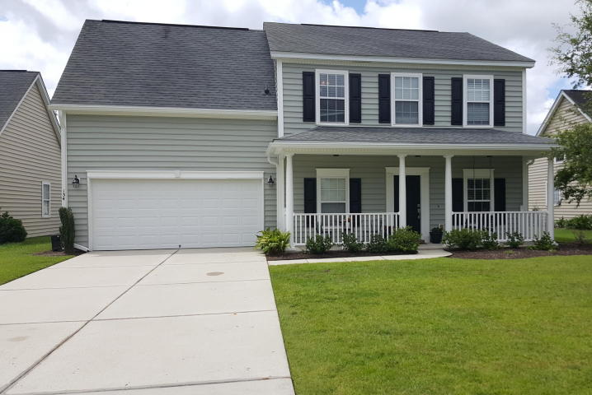
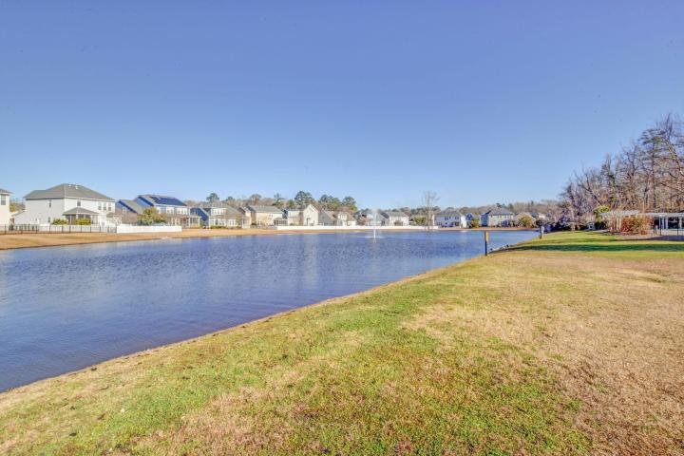
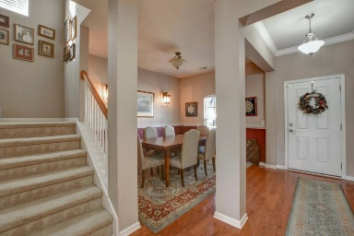
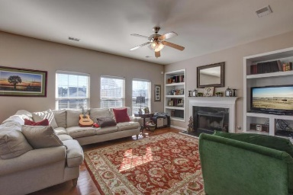
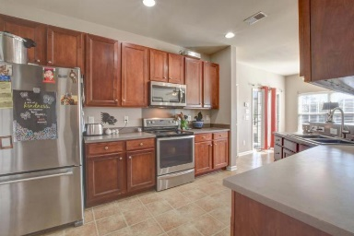
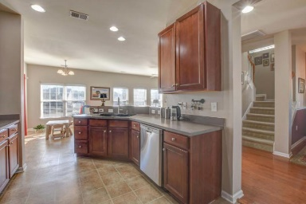
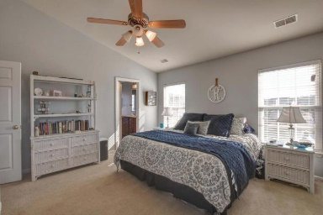
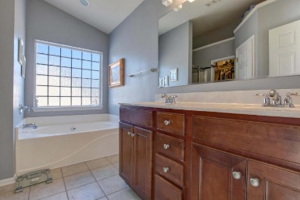
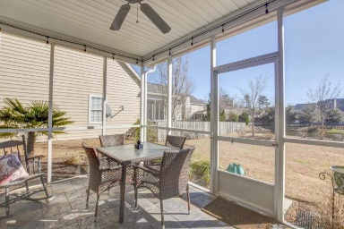
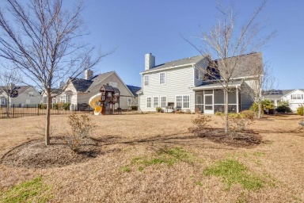


134 Gathering Island Road Summerville, SC 29485 ~ MLS# 18001533 ~ $260,000
Welcome to Legend Oaks!
~ Motivated Seller ~
This is one of the Low Countries incredible golf communities!
This spacious 4 bedroom, 2.5 bath home has a nice yard with a play set and is pond front! This home is family friendly, A Spacious living area, separate dining room. The fireplace is welcoming on cold nights and the screen porch is inviting those warm weather cook outs! Upstairs is a generous Master suite, Extra large bedroom 2, bedroom 3&4 are well sized too. This home is convenient to the schools, Very close to Ashley Ridge high and Rollings school of the arts.
Christopher McCormick
Office - 843-871-9133
Cell - 843-224-3204
cj.mccormick@agentownedrealty.com
AgentOwned Premiere Group
1800 Trolley Rd
Summerville, SC 29485

