Slide 1
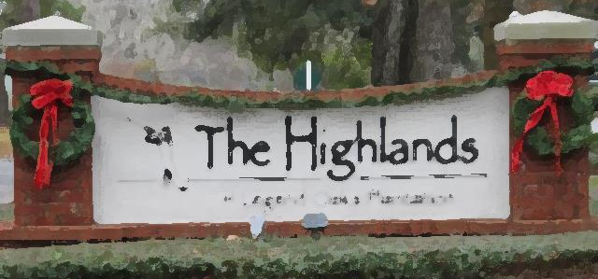
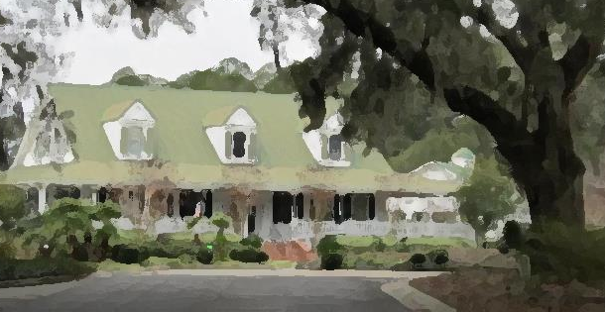
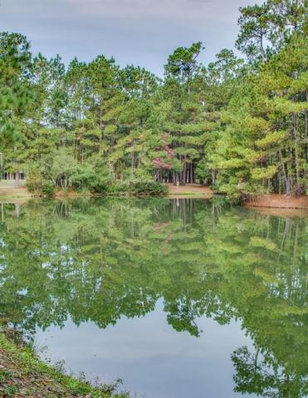
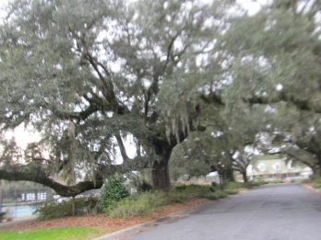
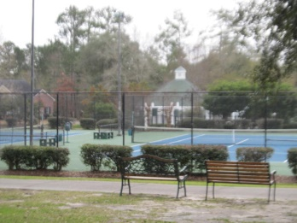
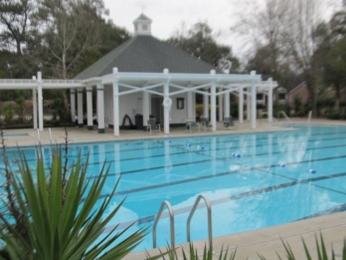
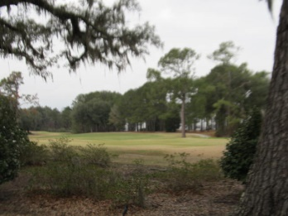
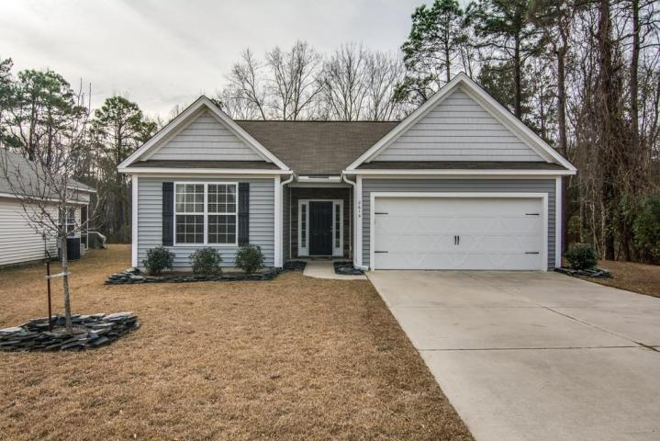
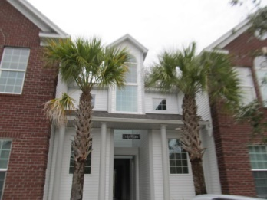
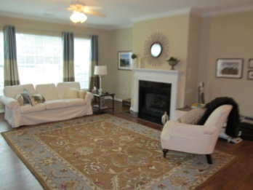
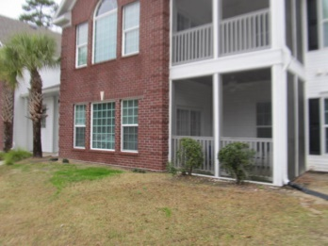
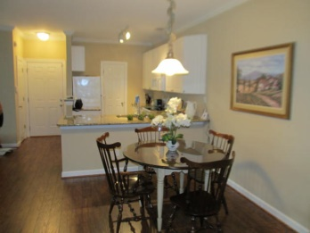
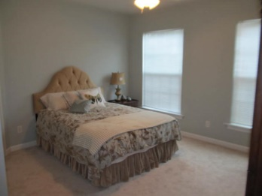
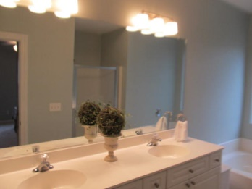
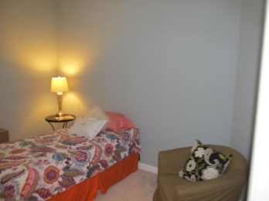
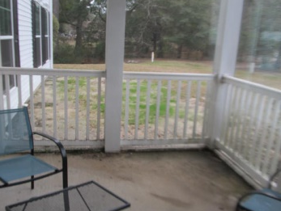


Location…
Location…
Location!
Charming &
Comfortable Living
134 Golfview Lane
· The Highlands of Legend Oaks Plantation · Summerville ·
· MLS# 15000329 · $137,500 ·
Completely Renovated, Move-in-ready, 3 bed, 2 bath condo in Beautiful Legend Oaks Plantation. Over $20,000 just spent in upgrades including new kitchen cabinets, granite counter tops, new appliances, gleaming Pergo wood flooring, carpet, custom paint colors and new light fixtures. This first floor unit is just shy of 1,500 square feet with 3 bedrooms, 2 full baths, large utility room, kitchen pantry and screened-in-porch. The open concept floor plan has a spacious family room with gas fireplace that is adjoined by the dining area and kitchen. The master suite has his & hers closets, and dual sinks in the master bath, plus separate shower & garden tub. Enjoy an active lifestyle as this condo is just steps from the golf course, club house, swimming pool, tennis courts & walking trails. Top Rated Dorchester II Schools. Hurry!
Julie Johnson
843-826-0088
juliemjohnson123@Gmail.com
AgentOwned Realty Premiere Group · 1800 Old Trolley Rd · Summerville, SC 29485

