Slide 1
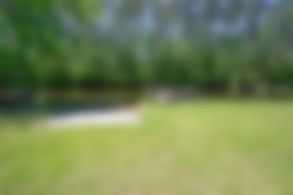
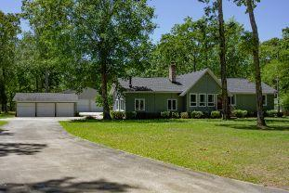
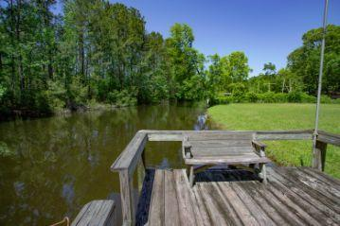
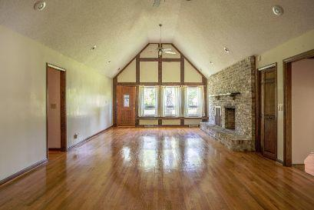
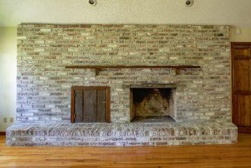
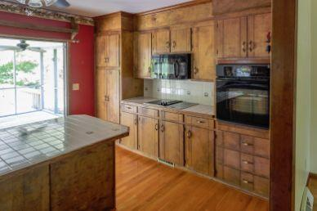
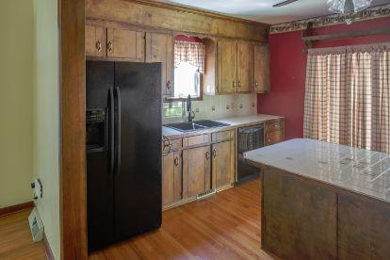
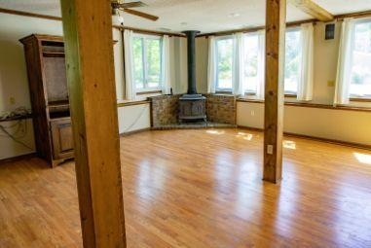
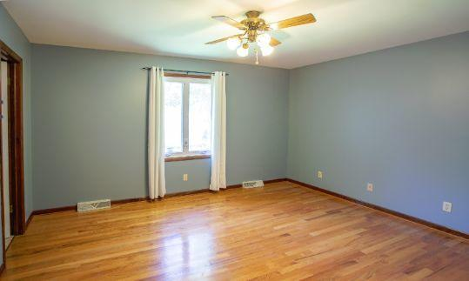
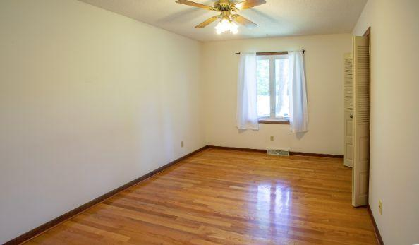
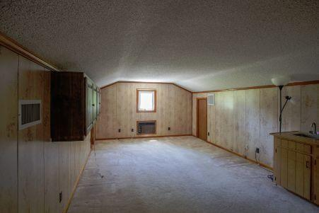
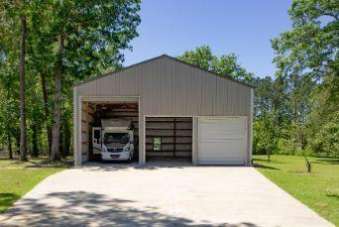


Private Boat Ramp & Dock!!
134 Rutledge Drive
Eutawville, SC 29048 | MLS# 20011323 | $399,900
3 Beds | 2½ Baths | 2,252 Square Feet
This 3 bedrooms and 2.5 bath home is waterfront and has the option for 6 car garage. One bay currently houses a Motor Home (does not convey). This home has beautiful hardwood floors and tiled bathrooms. Original garage has been converted to additional living space. It could be use for an entertainment room, separate living room. Room over the original garage has also converted. It could be a bedroom, flex space, craft room etc. Two wood burning fireplaces. The converted garage and attic space may not be included in the tax records sq footage. You have a boat ramp and your personal dock. From your dock you can be in big water in minutes yet can fish from your dock when rough water. Santee Cooper marginal lease is 453. per year. Buyer and Buyers agent please verify information of importance.
AgentOwned Premiere Group
141 A N. Main Street
Summerville, SC 29483
Carla C Davis
Mobile - (843) 437-4873
gaweber@tds.net

