Slide 1
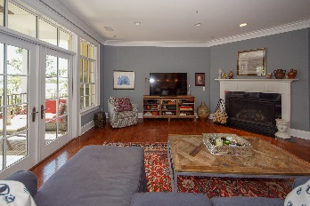
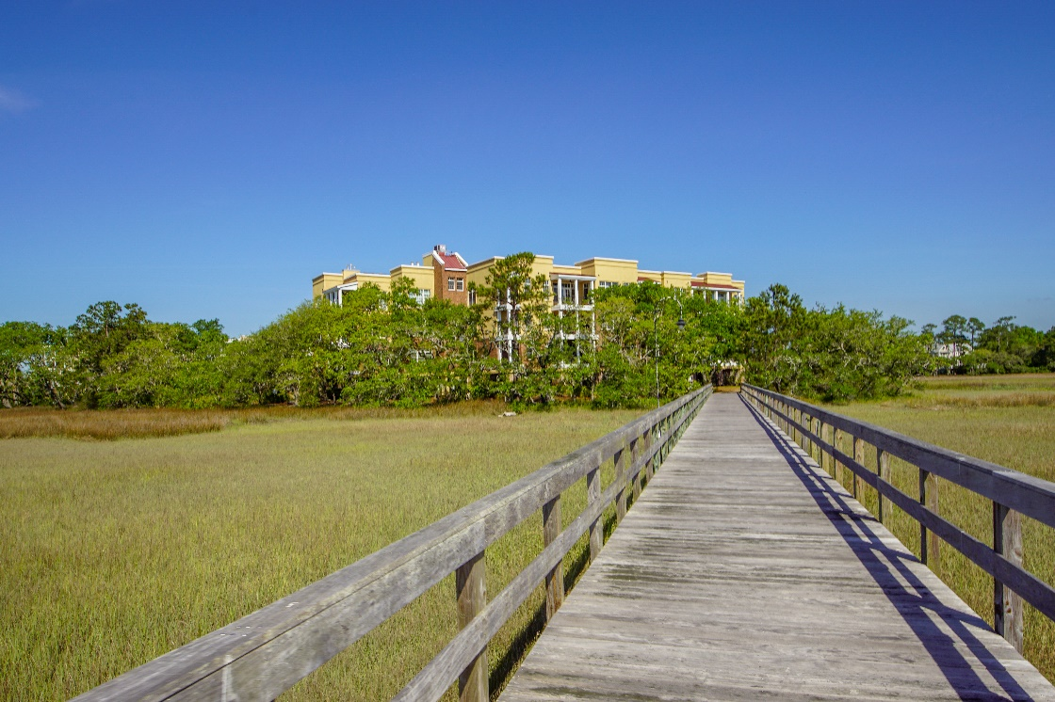
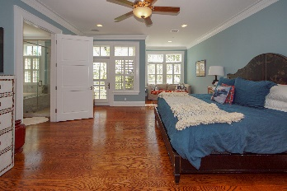
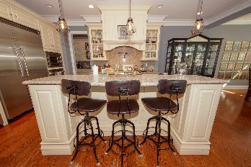
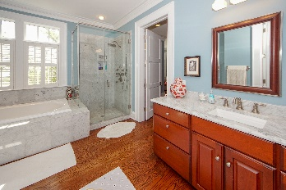
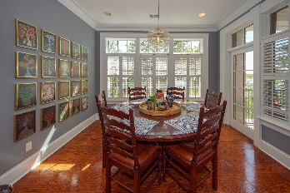
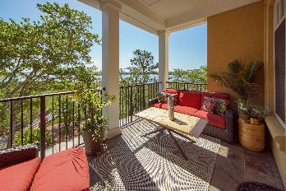


MOTIVATED IS THE WORD!
134 Fairbanks Oak Alley 302
Daniel Island ~ Charleston, SC 29492
CONDOMINIUM FOR SALE
New paint and updated lighting fixtures await your visit at this top-notch vantage point for sunset and sunrise. Forget the yard and trade in your mower for a boat slip. This 3 bedroom, 3.5 bath unit has a deluxe kitchen with separate pantry and prep area which makes it perfect for entertaining with the open floorplan or even on the porch overlooking one of the most beautiful views on Daniel Island. Each bedroom has a separate bathroom and guests claim it feels like they have their own wing with the separation between the master bathroom and the guest rooms. There is an extra den that can be used as an office or for formal dining or even a formal living room area for friendly visits. With a large gas burning fireplace in the great room, well... this condo is great!
MLS ID: | 19012803
Sale Price: | $1,100,000
Area: | 77 - Daniel Island
Bedrooms: | 3
Bathrooms | 3½
Apx. SqFt: | 3,251
Year Built: | 2008
County: | Berkeley
Tax Map #: | 2760502005
David H Seay
CCIM, BIC, CCIM, REALTOR
(843) 364-6720
david@seaydevelopment.com
Seay Development, LLC
3404-202A Salterbeck Street
Mt. Pleasant, SC 29466 www.seaydevelopment.com

