Slide 1

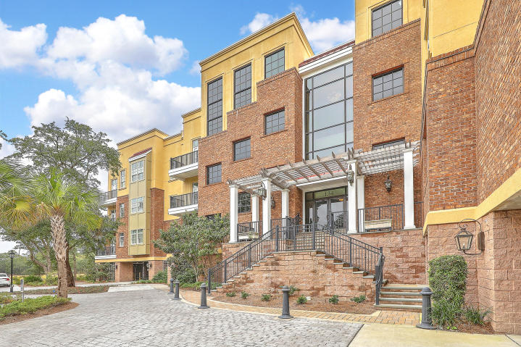
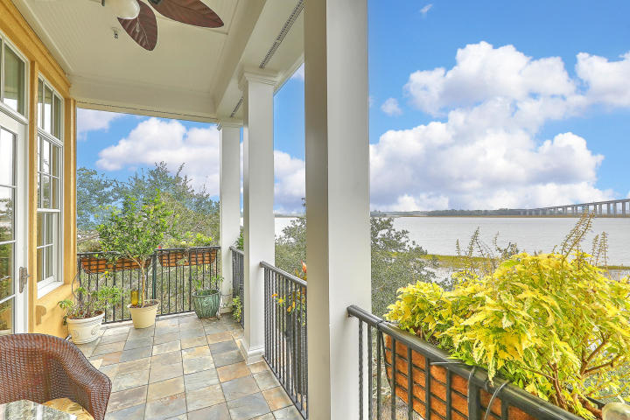
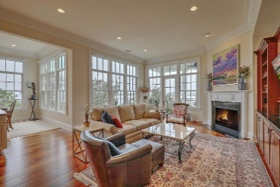


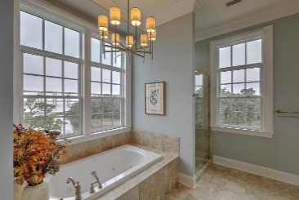
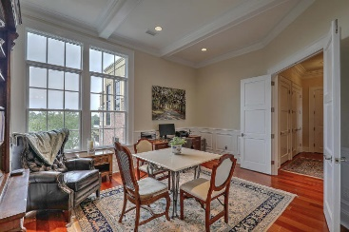
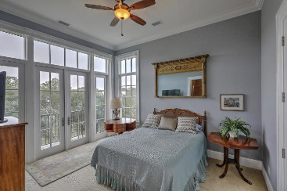
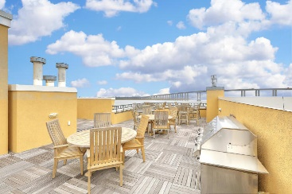
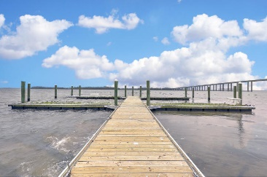


HUGE PRICE REDUCTION!!!!!
134 Fairbanks Oak Allee 403
Daniel Island Park | Charleston, SC 29492 | MLS# 18030676 | $1,250,000
$150K PRICE REDUCTION
Amazing location with breathtaking panoramic views of the Wando River!! This top floor condo is a rare find and an opportunity you won't want to miss. With over 3200 sq ft and 4 bedrooms 4.5 baths, this home has everything you need including a 50 ft boat slip! The Gourmet kitchen features a designer appliance package including a wine cooler, custom wood cabinets, granite countertops and backsplash, double convection ovens, convection microwave, and a generous walk-in pantry. The kitchen opens to the spacious living room with a gas fireplace and separate dining room. Both with 12 ft ceilings and views you can't find anywhere else! The master suite has separate his/hers walk in closets and a private entry to the back porch to enjoy your morning coffee or or catch the evening sunset..The luxurious master bath includes a beautiful double sink quartz vanity, new custom wood cabinetry with soft close drawers, marble countertops, a jetted spa tub, and a frameless glass enclosed shower with an impressive multi-shower system. The 3 guest bedrooms are all very spacious each with their own full bath and walk in closets. Other features include... electric powered Hunter Douglas blind system on many windows throughout the condo, lots of extra storage inside the unit and 2 designated parking spots in the garage. The dock is only shared with 9 total units and offers water and power. The shared roof top terrace is furnished with top of the line teak furniture and is perfect for entertaining!
Kristen Kern-Whitehead
Mobile - 843-670-1671
kwhitehead@kwchs.com
www.charlestonislandagents.com
Keller Williams Realty
Charleston Islands
1304 Palm Blvd
Isle Of Palms, SC 29451

