Slide 1
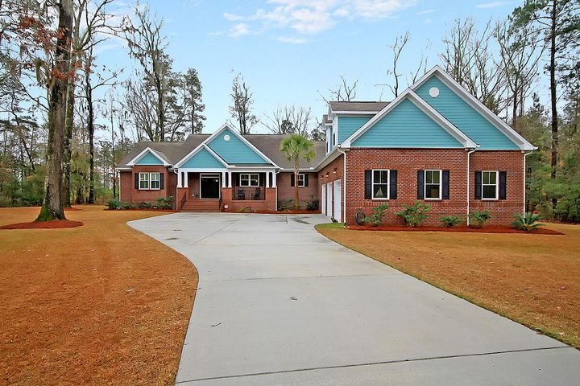
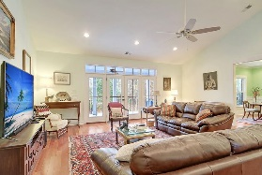
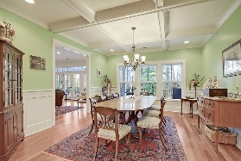
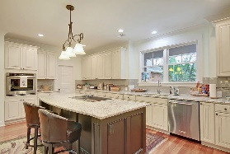
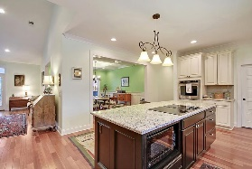
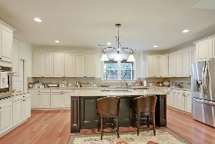
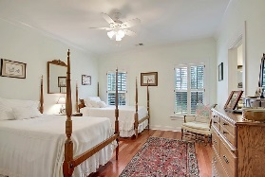
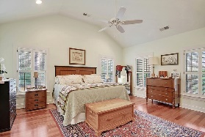
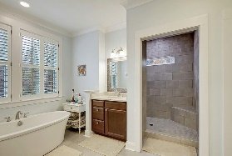
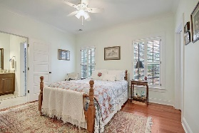
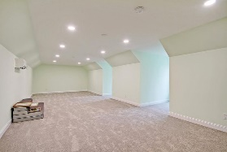
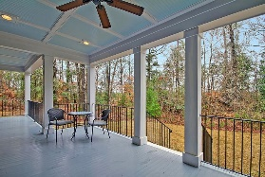
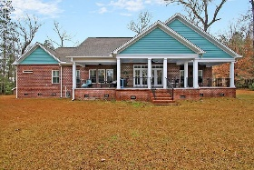
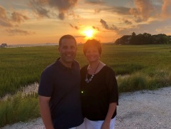

Over 4 Acres! 3 Car Garage! Gated Community!
134 Boyle Way
Boyle Plantation
Summerville, SC 29485
MLS# 21004379
$625,000
4 Bedrooms | 3½ Baths | 3,498 sf
Looking for a home on a large lot with tons of privacy? Would love the security of a gated community? Need a three car garage? Then this is the house for you! This custom built home has it all! Located in a cul de sac on 4.25 acres, this one story has a great floor plan and so many great extra details that you can only get in a custom built, five year old home. The welcoming front porch and foyer greet you and you immediately feel at home. The living room offers beautiful views of the wooded backyard with doors to access the back deck. The large dining room has gorgeous coffered ceilings and wainscoting. Overlooking both of these rooms is the kitchen, which is a chef's delight! Ample cabinetry, large island and a huge pantry! Great open floor plan and flow. On the left side of the house, separate from the other bedrooms, is the master suite. This room has plenty of room for a seating area and then there's the master bath. This stunning bathroom offers a stand alone tub, dual vanities, huge walk in shower stall and oversized walk in closet. Head to the other side of the home and you'll find two more good sized bedrooms that share a jack and jill bathroom. In the hall, you'll find a half bath then the large laundry room. The laundry room has a sink, built in cabinetry with tons of storage. Head upstairs from that hallway and find the huge FROG with a full bathroom! This room has so many uses, fourth bedroom, media room, toy room, mother in law suite...you name it! It has a large walk in closet with built in shelving as well as storage in the dormers. Back downstairs, head outside to the back deck where you can sit and relax and take in all that nature has to offer with stunning wooded views. This house in serviced by Dorchester District 2 schools, is conveniently located away from it all, yet everything you need is just a short drive away.
Larry & Kathy Mazalatis
Larry Cell 843-693-0529
Kathy Cell 843-693-0159
Office 843-871-9133
AGENTOWNED PREMIERE GROUP | 1800 TROLLEY RD | SUMMERVILLE, SC 29485

