Slide 1
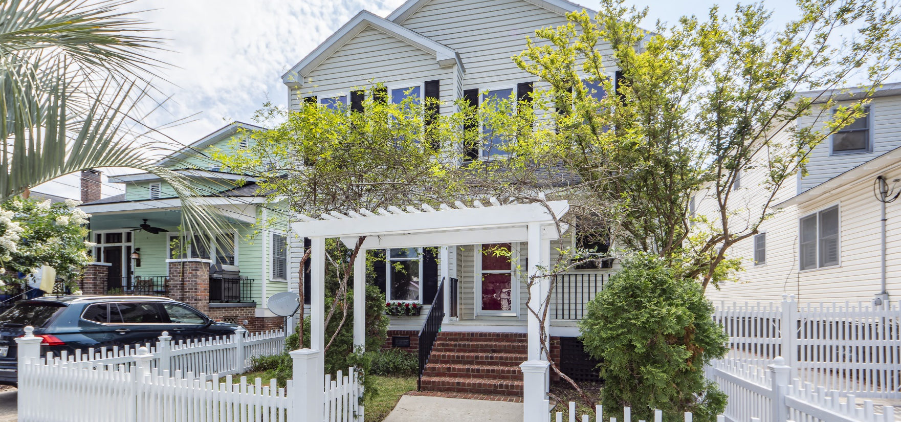
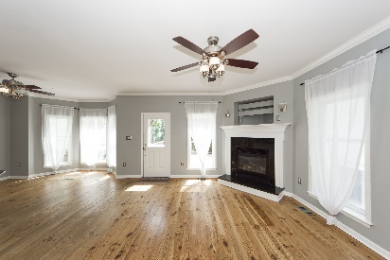
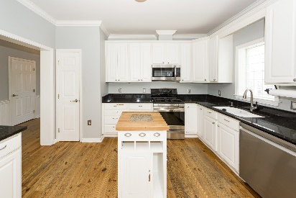
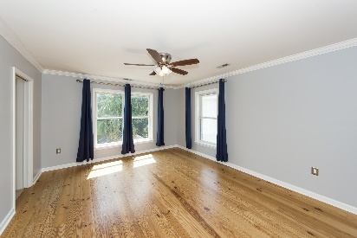
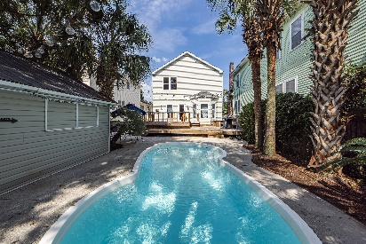

Price Reduced $200,000! Live Downtown! Walk to Hampton Park!
134 Darlington Avenue
Wagener Terrace | Charleston, SC 29403 | MLS# 24013145 | $996,200
GREAT location and a pool in the backyard! House was built in 2000-open floor plan. Walk to Hampton Park, restaurants and much more. Easy outdoor entertaining. All bedrooms upstairs have their own private bath. House has a garage and additional parking. Own in historic downtown. Move in ready!
Virtual Tour
Lisa Deaton
843-224-7878
lisamdeaton@comcast.net
AgentOwned Charleston Group
902 Savannah Hwy
Charleston, SC 29407-7802

