Slide 1
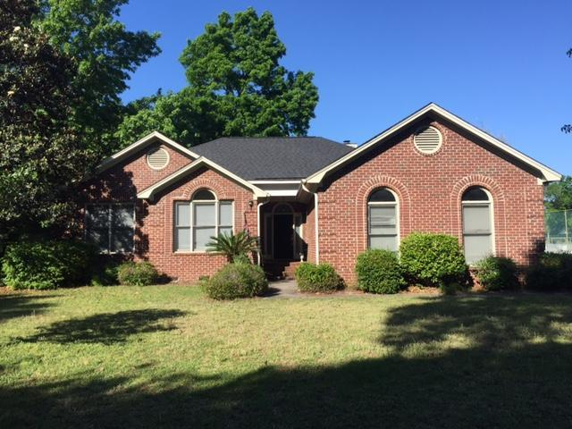
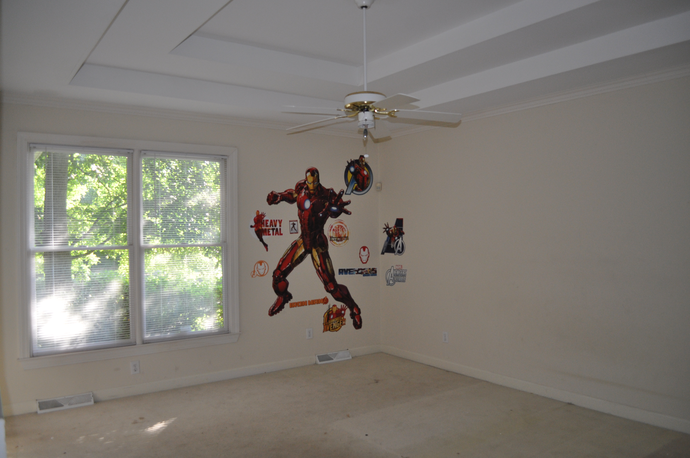
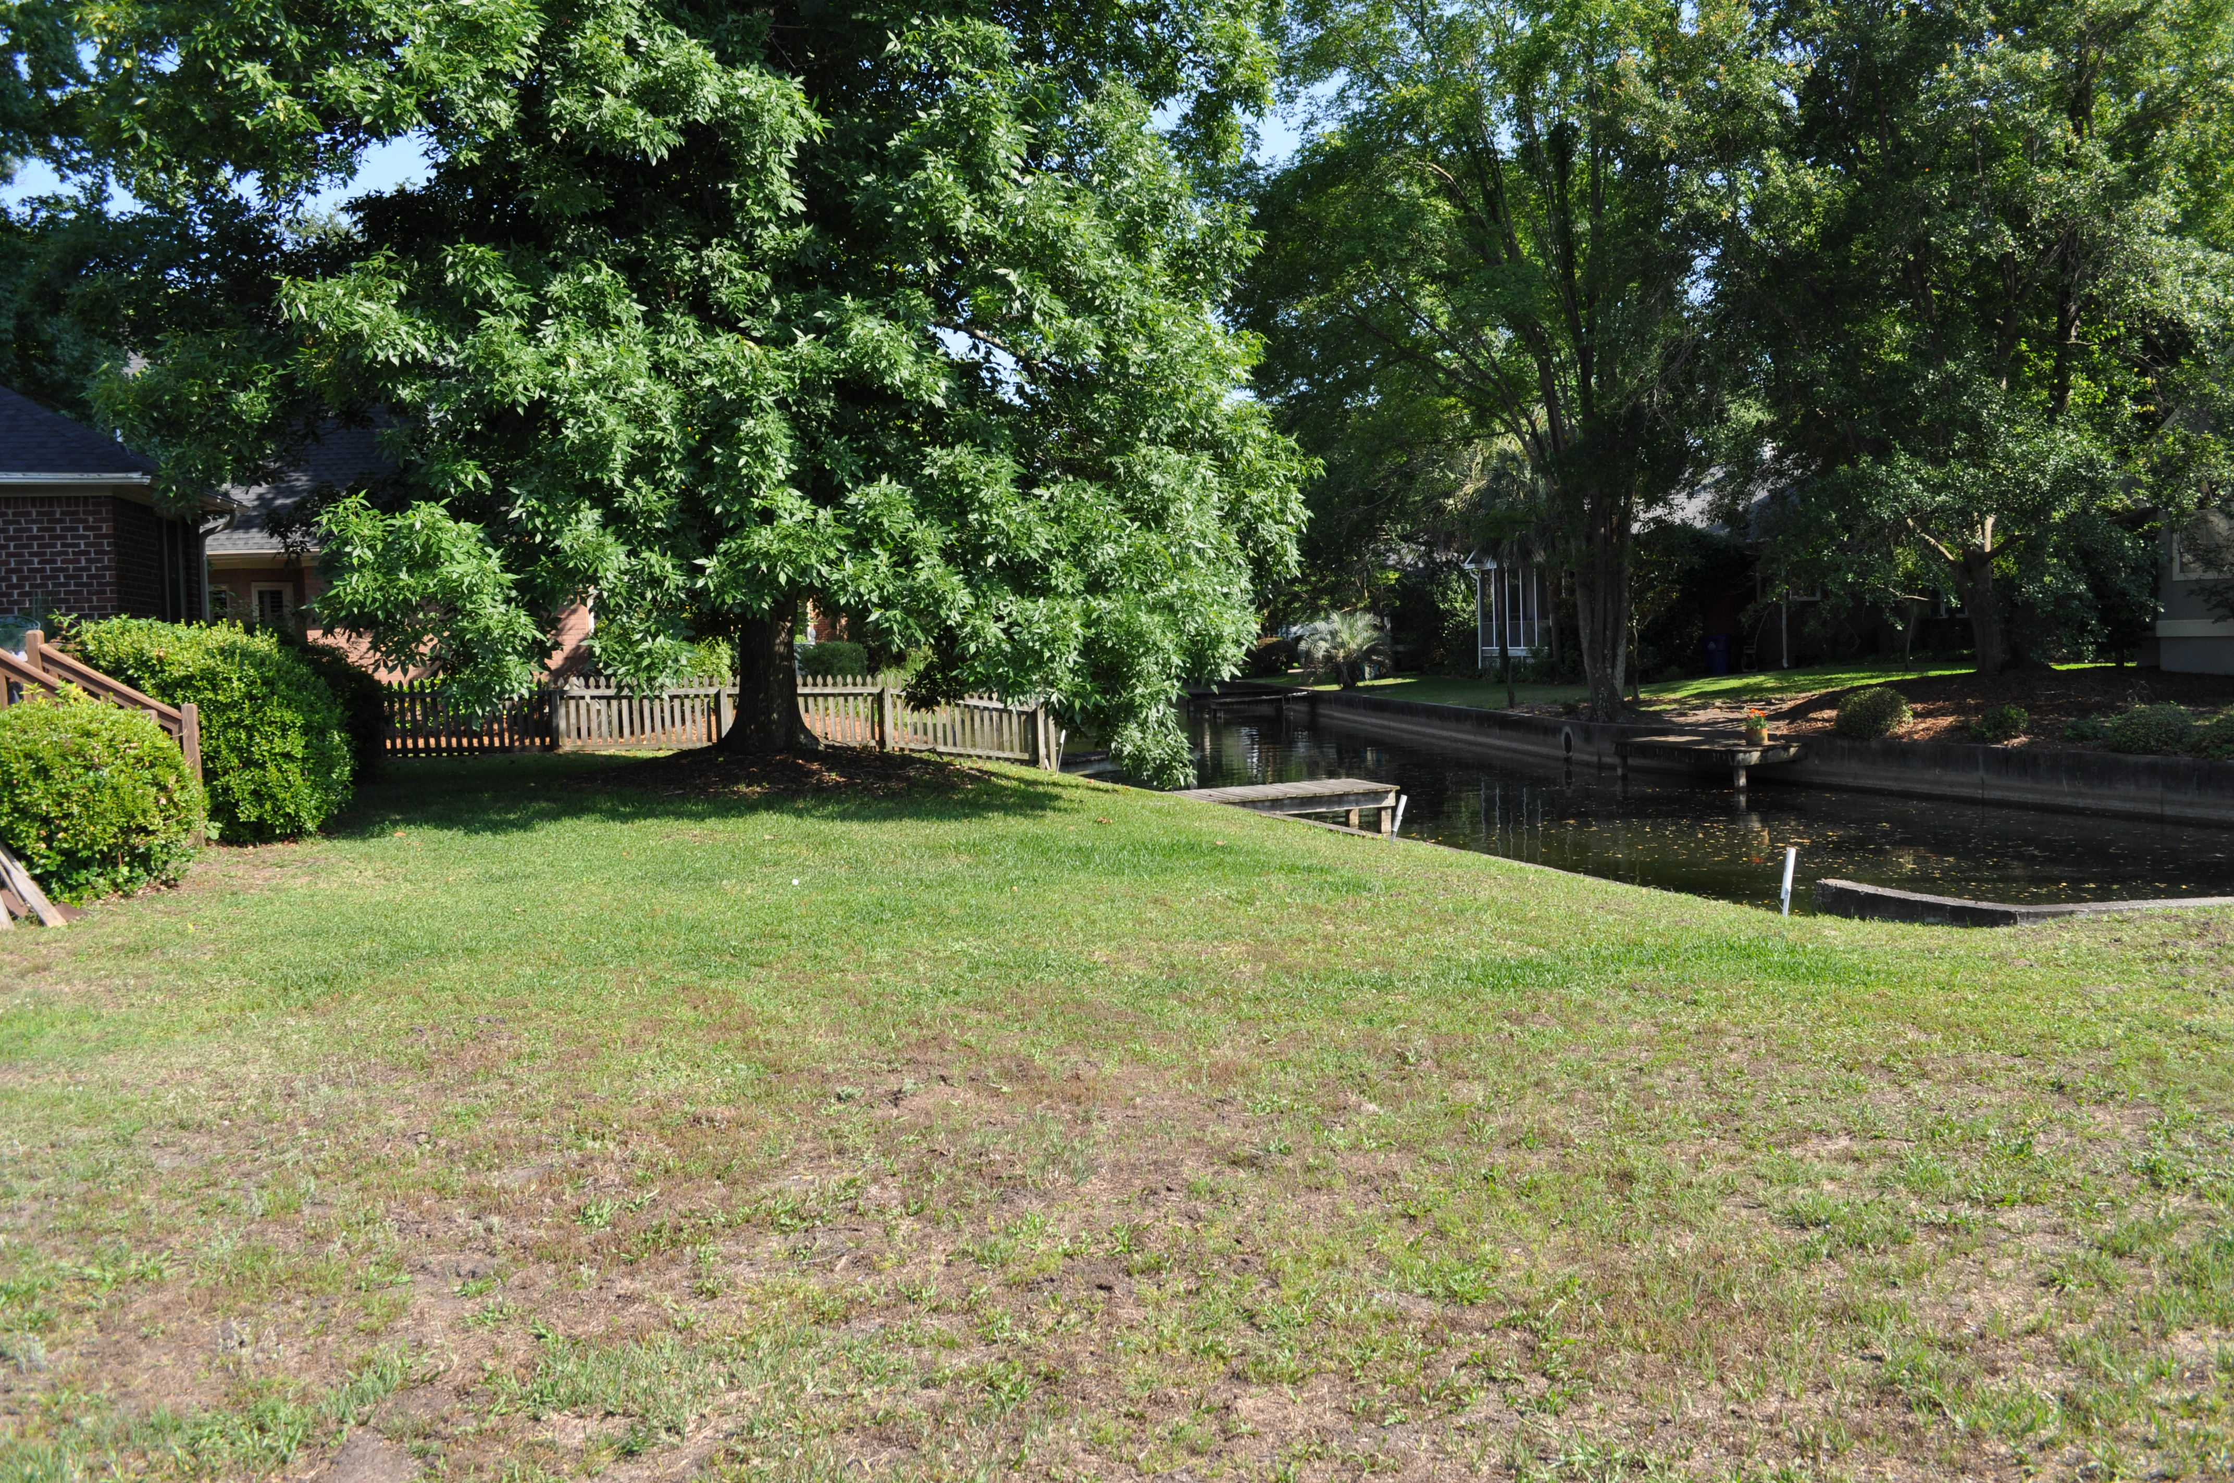
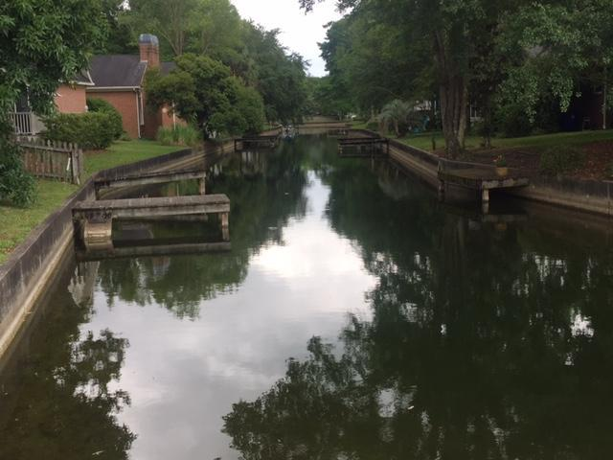



Do not miss this opportunity!
1138 Waterfront Dr
Hidden Lakes ~ Mt Pleasant ~ MLS# 16000069 ~ $765,000
1350 Hidden Lakes Drive
Hidden Lakes ~ Mt Pleasant ~ MLS# 16013090 ~ $424,900
Seller has decided to sell this home as-is instead of updating it post-tenants. Now's your chance to pick up a great canal-front home in Hidden Lakes at a great price and make it your own!
The Boulevard Company, LLC
Mark Macpherson
mark@beachbreak-properties.com
843.367.5640 Mobile

