Slide 1
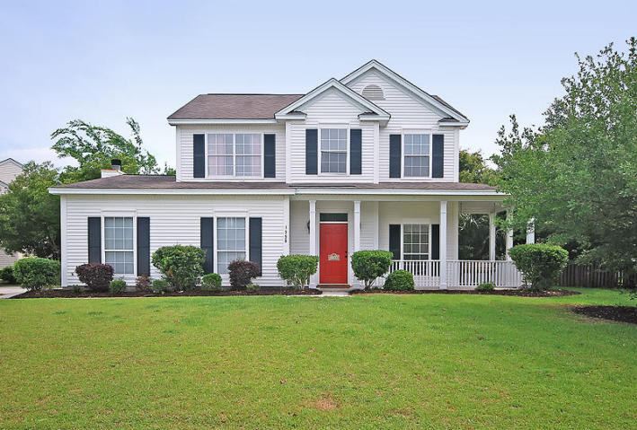
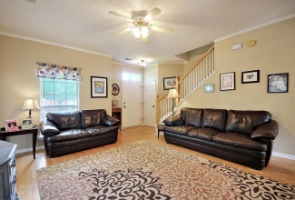
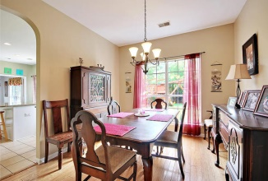
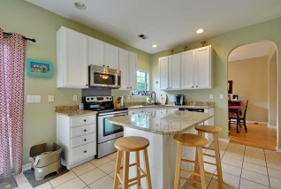
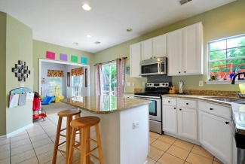
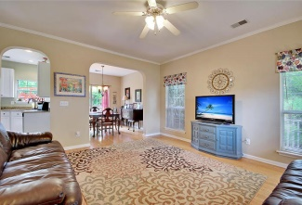
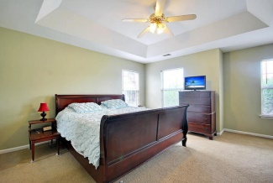
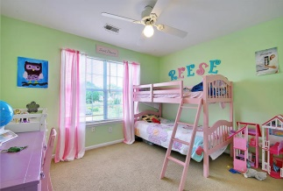
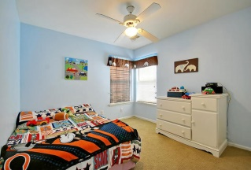
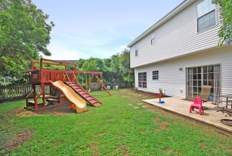
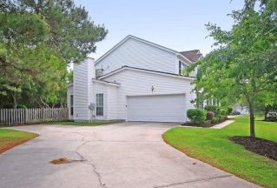

1350 Sassafrass Circle
Dunes West
Mount Pleasant, SC 29466
MLS# 15013119
$349,000
3 Bedrooms | 2½ Baths | 1,845 sf
Just Listed!
Loaded with Updates
Beautiful, updated, and private 3 bedroom, 2.5 bath home in Palmetto Hall subsection of Dunes West supersedes all expectations. The gorgeous kitchen is a chef's delight with an island stainless steel appliances, and granite counter tops. The kitchen has everything needed for entertaining. The home flows perfectly from when you enter seeing the handsome wood floors that extend from family room to the large dining room. The master bedroom is upstairs with it's own bath and large walk-in closet. Two additional bedrooms upstairs share bath and there is a wonderful oversized laundry room-perfect for any family! Outside there is a wraparound front porch, deck, and big fenced back yard that offers a ton of privacy. Dunes West in Mount Pleasant is a wonderfully landscaped community. The neighborhood is close to local shopping and grocery stores and is a short drive to downtown Charleston with 5-star restaurants, world class shopping and iconic history as well as a short drive to the beaches, the airport, Boeing and Daniel Island. Come take a look because you will not find another home that offers as much as this one: family friendly, a chef's delight and entertainer's dream!
Stan Huff
843-670-2835
stan.huff@agentowned.com
Jill Marcacci
843-297-5590
jill@agentowned.com
www.agentownedrealty.com
AgentOwned Realty Co. Preferred Group, Inc. | 824 Johnnie Dodds Blvd | Mt Pleasant, SC 29464

