Slide 1
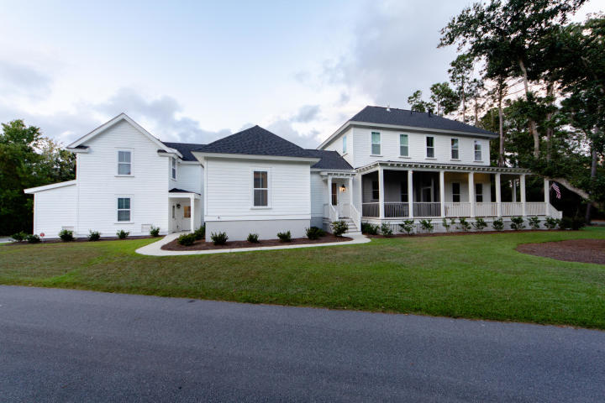
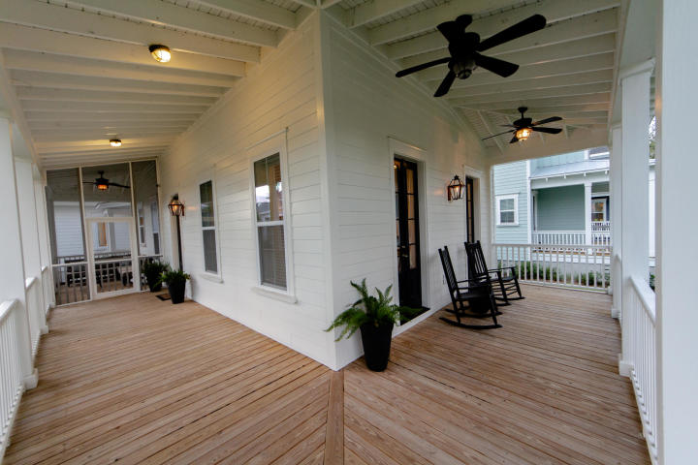
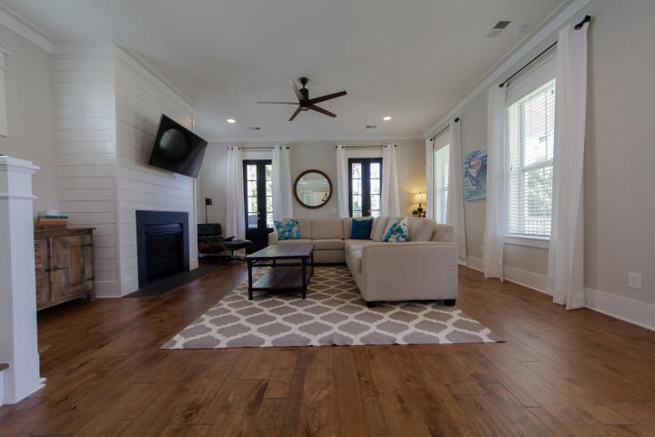
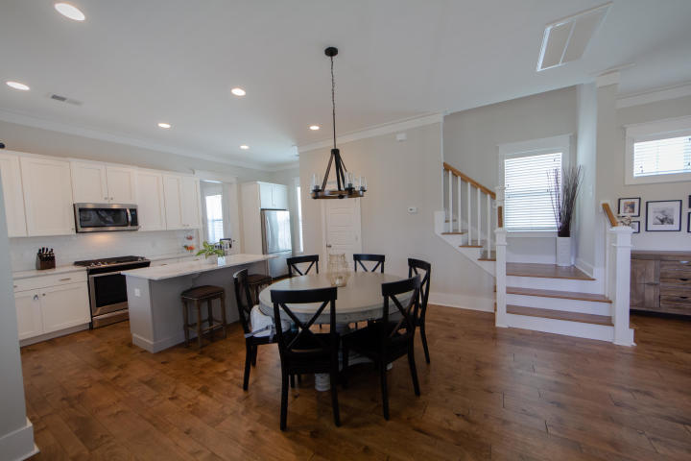
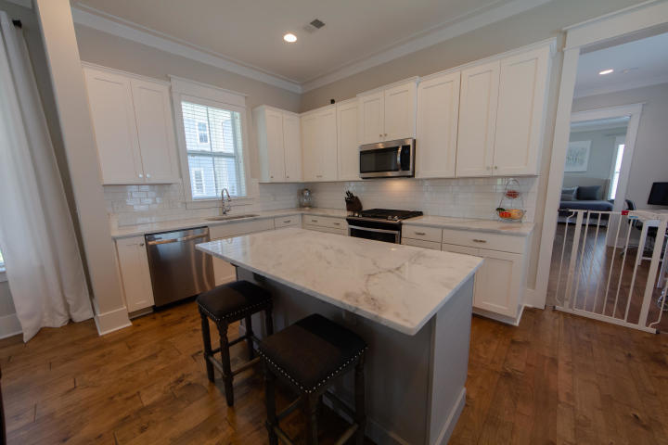
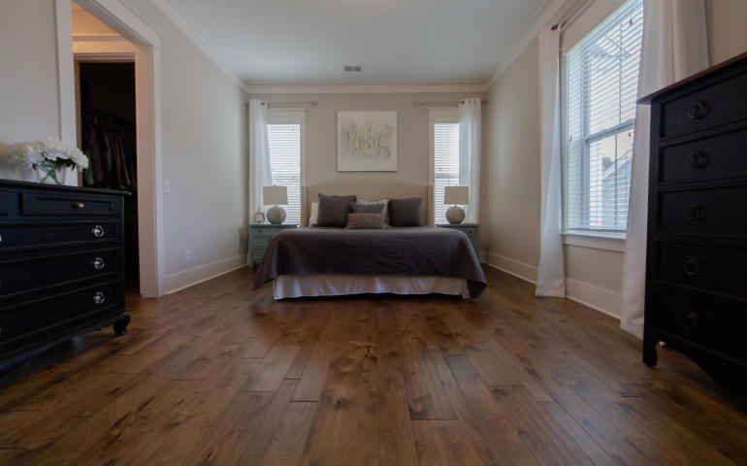
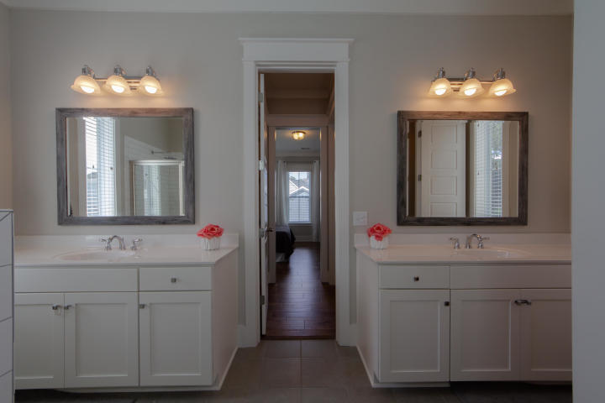
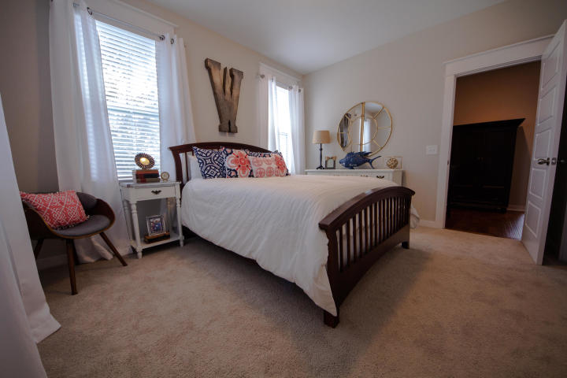
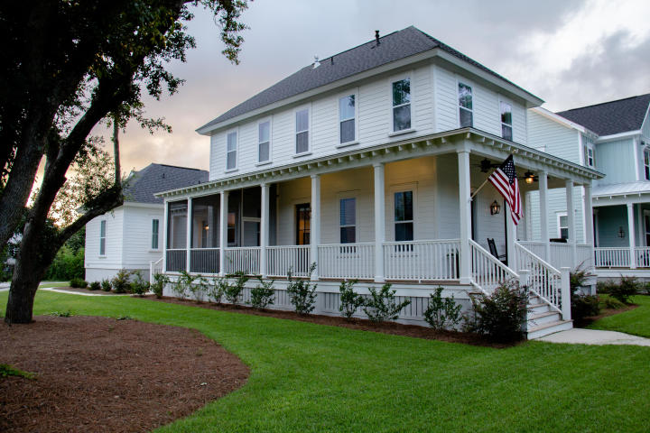
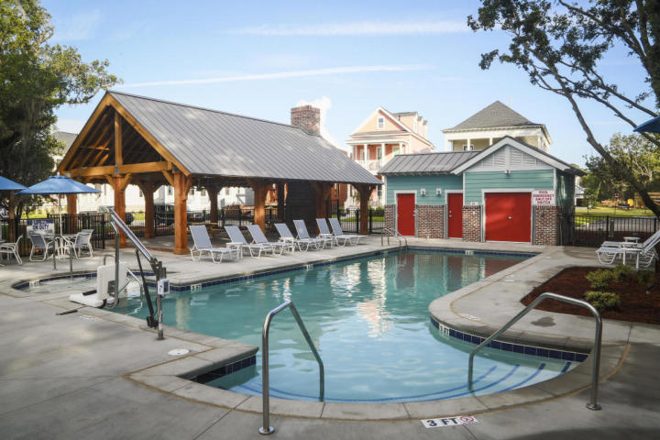
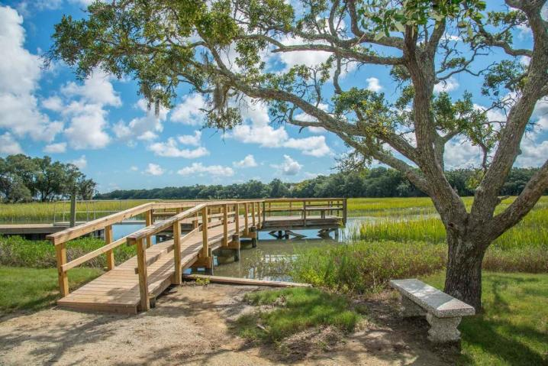


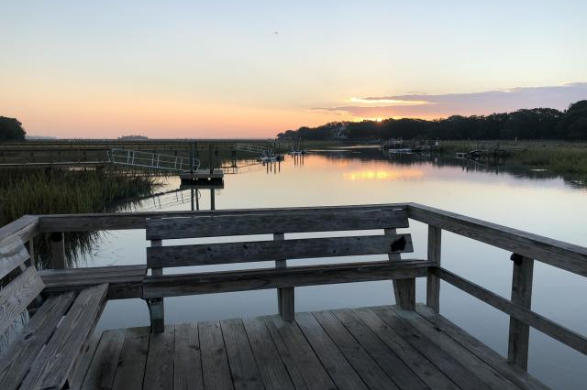
Open House
Thursday 11a-1p
1350 Seaside Plantation Drive
Seaside Plantation ~ Charleston, SC 29412
MLS# 18026554 ~ $640,000
Charming Charleston home welcomes you with a large wrap around porch and side entry front door. Home includes a detached 2 car garage with FROG! Your guests will feel at home with this spacious room over the garage, complete with kitchenette and full private bath. This open plan features 10 foot ceilings and a large downstairs owners suite tucked into the rear of the home. Also on the main floor is a large laundry room, office space, mudroom and half bath. This home looks brand new with tons of upgrades including; white cabinets, marble countertops, stainless appliances including gas stove, refrigerator, and beautiful hardwood floors and hardwood stairs, screen porch, stained solid wood front door and floor to ceiling French doors, fireplace with ship lap, and wood blinds. Amenities abound with neighborhood pool, creekside park, dock, boat ramp, play park, dog park, walking trails, and bocce court. This is the second largest lot in this fun, new neighborhood at over a 1/4 acre. Get ready to call Freeman's Point, James Island's Premier Waterfront Community, home!
Jason Newhauser
(843) 534-6564
jasonsellscharleston@gmail.com
www.jasonnewhauser.com
Coldwell Banker Residential Brokerage
1127 Queensborough Blvd. 103
Mt Pleasant, SC 29464

