Slide 1
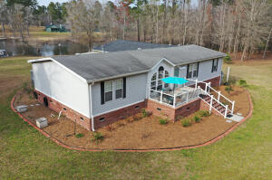
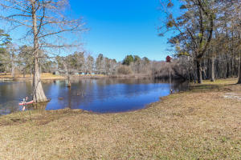
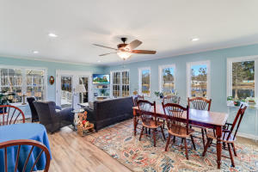
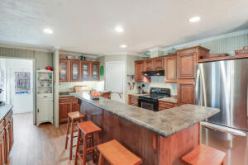
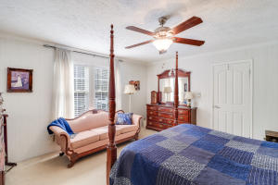
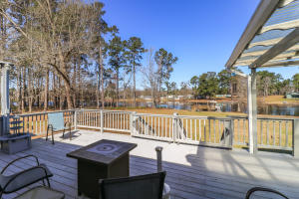
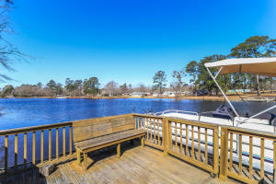
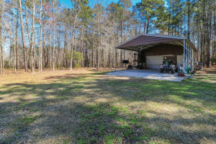
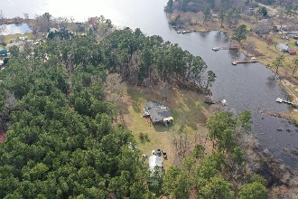


1350 Cottage Drive
Summerton, SC 29148
MLS# 21006057 | $890,000
Waterfront Living on Lake Marion! Over 6 Acres!
SCHEDULE YOUR SHOWING TODAY!
This is a once in a lifetime opportunity! Over 6.5 deeded acres on Lake Marion!! It's not very often you see a home with 6.93 acres and access to Lake Marion right at your back door and a small pond to go along with it! Spoil yourself and enjoy all this home, acreage and lake has to offer. Approaching the home you will instantly get the sense of tranquility within you. Wide open space with views of the water. Enter the home in the foyer, kick off your shoes and relax in the spacious living area that opens to the beautiful kitchen. Plenty of wood cabinets for storage, an eat in area and an island perfect to grab a quick meal or entertain around. The French doors in the eat in kitchen area open to a wonderful sun room. Enjoy all the natural light through out, and the gorgeous views. A separate dining area lends plenty of room for a dinner party or a family holiday meal. The spacious master bedroom has an en suite with dual vanities and a large soaking tub. Two more generously sized bedroom's and an additional full sized bathroom are offered in this home. Wanting to enjoy the outdoors? This home has everything you need! A large deck out back is perfect for grilling or just enjoying the peace and quiet amongst family and friends. A separate carport/garage has room for a workshop, additional sleeping quarters or storage for your water toys. With 6.93 acres the outdoor opportunities are endless. Schedule your showing as soon as possible, you don't want to lose out on this rare opportunity to own this much land on Lake Marion!
Brandon Ray
(843) 499-1928
brandon.ray@carolinaone.com
www.therightrayhome.com
Carolina One Real Estate
900 N Main St
Summerville, SC 29483

