Slide 1
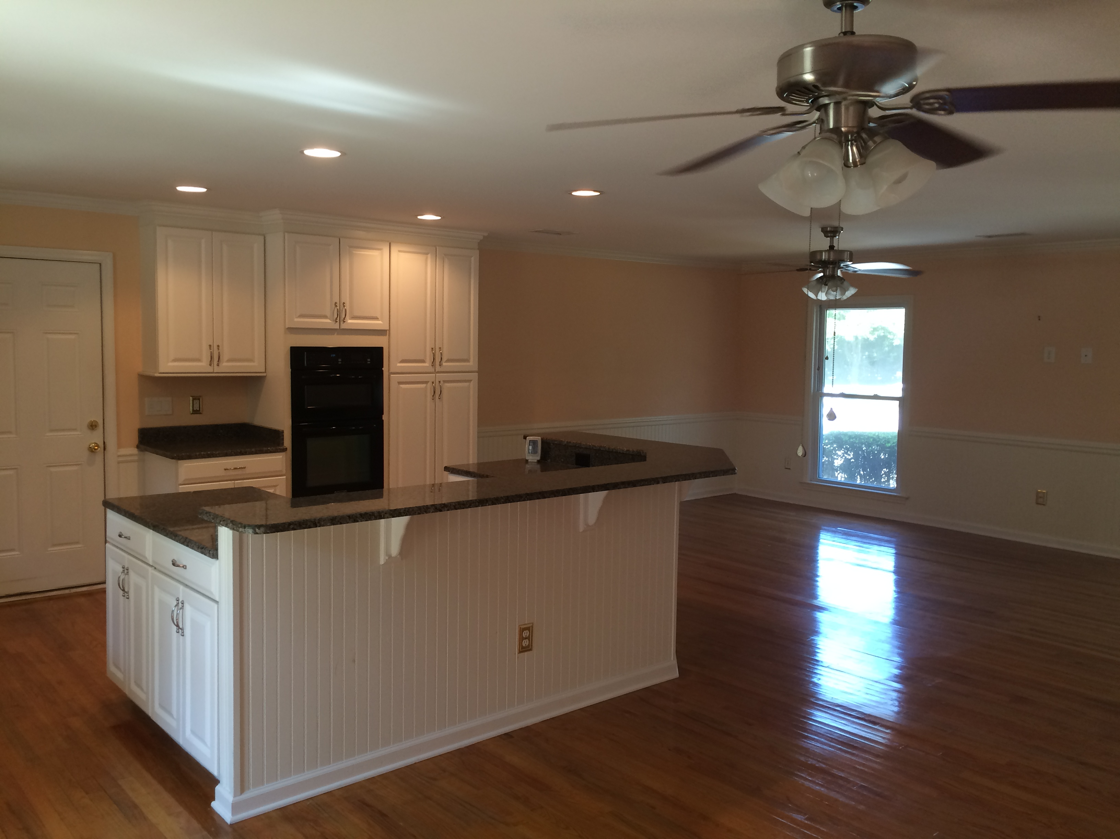
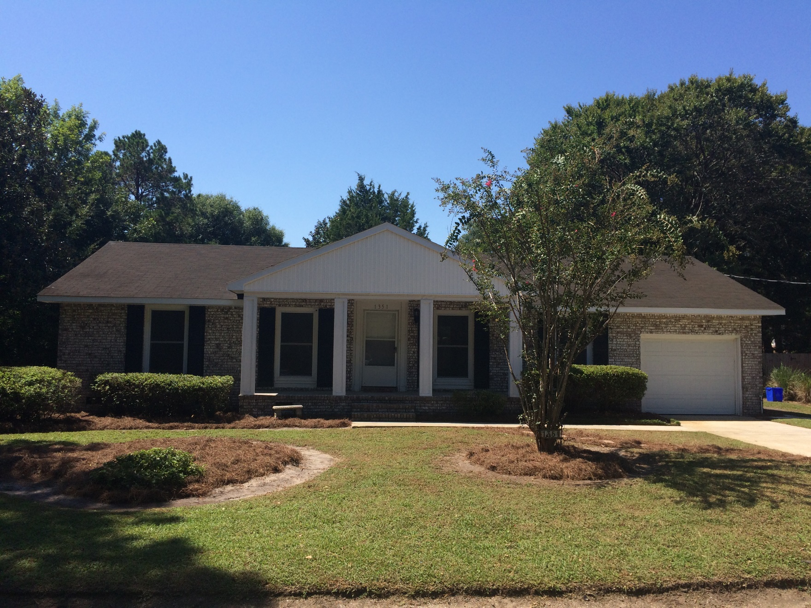
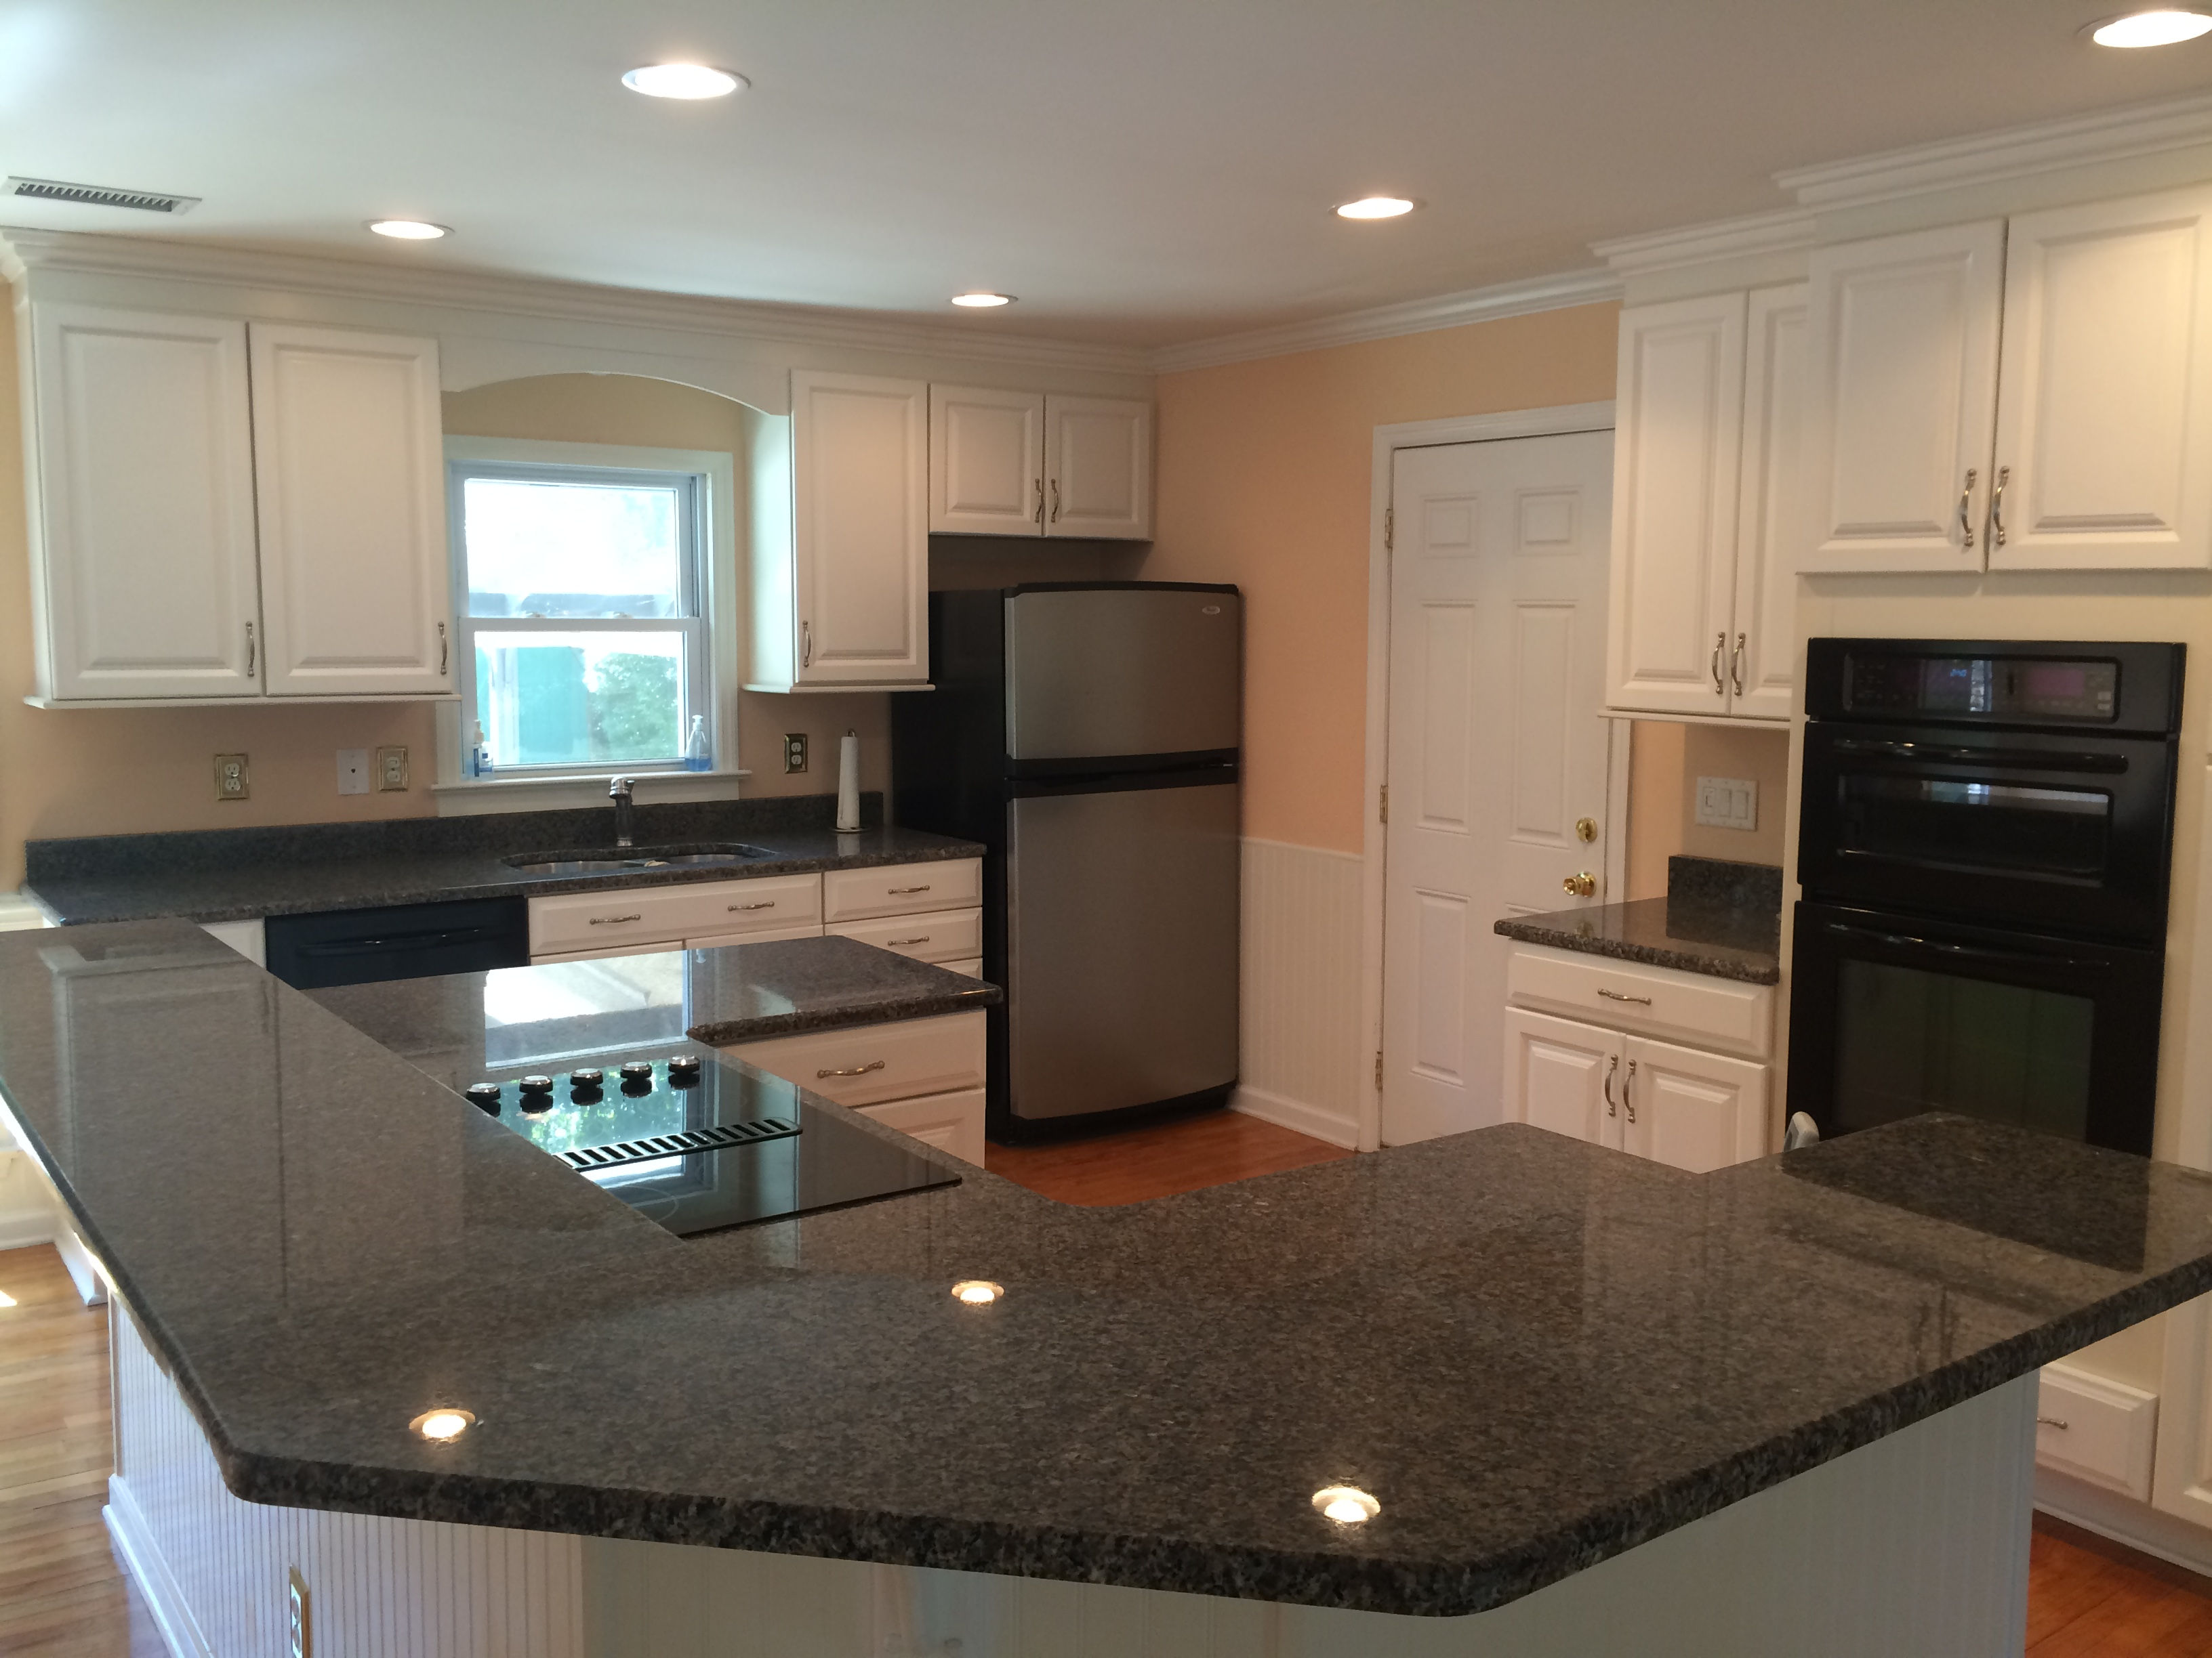
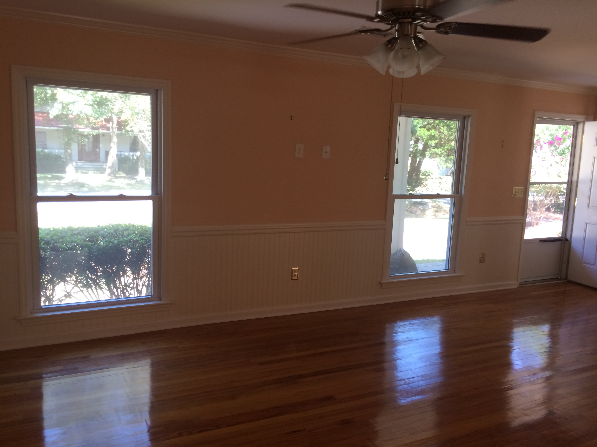
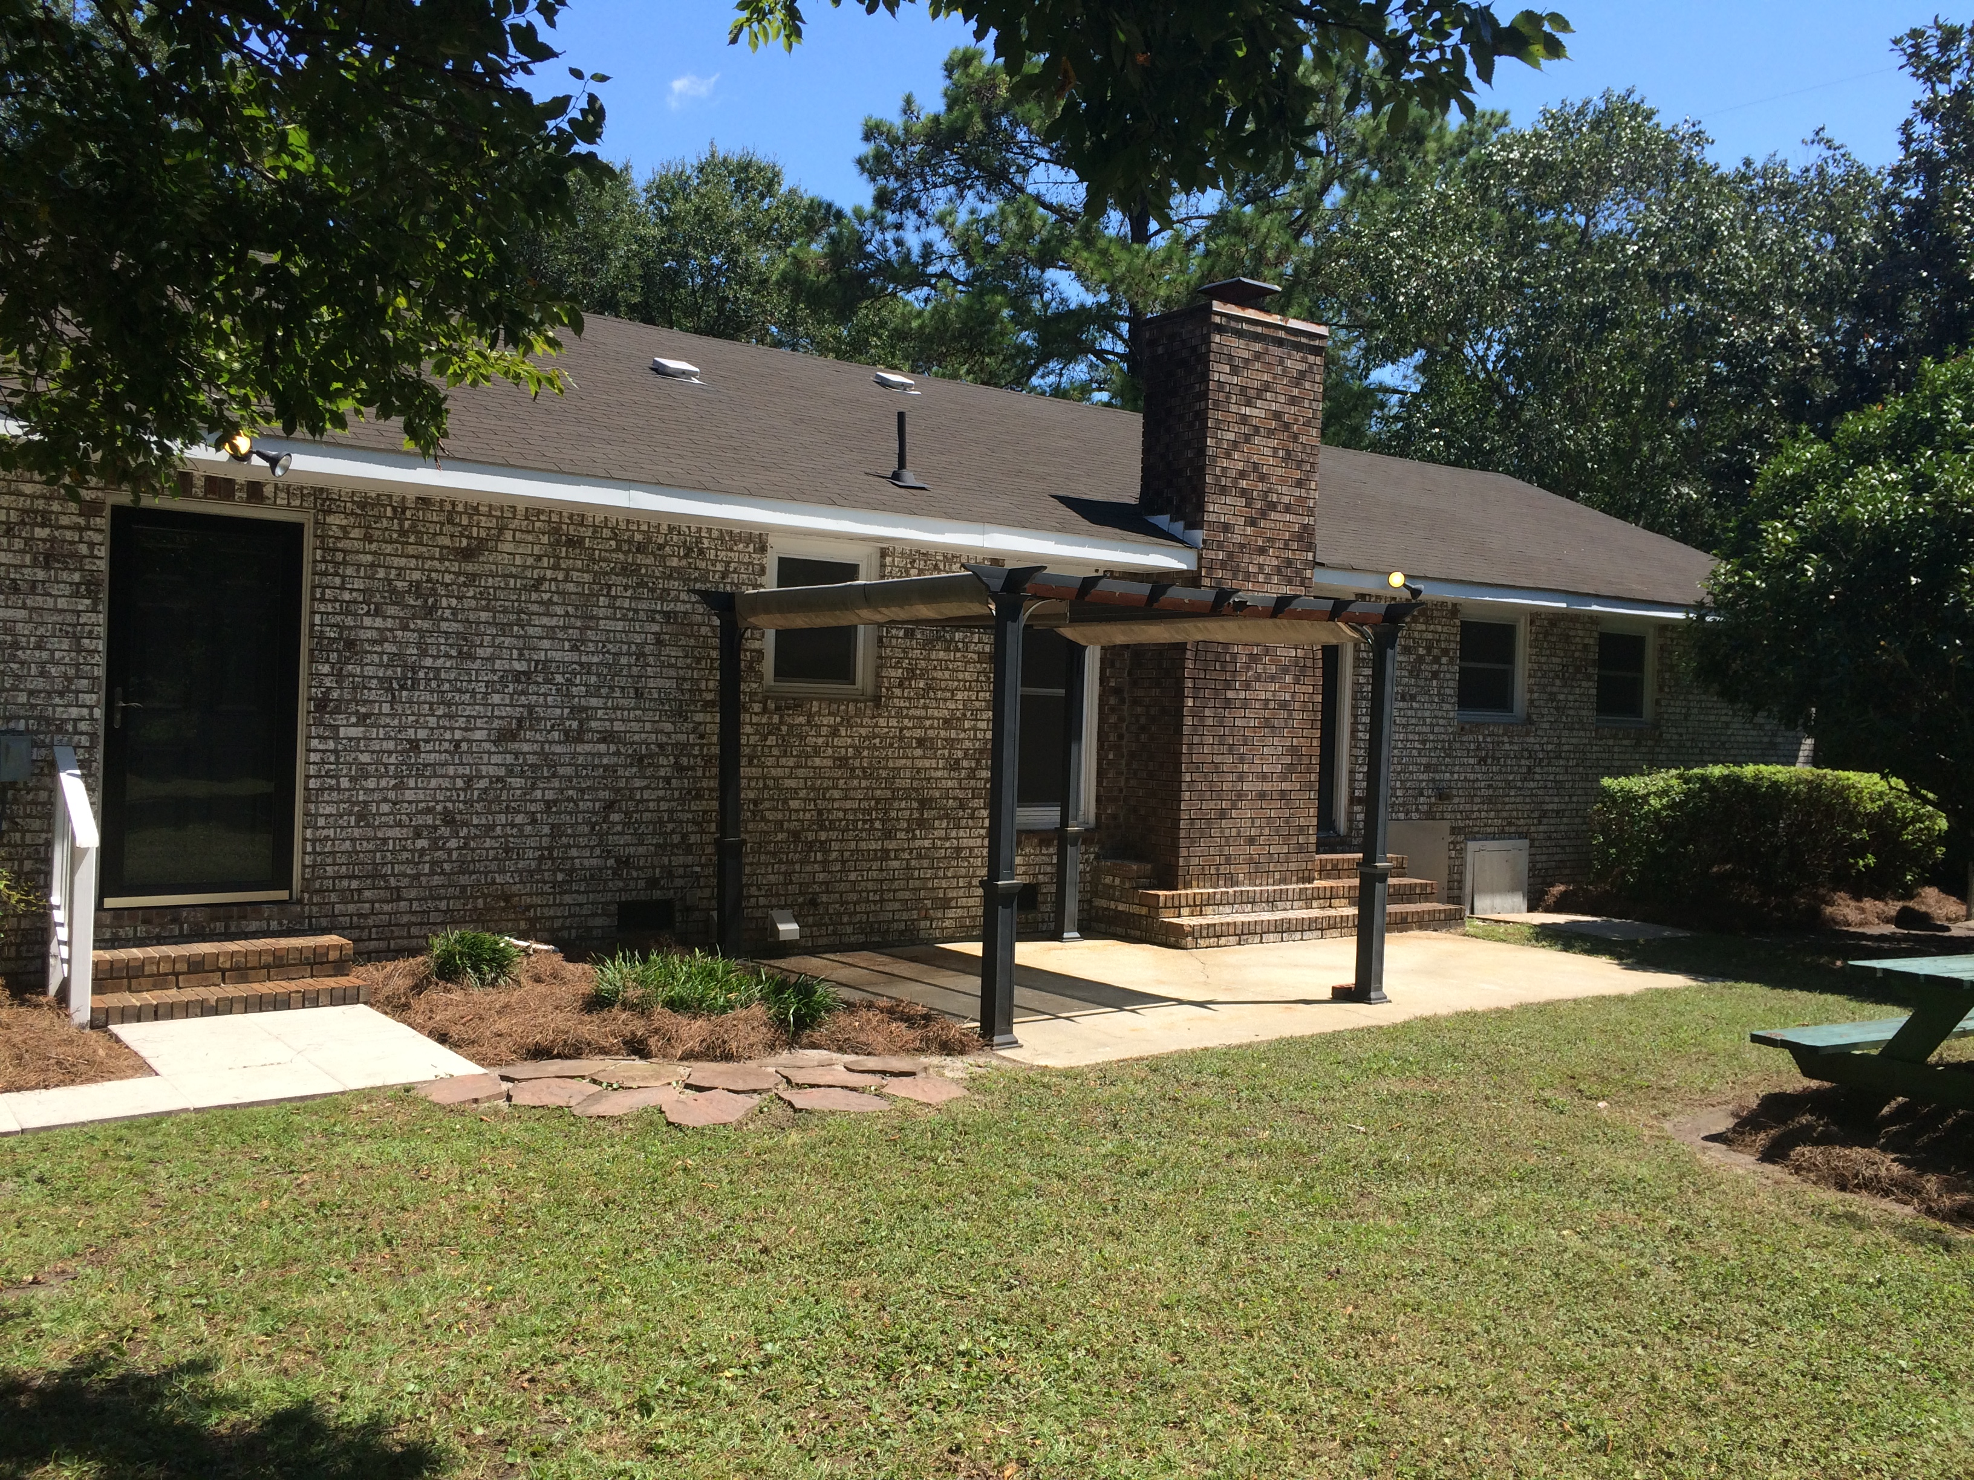
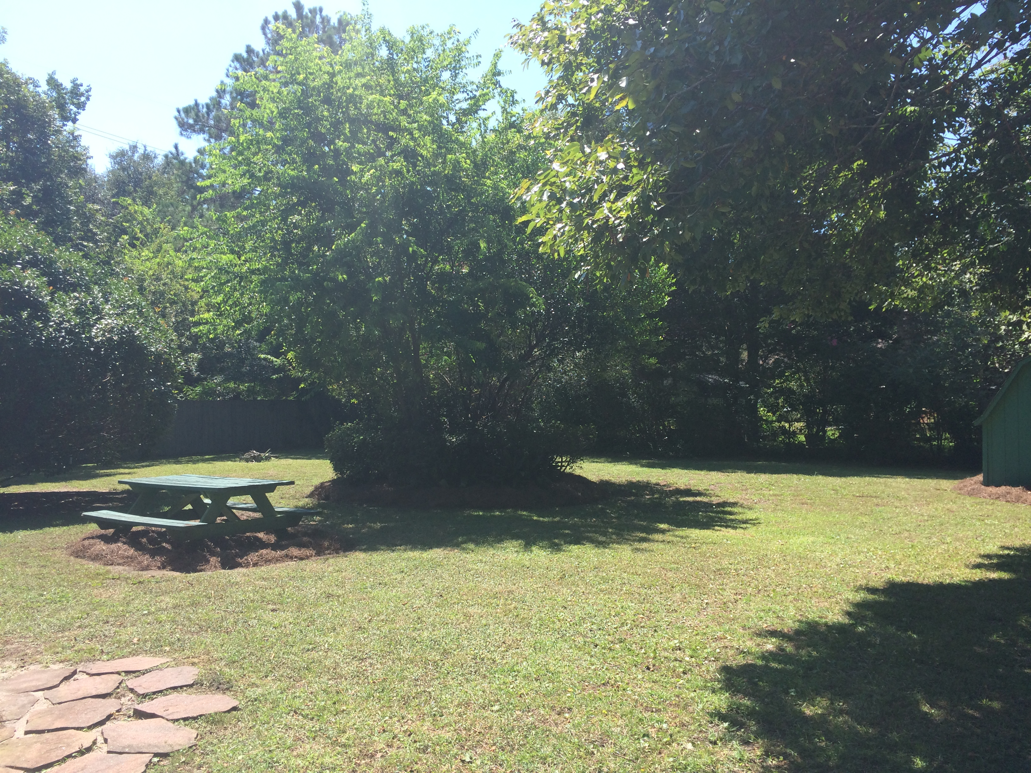


OPEN HOUSE
Saturday, Oct 15th
1:00-4:00
$450,000
$450,000
1351 Roddington Street
The Village · Mount Pleasant, SC 29464 · MLS# 16023852 · $379,000
Jimmy Banyas
(843) 822-2622
jimmybanyas@gmail.com
Fully renovated in 2010, this 4 sided brick home has 1820 sqft with 3 beds and 2 full baths. The garage has been converted to heated and cooled space adding approximately 350 sqft. The homes has updated vinyl windows, smooth ceilings with fans in every room. The kitchen has been updated with granite counter tops, new cabinets and appliances, including refrigerator and can lighting. Hardwood floors throughout along with a wood burning fireplace. Attic has been insulated with spray foam. The crawl space has been encapsulated with vapor barrier. The yard is .33 acres with a fully fenced in backyard with nice landscaping and plenty of room to expand the home. There is a nice patio along with storage shed. There is no HOA for the neighborhood and a prime location off of Rifle Range
AgentOwned Charleston Group
902 Savannah Hwy
Charleston, SC 29407
Real Estate ● Mortgage Insurance ● Business Brokerage

