Slide 1
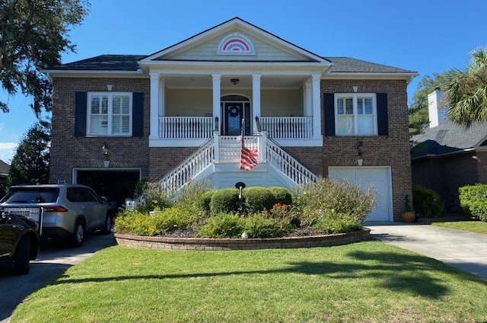
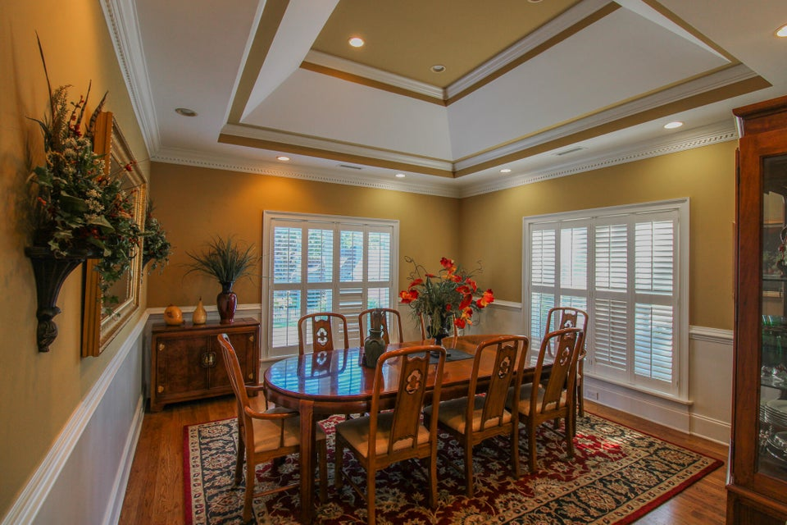
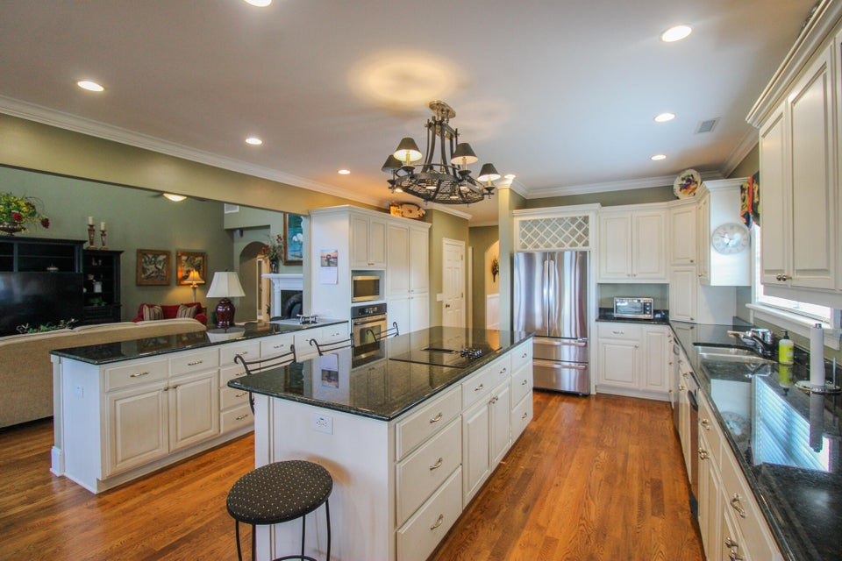
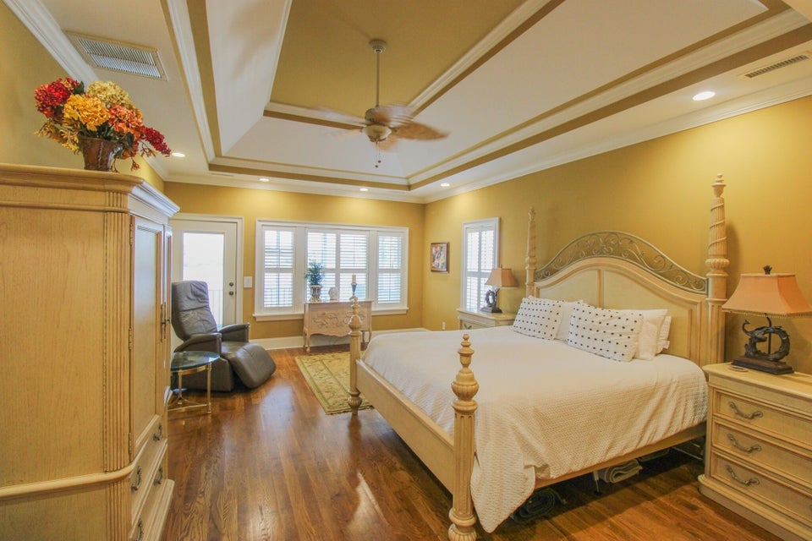
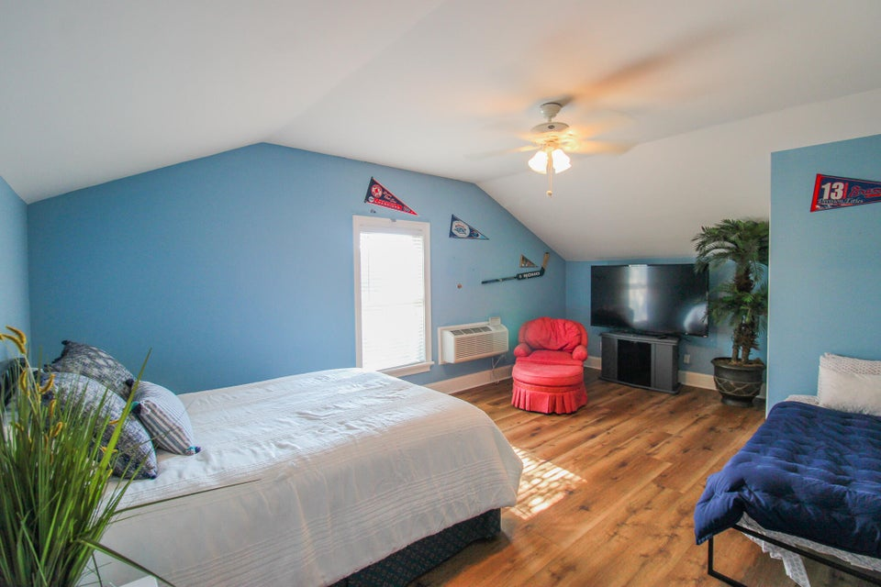
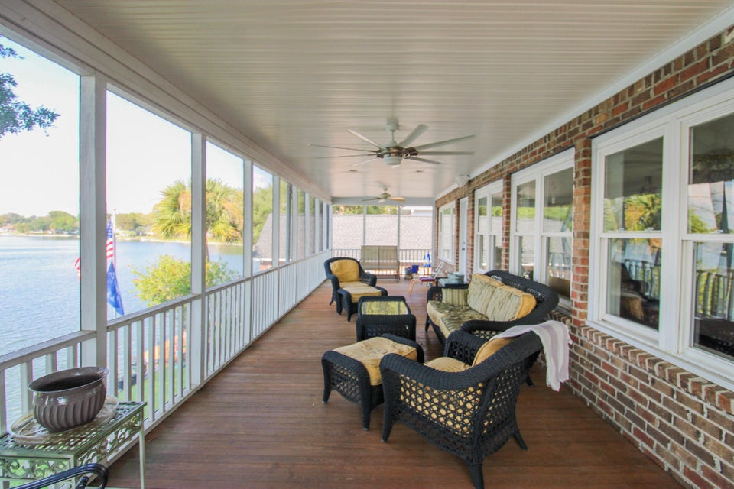
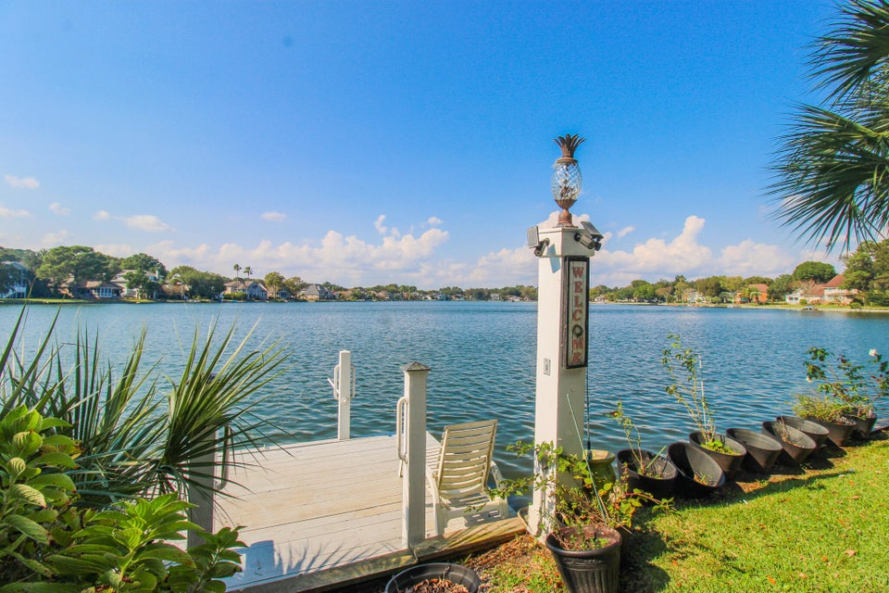



Furnished Rental with a Water View
1-12 month lease will be considered
and pets negotiable
1351 Deep Water Drive
Lakeshore
Mount Pleasant, SC 29464
MLS# 24026336 | $4,500
3 Bed | 2½ Bath | 2,500 SF
Fully furnished 3 bed/2.5 bath upstairs unit available for rent in the Lakeshore neighborhood of Mount Pleasant. This stunning home features hardwood flooring throughout, charming furnishings, stainless steel appliances in the kitchen, a separate dining area perfect for entertaining, spacious bedrooms with their own spacious closets, laundry room with washer/dryer included, and a large screened-in porch overlooking the lake. Future tenants will also have access to the dock. This location is conveniently located near local restaurants and shopping centers such as Seaside Farms and Mount Pleasant Towne Center as well as a short drive to both Isle of Palms Beach and Sullivans Island. Small dogs negotiable. Off-street parking. All utilities are included.
One year lease terms preferred. Available Now!
Non-Refundable Fees Applicable for Moving Forward: $75 Application Fee | $350 Pet Fee
Leah Rust
Listed by LeasingAndManagement.com
For more info, please contact:
Leah Rust
843-709-9211
leahmrust@gmail.com

