Slide 1
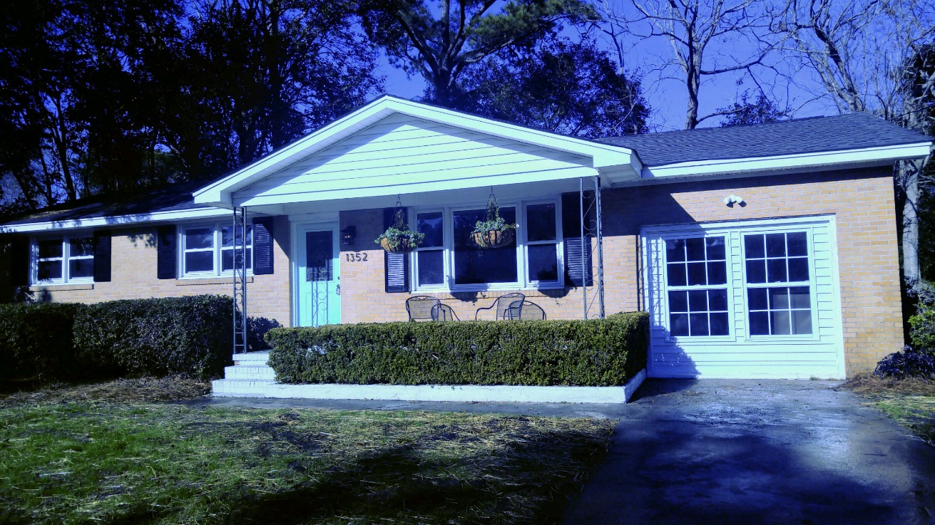
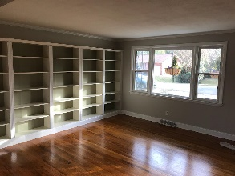
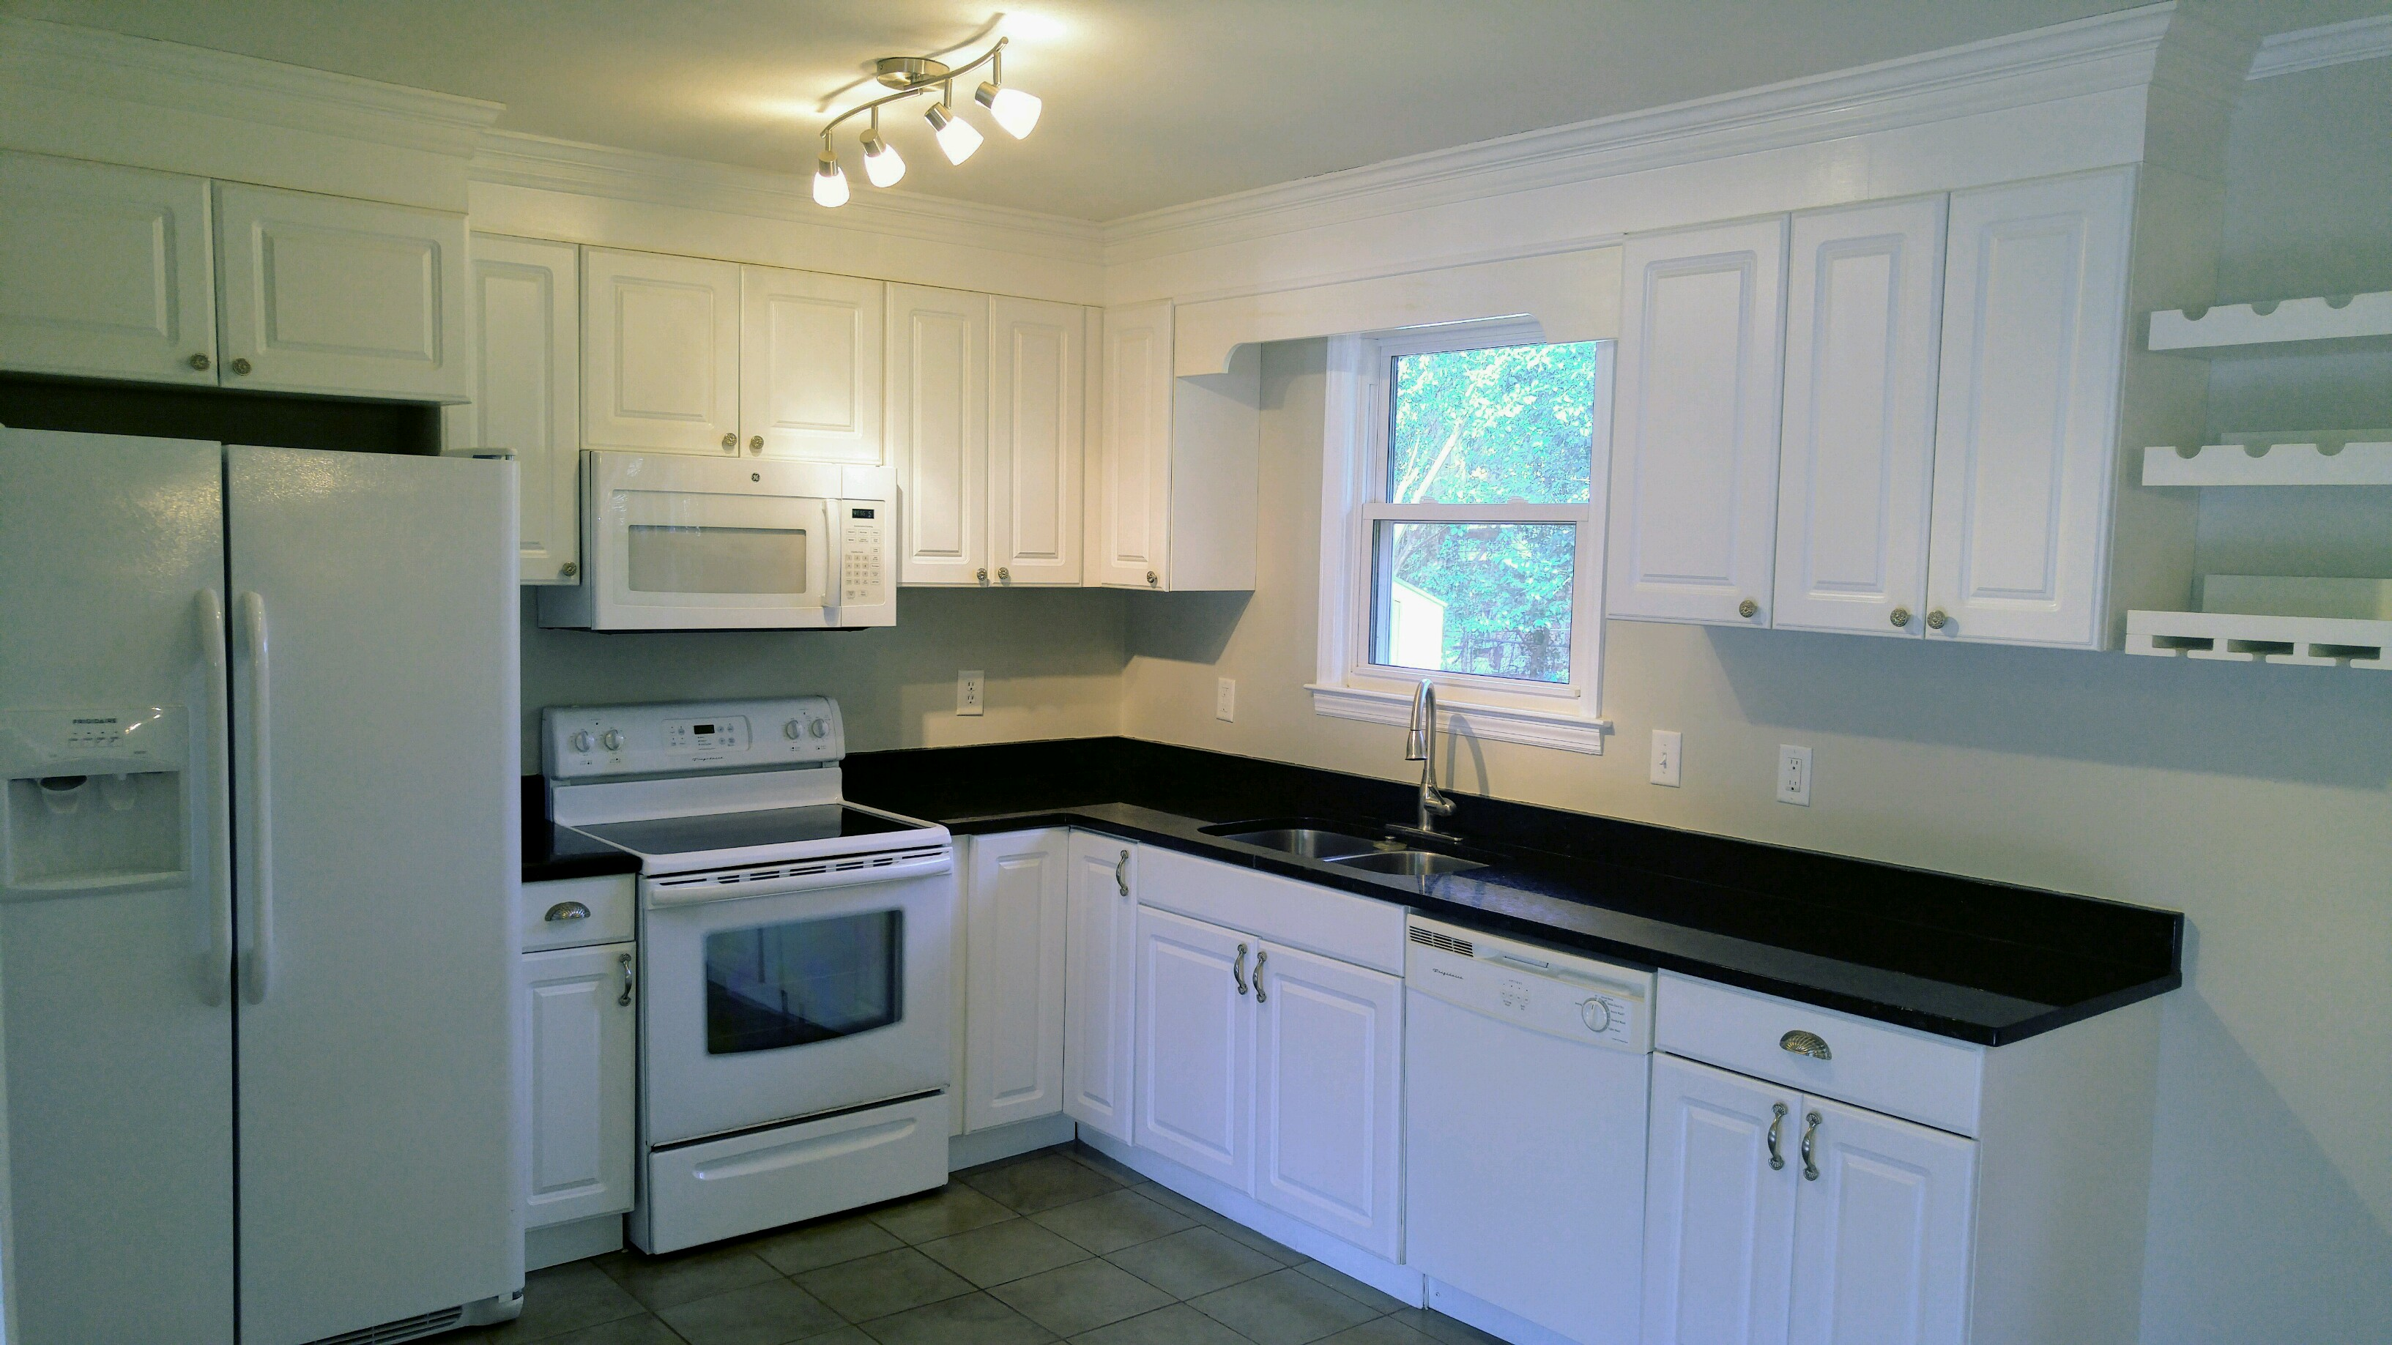
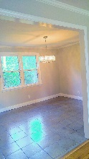
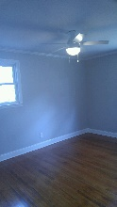
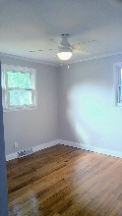
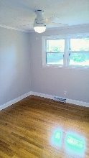
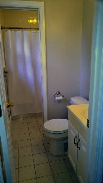
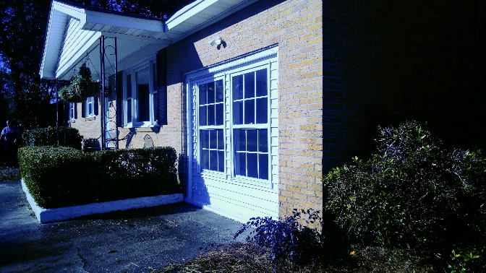
1352 Hermitage Avenue Whitehouse Plantation · Charleston, SC 29412
Like-new Brick Ranch in an Established Neighborhood
This home has been beautifully renovated throughout in 2007. This house has been extremely well maintained. The refrigerator and water heater are less than a year old! Light fixtures have been recently replaced. Freshly painted inside in a very beautiful neutral gray. The beautiful hardwood floors throughout the home have been refinished and in great condition. The house has three bedrooms in the main part of the home and a wonderful bonus room that can be used as a forth bedroom, playroom, or living space. This home has a wonderful open floor plan. Large fenced-in backyard. Amazing, caring, fun neighbors. Zoned for Harborview Elementary School! Only 10 minutes from downtown and 10 minutes to the beach on the harbor! This property does not require flood insurance and has not flooded with the recent floods.
Jacqueline Bond Anthony 843-284-9500 | janthony@anthonyandmoore.com
Anthony & Moore LLC | 222 W. Coleman Boulevard, Suite 121 |Mount Pleasant, SC 29464

