Slide 1
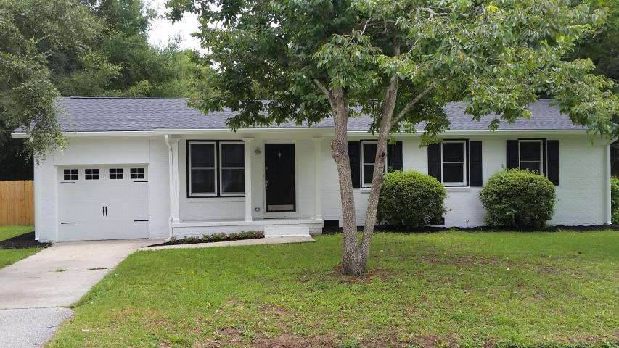

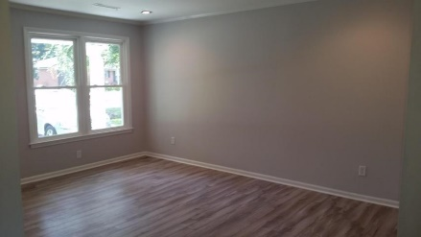
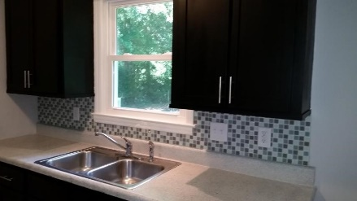
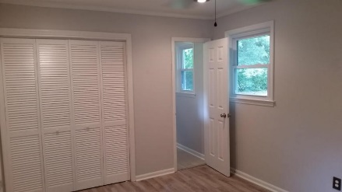
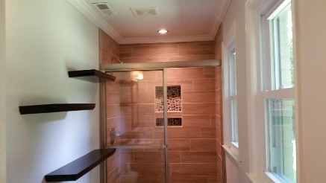
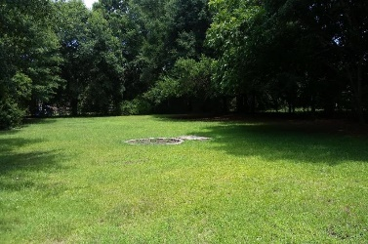



No HOA! No Flood Insurance! Must See!
1356 Freer Street
Greencrest ~ Charleston ~ MLS# 15017292 ~ $245,000
1,118 SF ~ 4 Bedrooms :: 2 Baths
This James Island true 4 bedroom home is a MUST SEE!! This house has been totally upgraded and is now the cutest house on the block. This home features new floors throughout. New can lighting in the living room and the master bedroom. All 4 bedrooms have new ceiling fans. Brand new stainless steel appliance package in the kitchen. Brand new roof. Brand new windows. Fully upgraded bathrooms. New light fixtures. New gutters. This home sits close to the end of quite and private road. There is NO HOA fees and NO FLOOD INSURANCE. Huge half acre lot!!!!
Lizzie H Ray
(843) 452-9298
lizzieray1122@gmail.com
Eric Draper
(843) 442-7118
eric.draper@gmail.com
www.charlestonrealestategroup.com
Charleston Real Estate Partners. LLC | 792 Folly Rd. C1 | Charleston, SC 29412

