Slide 1
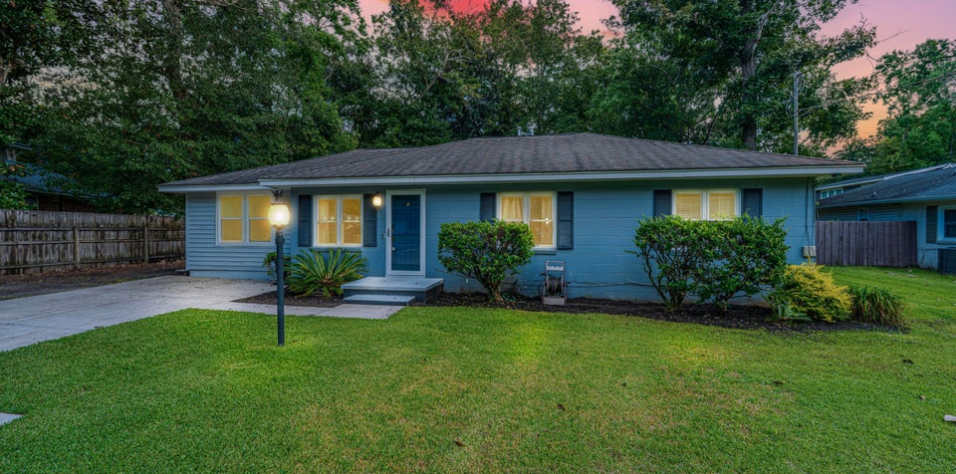
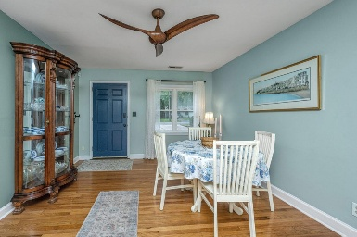
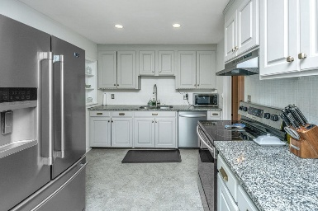
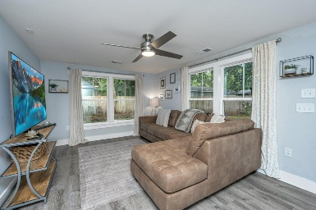
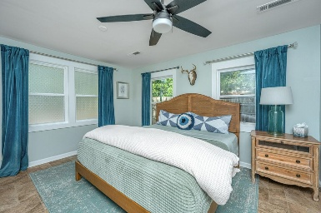
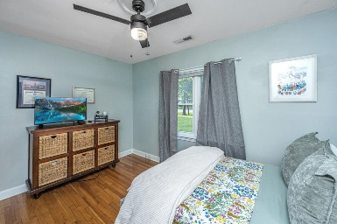
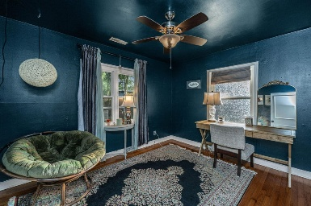
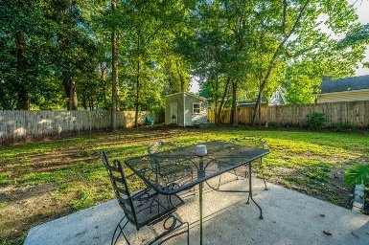
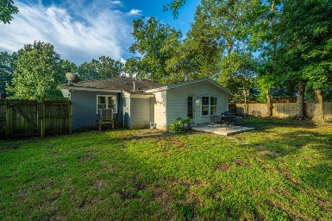


1356 S Sherwood Drive
West Oak Forest | Charleston, SC 29407 | MLS# 25024773 | $599,900
Great Property in West Ashley!!
Introducing a prime Charleston-area retreat with unbeatable location, style, and space. Location, location, location nestled in the desirable West Oak Forest neighborhood, this single-level gem at 1356 S Sherwood Dr places you just 10 minutes from downtown Charleston, MUSC, the College of Charleston, and The Citadel. Enjoy easy access to work, dining, culture, and the best that this historic city has to offer. Recently renovated to blend modern comforts with classic appeal which includes a master bedroom suite, walk-in closet, master bath, laundry room, family room and pantry. Expansive lot providing plenty of outdoor possibilities. Well appointed hardwoods and ceramic tiles for a durable, stylish look. Kitchen upgrades feature granite countertops, a tile backsplash, and stainless steel appliances eat-in kitchen and separate dining area for everyday meals and entertaining. Recessed lighting and smooth ceilings create a bright, contemporary feel. Private patio ideal for outdoor gatherings, grilling, or relaxing in the Charleston breeze. Storage shed adds practical space for tools, bikes, and seasonal items. Large lot offers potential for future landscaping, a garden, or recreational fun. This home is a rare find in a coveted location so schedule your tour today to experience its charm and potential firsthand.
Drake Herrin
843-729-4692
dherrin@carolinaone.com
www.DrakeHerrin.com
Carolina One Real Estate
873 Orleans Road, Ste 102
Charleston, SC 29407-5753

