Slide 1
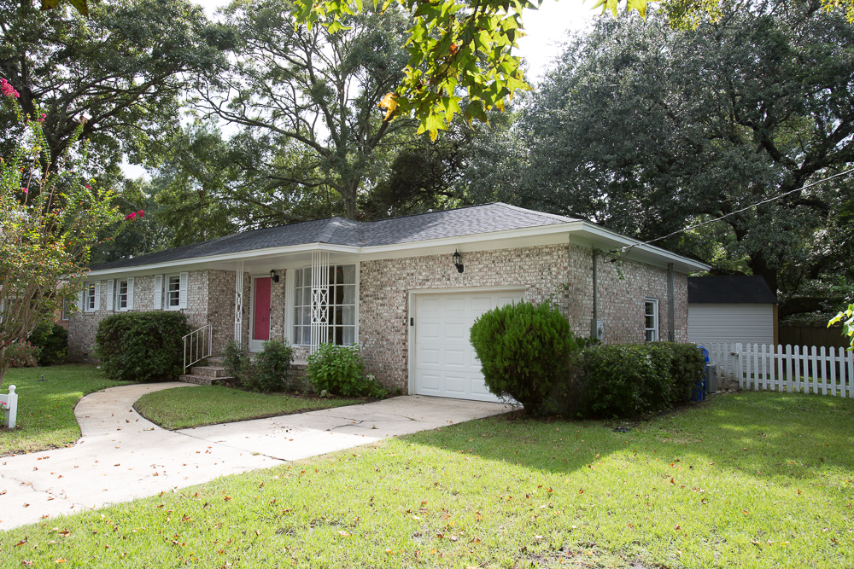
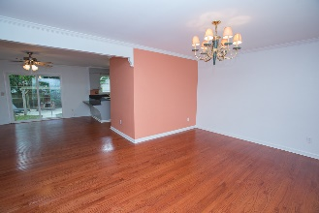
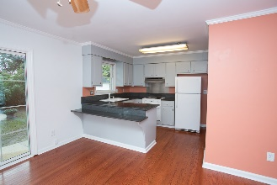
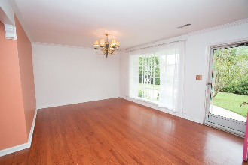
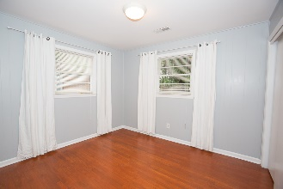
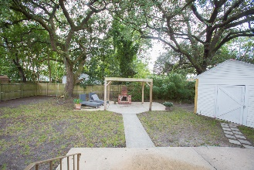


Unbelievable Deal in West Ashley!
Just reduced!
1357 Ashley Hall Road
Memminger Hall · Charleston · MLS# 16025487 · $214,900
Michael Dew
O (843) 769-5100
M (843) 870-7000
michaeledew@gmail.com
www.michaeldewrealestate.com
Beautiful 4 bedroom, 2 bath brick ranch in the heart of West Ashley. Original hardwood floors throughout. Updated eat in kitchen with breakfast bar and family room. Sliding glass doors open to the patio overlooking fenced in back yard. Perfect for entertaining. All electrical has been updated. Roof and HVAC recently replaced.
AgentOwned Charleston Group
902 Savannah Hwy
Charleston, SC 29407
Real Estate ● Mortgage
Insurance ● Business Brokerage

