Slide 1
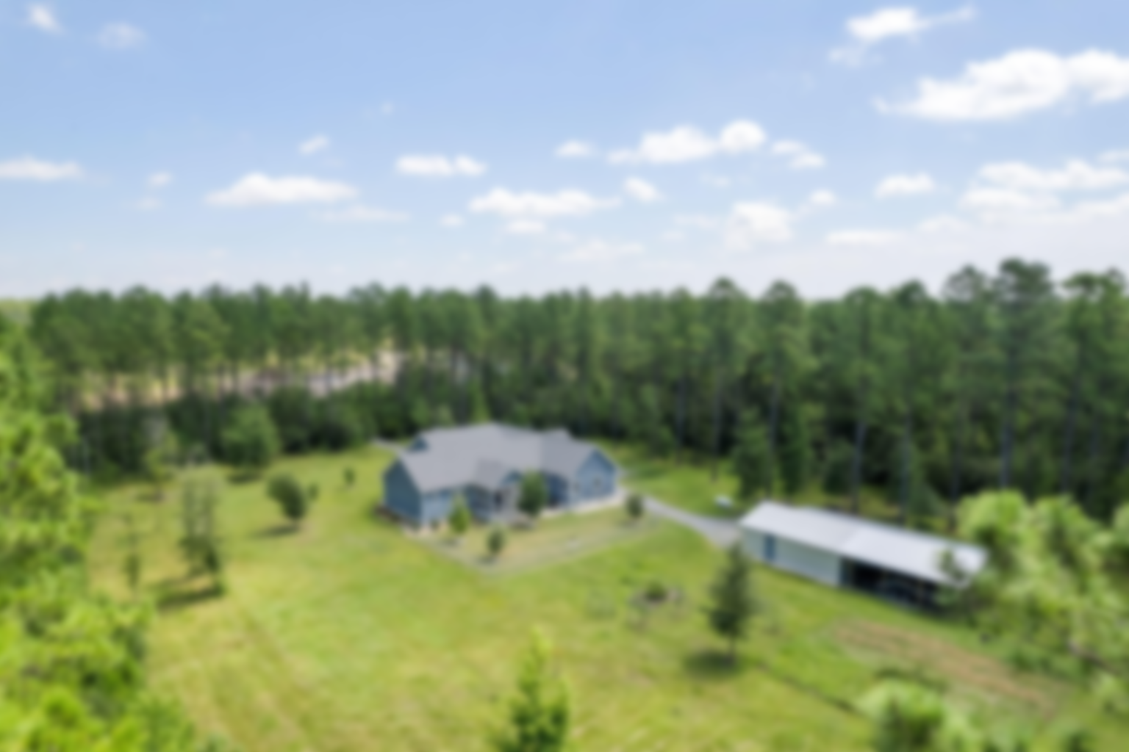
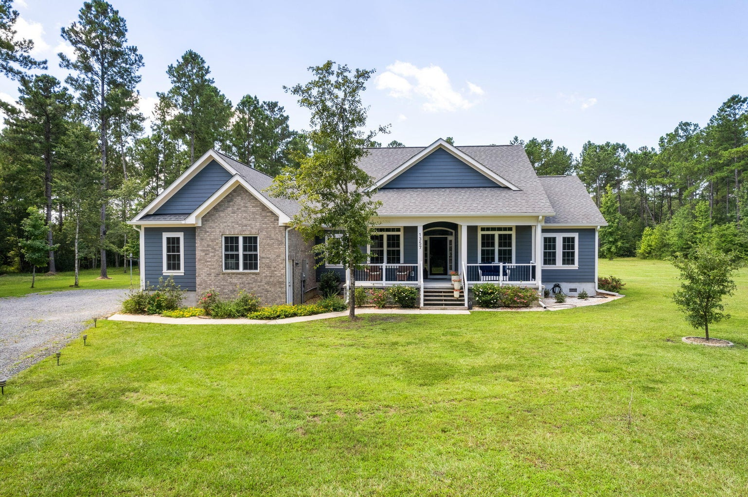
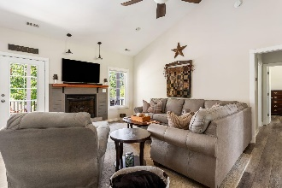
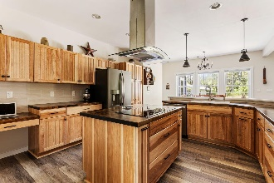
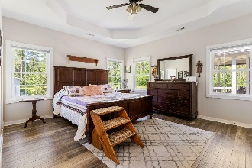
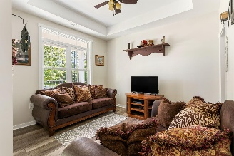
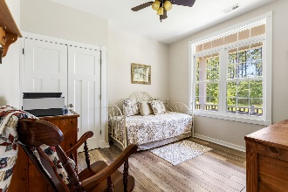
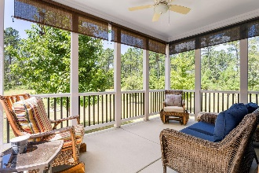
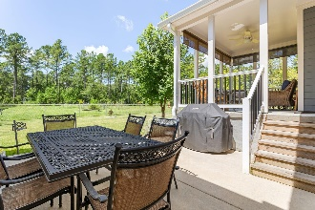
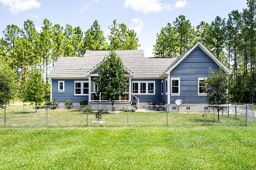
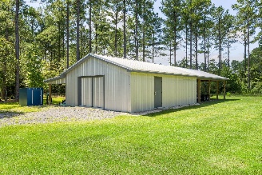



$10,000 Seller Contribution
Welcome to luxury lakefront living at 1891 Bolden Drive in highly sought after Riverside at Carolina Park! Custom built by Structures, one of Charleston's most acclaimed builders, the home was carefully crafted and meticulously executed, both inside and out, to take full advantage of the exceptional panoramic views of stunning Bolden Lake. Featuring over 1,000 square feet of covered porches, start your day soaking in the sunrise over Bolden Lake, while enjoying your morning coffee on one of two oversized front porches featuring a custom swing bed, copper gas lantern and lush, irrigated flower boxes. End your day enjoying a cocktail or mug of tea on the rear screened-in porch, watching stunning Carolina sunsets beyond the beautifully landscaped courtyard and sparkling saltwater pool.
As you enter the home, you will delight in the expansive open concept living, dining and kitchen space designed to take full advantage of the majestic lake views from each of the dozen windows in this triple-aspect space. Ideal for entertaining and day-to-day life, you'll note the 10' shiplap ceilings, a gas fireplace, solid oak floors and central dining space for up to 12. The stunning kitchen features top-of-the-line Thermador Professional Series appliances and a walk-in pantry, as well as exceptional custom cabinetry with maple interiors and dovetail drawers, built by renowned local craftsman Carl Woods. Designer lighting from premier vendors such as Circa/Visual Comforts and Arhaus further enhance the space and are carried elsewhere throughout the home.
The secluded first floor primary suite is a true oasis with soaring vaulted shiplap ceilings, an abundance of natural light and views of the garden, pool and courtyard. Custom cabinetry, designer lighting, an oversized shower, and soaking tub populate the luxurious primary bath, adjacent to dual walk-in closets.
The first floor also offers a powder room, mudroom, laundry room, multiple storage closets, and a flex room with barn doors, perfect for an office, den or play space.
Accessed by a beautiful custom staircase, the second floor offers ample space for family and guests with a bright loft area ideal for use as a family room or study, as well as three generously sized bedrooms and two full bathrooms. Two of the bedrooms have access to the upstairs porch and all three offer their own unique panoramic view over the lake and the treetops beyond.
The detached FROG, finished to the same high standard as the main house with hardwood floors, custom shades, high-end lighting on dimmers, and bespoke cabinetry, includes a full bathroom and large closet, as well as a large, light-filled multi-functional space, creating an ideal office, guest suite or home gym.
Luxurious amenities and meticulous attention to detail continue outside to the impressive outdoor oasis. Off the screened porch, a fenced grass courtyard populated with flowering perennials as well as mature magnolia and oak trees lead to the heated 15' x 25' saltwater pool with a triple water feature on a 15' stone feature wall, a separate spa, propane firepit and leathered travertine pool deck. This thoughtfully designed area is fully enclosed with a 5' fence and surrounded by mature hedges and palm trees, ensuring both safety and privacy in this elegant and timeless serene space.
The front and back yards include landscaping lighting, an all-natural cedar oil mosquito misting system and a full irrigation system that also extends to the potted plants. Electronic keypads on the main house, FROG and garage offer easy access, even remotely, while a 50A Tesla charger benefits electric vehicle owners.
This property offers not only a luxurious lifestyle, but also the convenience of modern living. Riverside at Carolina Park offers an endless array of amenities, including the Lake Club, just down the street, featuring a resort-style pool, wood framed picnic pavilion, and firepit overlooking scenic Bolden Lake. Residents also have access to a playground, tennis and pickleball courts, an open-air pavilion, dog park, the Great Lawn, miles of walking trails, as well as a future Riverside crabbing dock. The nearby Bend shopping development, easily accessed by a quick golf cart or bike
ride, includes restaurants, coffee shops, boutiques, a wine bar, hair and nail salon, yoga and dance studios, among other local businesses. A fantastic regional library, top rated Mount Pleasant schools, hospital, fire station, pharmacies, and Costco are also in the immediate area. This home is also only 20 minutes to the beaches of Isle of Palms and Sullivans Island and 30 minutes to Downtown Charleston and the Charleston International Airport.
1357 Bootsie Way
Landry Farms | McClellanville, SC 29458 | MLS# 23018103 | $864,000
Take a Virtual Tour
Denise Swift-Hendricks
843-754-5017 | denise@coastalcarolinacastles.com
www.coastalcarolinacastles.com
Keller Williams Realty Charleston | 503 Wando Park Blvd, Ste 130 | Mt. Pleasant, SC 29464

