Slide 1
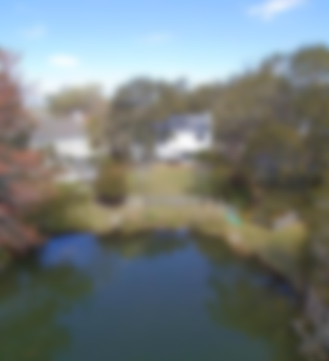
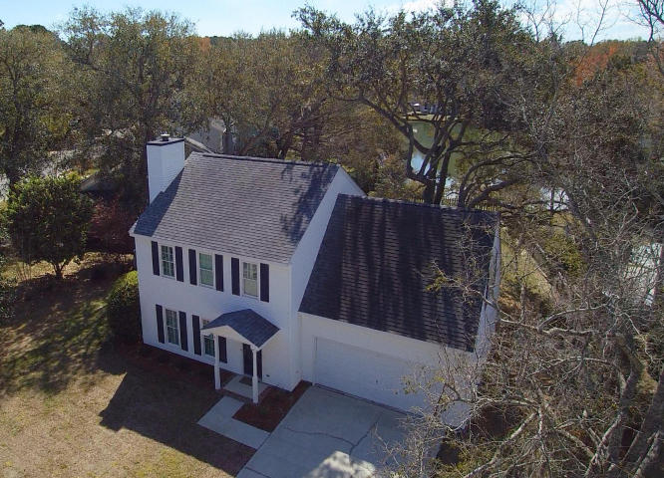
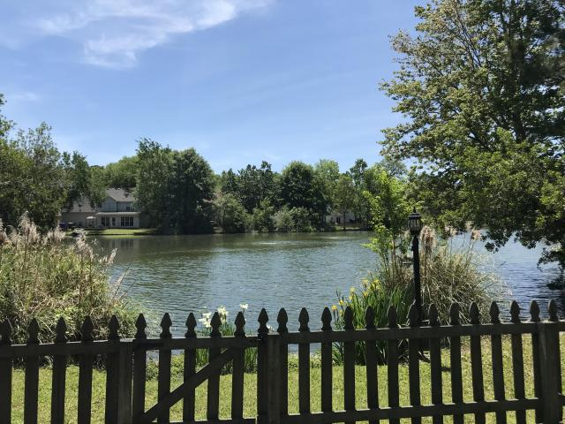
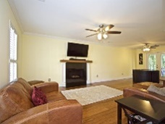
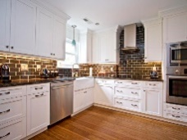
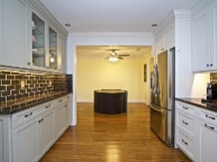
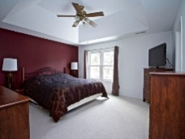
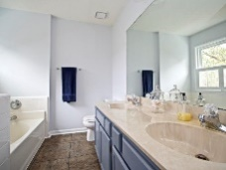

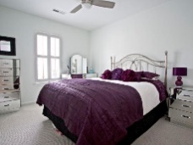
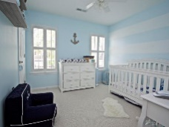
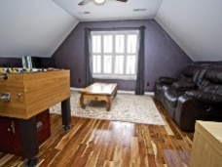
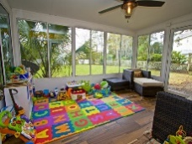
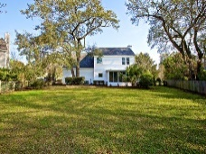



Lakeside in Center Lake
1138 Waterfront Dr
Hidden Lakes ~ Mt Pleasant ~ MLS# 16000069 ~ $765,000
1358 Center Lake Drive
Mount Pleasant, SC 29464 ~ MLS# 18007970 ~ $475,000
Lakefront living in Center Lake! This beautiful 3 bedroom, 2.5 bath + FROG home not only boasts a fantastic lake-front lot, it also has tons of beautiful upgrades throughout! As you walk in the front door, you'll immediately notice how meticulous the current owners keep this home. In the last few years, they have upgraded nearly everything: from the smooth ceilings and fresh paint throughout; to the gorgeous flooring (carbonized bamboo, porcelain and ceramic tile, and upstairs carpet). Not to mention impact resistant windows & doors (except sunroom); bathrooms; HVAC; roof shingles; and so much more! And how about the GORGEOUS kitchen?! It features solid wood cabinets, soft close hardware, Bosch and Samsung stainless steel appliances, glass tile backsplash, under cabinet lighting and a spacious layout with loads of storage space. Neighbors love the Hidden Lakes & Center Lake neighborhood for it's proximity to shopping, beaches, and downtown. It offers a community pool, clubhouse, tennis courts, playground, a huge freshwater lake and canal system and even boat/RV/trailer storage (*an additional fee.)
Come see this stunning home before it's gone!
Mark Macpherson
mark@beachbreak-properties.com
843.367.5640 Mobile

