Slide 1
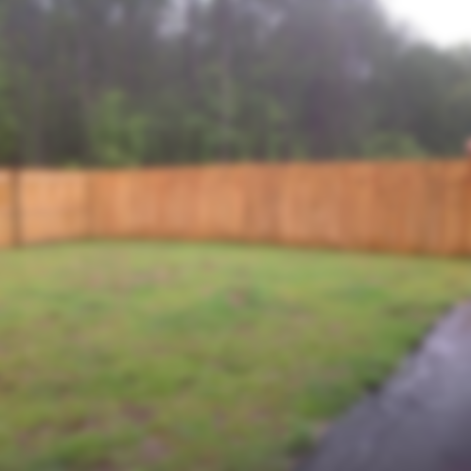
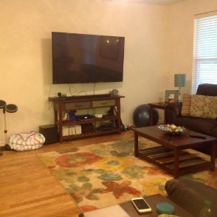
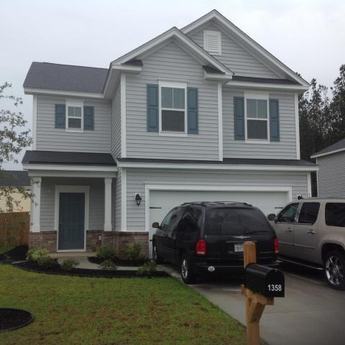
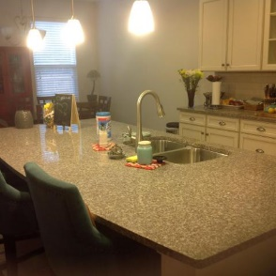
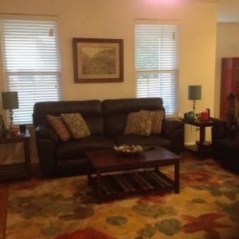
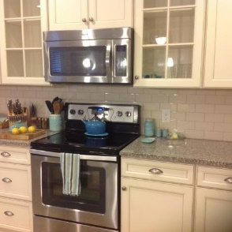
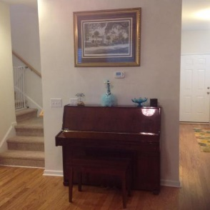
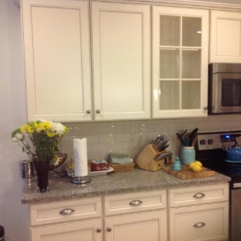
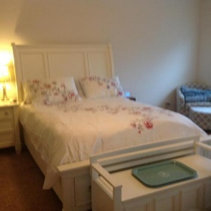
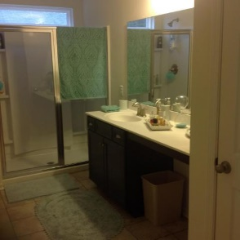
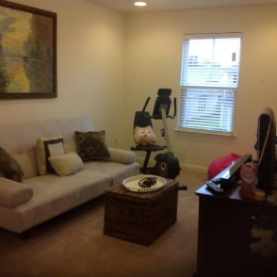
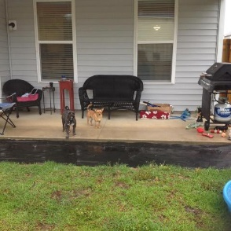


Got to see it to believe it!
Beautiful house less than a year old!
Reduced $10k
1358 Wild Goose Trail
Drakesborough | Summerville | MLS# 17015979 | $230,000
This beautiful 3 bedroom, 2.5 bathroom home was completed in 2016! This property has everything you could ever dream of! From a beautiful kitchen with HUGE island, plenty of storage, open floor plan, upgrades galore, fenced in back yard, and a built in jacket nook. This property also has a loft that could be made into an additional bedroom! Also has remainder of builder warranty that will transfer to new owner! Buyer and buyers agent please verify all information of importance!
Carla C Davis
Mobile - (843) 437-4873
gaweber@tds.net
AgentOwned Premiere Group
141 A N. Main Street
Summerville, SC 29483

