Slide 1
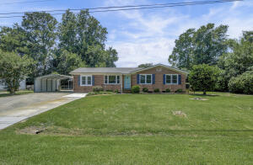
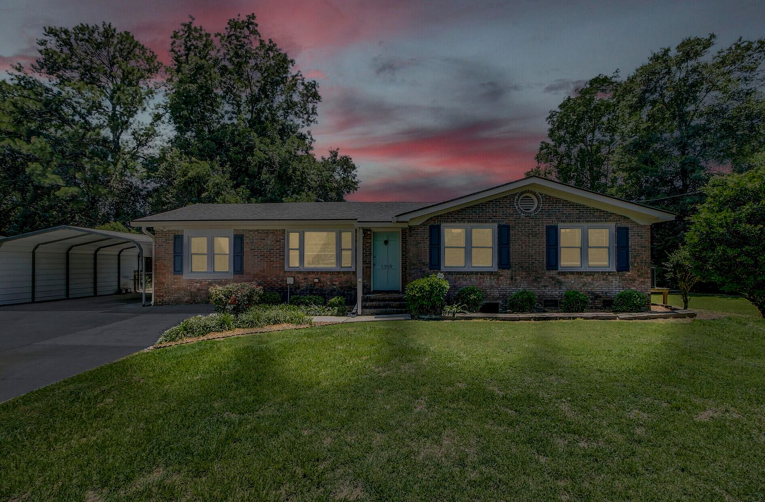
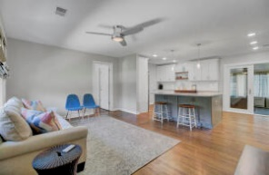
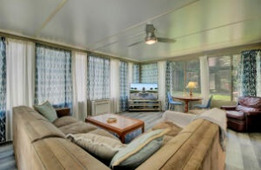
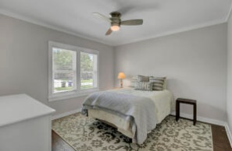
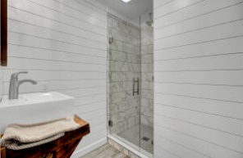
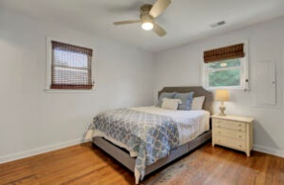
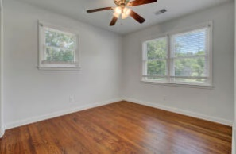
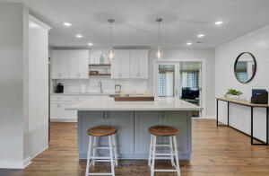
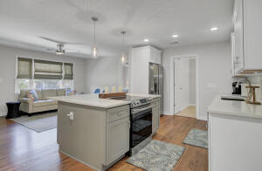


10k Buyer Interest Rate Buy Down!* 20k Price Correction!
Price Reduced
1359 Whitehouse Boulevard
Whitehouse Plantation | Charleston, SC 29412
MLS# 22015894 | $529,000
Like New & Beautifully Renovated Home w/Incredible attention to detail! 4 Bed 3 Bath! Open & Split Floor Plan, All New Designer Kitchen w/Custom Cabinetry and Beautiful Quartz Counters! 2021 Stainless Appliances Convey. All New Master Bedroom w/Custom En-Suite & Rainshower. 2nd Master w/New Custom En-Suite! All New Guest Bathroom. Refinished Hardwoods & All New in Kitchen/Master. NEW HGTV Paint Color throughout interior, Shiplap Accents and New Light Fixtures. Extra Large Sunroom w/New HVAC. 2018 Roof, & 2019 Rinnai Water Heater! Whitehouse Plantation is a sought-after neighborhood on James Island & No HOA. 10 minutes to Folly Beach & Downtown! *If Buyer's uses preferred lender, Seller will pay $10k toward interest rate buy down, this could reduce interest rate by 1% or more saving a potential $300+ a month in payments per Lender, Call Jamie Minster w/CMG Financial 843-302-6271 or jminster@cmgfi.com for more information.
Take a Virtual Tour: https://virtualrealtyllc.gofullframe.com/ut/1359_Whitehouse_Blvd.html
David Tester, ABRM
(843) 452-7337 | david@davidtester.com
www.davidtester.com
Charleston First Real Estate, Inc | 2208 Forest Lakes Blvd | Charleston SC 29414

