Slide 1
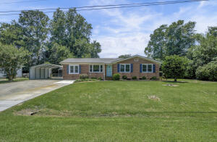
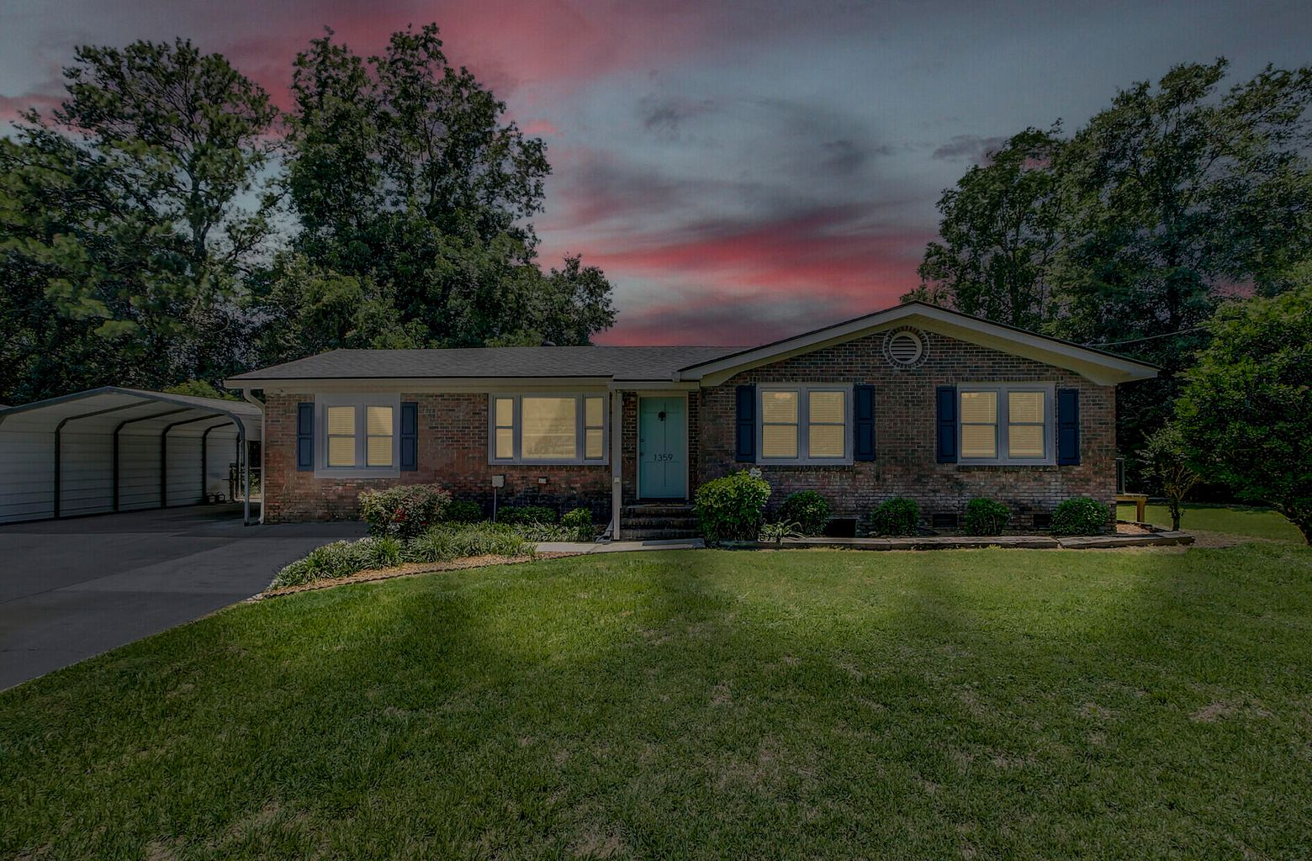
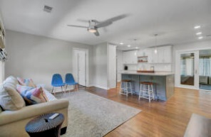
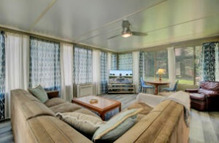
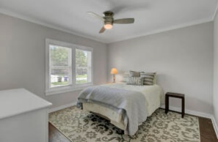
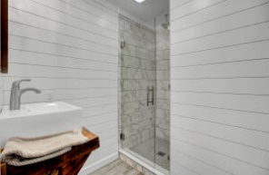
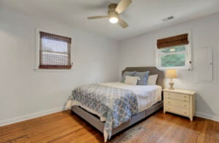
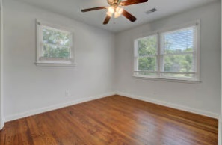
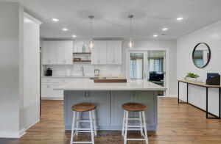
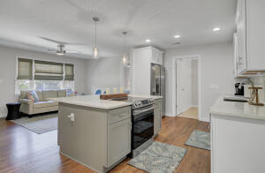


Brokers Open House w/$100 Raffle! 7/16 1-4pm
Price Reduced
1359 Whitehouse Boulevard
Whitehouse Plantation | Charleston, SC 29412
MLS# 22015894 | $549,000
Like New & Beautifully Renovated Home w/Incredible attention to detail! 4 Bed 3 Bath! You could see this home on HGTV as the ''After'' photos! Open & Split Floor Plan, All New Designer Kitchen w/Custom Cabinetry and Beautiful Quartz Counters! 2021 Stainless Appliances Convey. All New Master Bedroom w/Custom En-Suite & Rainshower. 2nd Master w/New Custom En-Suite! All New Guest Bathroom. Refinished Hardwoods & All New in Kitchen/Master. NEW HGTV Paint Color throughout interior, Shiplap Accents and New Light Fixtures. Extra Large Sunroom w/New HVAC. 2018 Roof, & 2019 Rinnai Water Heater! All the sweat equity is done for you! Whitehouse Plantation is a sought-after neighborhood on James Island & No HOA. It's only ten minutes to Folly Beach & ten minutes to Downtown! Come see your new home!
Take a Virtual Tour: https://virtualrealtyllc.gofullframe.com/ut/1359_Whitehouse_Blvd.html
David Tester, ABRM
(843) 452-7337 | david@davidtester.com
www.davidtester.com
Charleston First Real Estate, Inc | 2208 Forest Lakes Blvd | Charleston SC 29414

