Slide 1
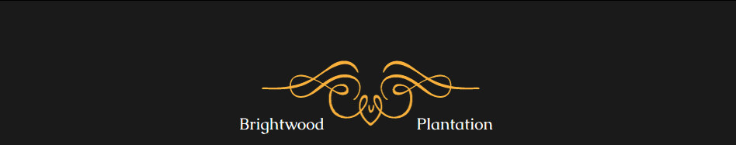

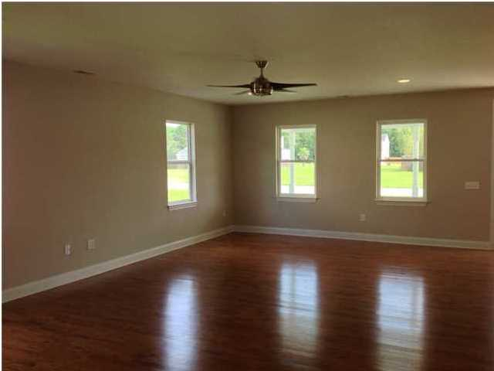
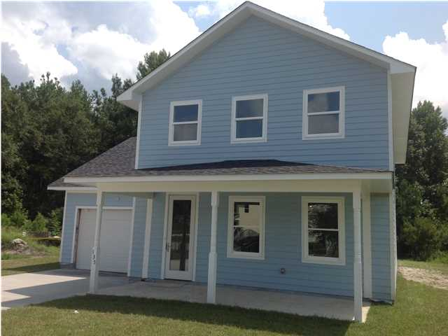
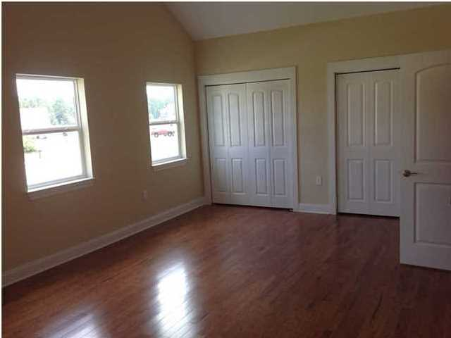
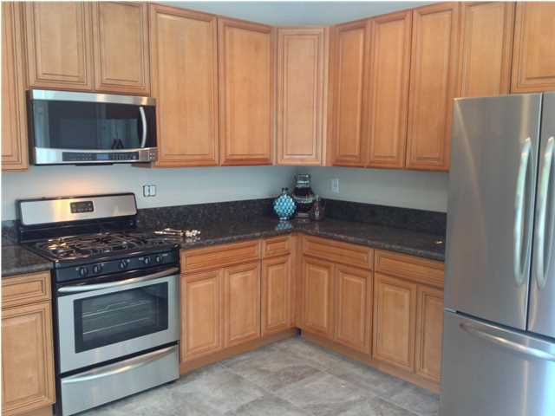
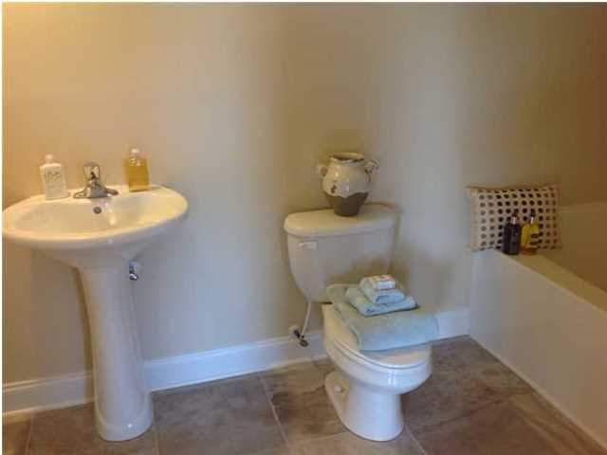
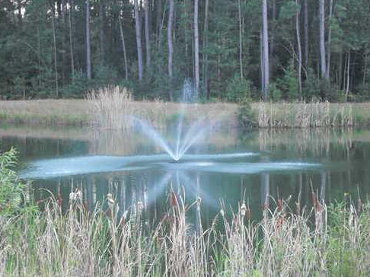
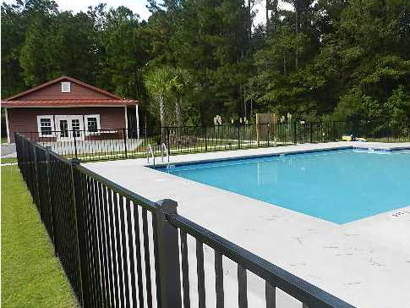


135 Brightwood Dr Brightwood Plantation - Huger, SC MLS# 1425808 - $195,000
Gorgeous cottage home is ready for new owners in the newly developed Brightwood Plantation~ This beautiful 2,294 sqft home features 4 bedrooms, 2.5 bathrooms and an open floor plan that is perfect for entertaining or family living~ The first floor is extremely functional with the kitchen, family room and dining room open to each other displaying a great use of the square footage~ The 4 bedrooms are found on the second floor~ The large, private master suite includes a large soaking tub ~ The 3 additional bedrooms are generously sized and private ~ The kitchen comes standard with high quality, soft close, raised panel wood cabinets on the bottom and 42" upper cabinets, granite countertops, a smooth top range and stainless steel appliances. The house has tons of storage and is built to Energy Star standards with eco-friendly, energy efficient features including: Energy Star appliances, water heater, spray foam in attic, Air condition unit specially engineered for each home, programmable thermostats, Pella LOW-E windows and doors, comprehensive air sealing of the home & HVAC ducts~ This house comes standard with cement plank siding,30 year architectural shingles, a large covered front porch, a two car attached garage, a concrete driveway, and a fully sodded yard~ Neighborhood amenities include a club house and a large custom swimming pool~ The Quimby Creek boat landing is just a short drive away and offers access to the East branch of the Cooper River for fishing and boating~ Close and easy access to Clements Ferry Rd, Cainhoy Rd, I-526, Highway 41, BP, Nucor, Boeing, Daniel Island and Mount Pleasant~ If you work in Mount Pleasant, Daniel Island, Berkeley County, North Charleston you MUST see this house~ This property also has low taxes and is not in a flood zone~
Aviles Real Estate Brokerage
Susan Aviles
843-697-2383
Gil Aviles
843-697-5535
www.Aviles-RealEstate.com

