Slide 1
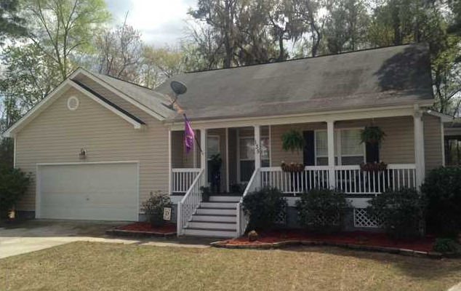
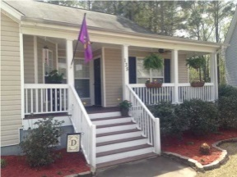
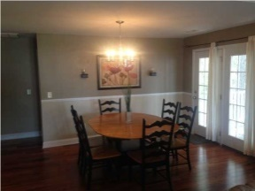
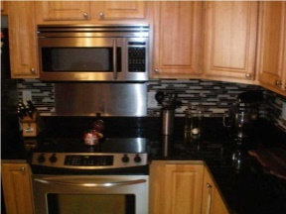
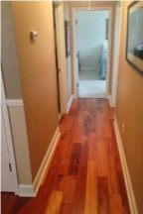
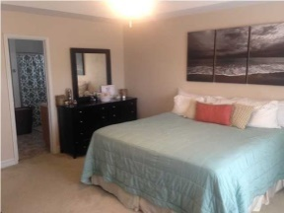
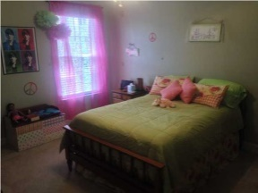
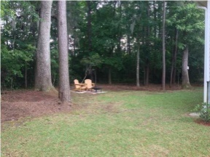
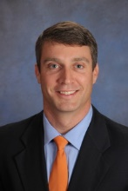
Stunning, Upgraded Cul-de-Sac Home
135 Hanahan Plantation Dr Hanahan MLS# 1409198
Just Reduced to $189,999
Open House Saturday 12-3 Refreshments Provided
WELCOME HOME to this meticulously maintained, exceptionally upgraded, and incredibly clean HOME OF YOUR DREAMS!***Safely located on a CUL-DE-SAC, this house features BACKYARD PRIVACY with HUGE LOT (.4 acres), with a wooded, protected wetland buffer behind it. *** As you cross the relaxing FRONT PORCH and walk in the front door, you immediately notice the cleanliness and pride of ownership, and feel the cool air from the NEW AC.***The open floor plan with VAULTED SMOOTH ceilings will impress you. The home has been upgraded with WOOD FLOORS in the living room, dining room, and hallway. The large kitchen boasts gleaming GRANITE counters, BEAUTIFUL back splash, under-mounted sink, and clean STAINLESS STEEL appliances that all convey. The kitchen has room for a breakfast table and what's that you see, a WALK-IN PANTRY!! That's right, a WALK-IN PANTRY gives you plenty of shelf storage space. The living area has a gas fireplace and the dining area has room for a big family table.*** The three bedrooms all have large windows for natural light, clean carpet, ceiling fans, and plantation blinds that convey. The great Master bedroom has a nice tray ceiling, master bath with DUAL SINKS, and big WALK-IN CLOSET. *** There is a HUGE ATTIC for additional storage. The attic in this floor plan provides the option of building out a Bonus room. A peaceful SCREEN PORCH also provides a relaxing, bug-free setting for enjoying the private backyard. The 2 car garage is EXTRA WIDE for lots of STORAGE SPACE. *** The neighborhood features a community pool (covered in annual HOA fee) and secure boat, RV, trailer parking (for additional fee). MAKE THIS YOUR HOME TODAY! Sellers to provide Home Warranty with acceptable offer!
Scott Baskin
843-324-4139 M | 843-972-2400 O scott@davidwertan.com | www.scottbaskin.com
RE/MAX Advanced Realty
311 Johnnie Dodds Blvd
Mt Pleasant, SC 29464

