Slide 1
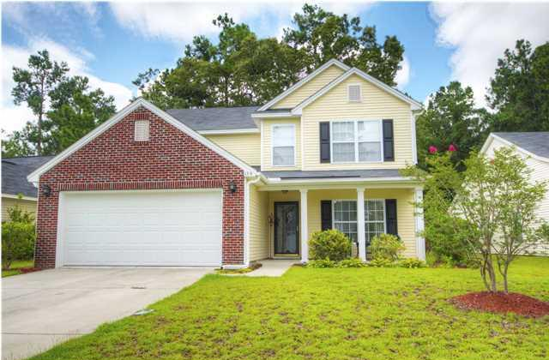
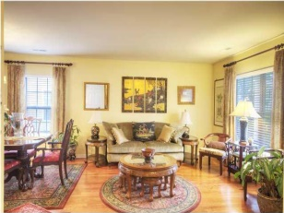
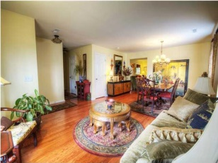
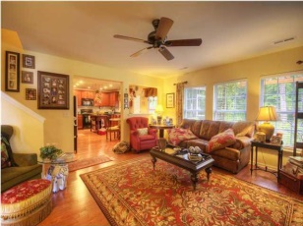
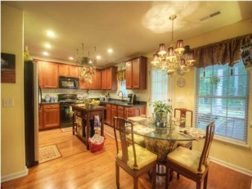
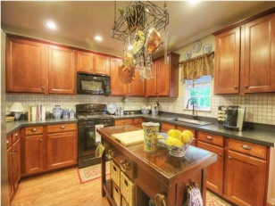
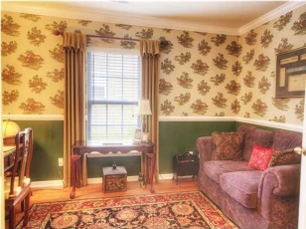
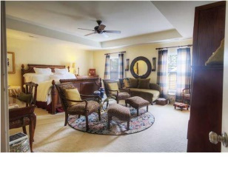
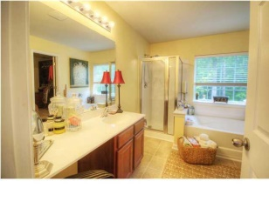
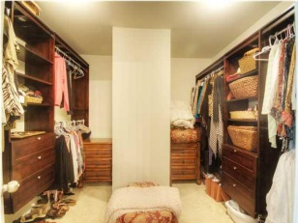
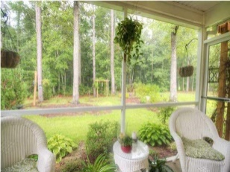
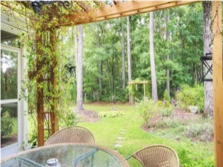
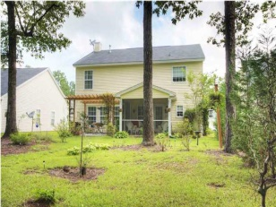


Minutes from Downtown Summerville
135 McGrady Dr
Summer Park
Ladson, SC 29456
MLS# 1420652
$239,000
Welcome home to this lovely 4 bedroom, 3 Full bath home loaded with upgrades and ready for you to move in! Upon entering home, you will notice the gorgeous wood floors that are throughout the first floor. Formal living room and dining room are a perfect spot for entertaining. Gorgeous kitchen has tons of cabinet space, oversized graphite sink, tiled back splash, walk in pantry and eat in kitchen area overlooking the family room which offers a gas fireplace. Downstairs you will also find an office, full bathroom, laundry room and access to the two car garage. Upstairs has three bedrooms that share a hall full bath. The master bedroom is HUGE! Part of it can be used as a sitting area/retreat. Large bathroom with dual vanities, shower, tub and custom walk in closet with built in shelves and drawers. Sit in the screened in porch and look at your beautifully landscaped yard with loads of privacy. This home backs up to woods to offer complete privacy! This home shows like a model home and is a must see!
Larry & Kathy Mazalatis
Larry Cell 843-693-0529
Kathy Cell 843-693-0159
Office 843-871-9133
AGENTOWNED PREMIERE GROUP | 1800 TROLLEY RD | SUMMERVILLE, SC 29485

