Slide 1
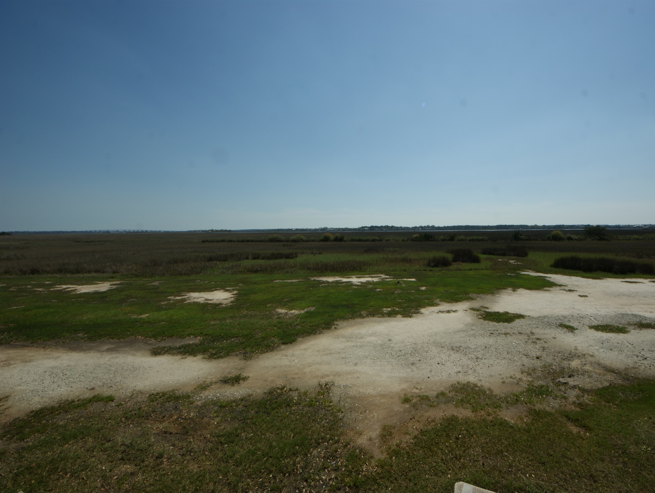
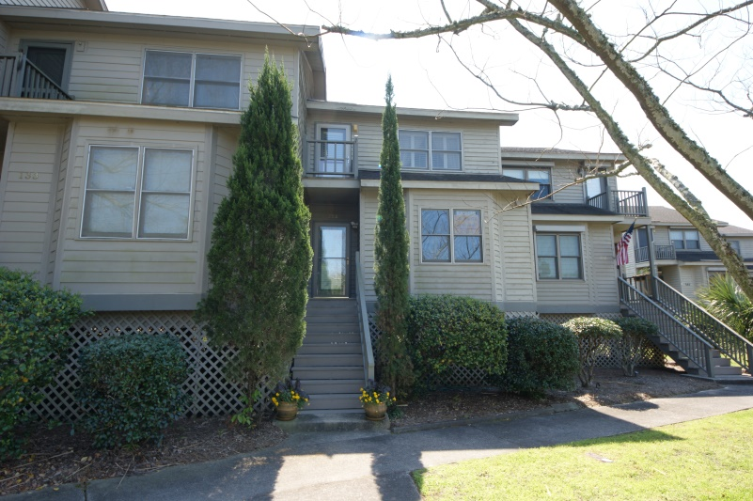
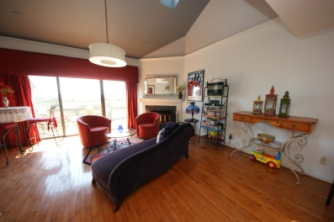
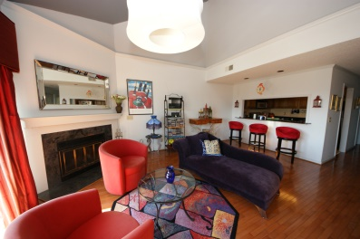
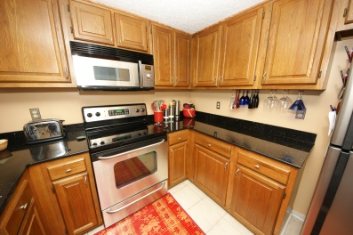
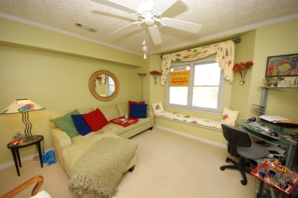
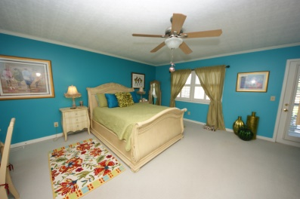
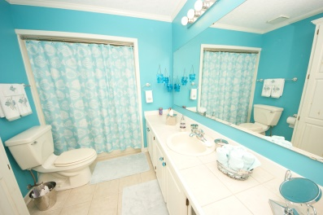

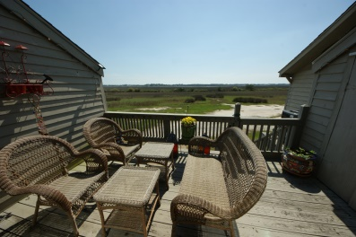
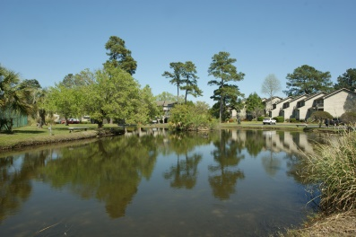
New Price!
135 River Breeze Drive
Waterway South
Charleston, SC 29407
MLS# 15006974
$209,900
This unit has a glorious view of the Intercoastal Waterway. Sit on the rear deck and enjoy the boats as they pass by. There is a bedroom and a full bath on the first floor and the huge master bedroom is located on the second level. The bedrooms are carpeted and the foyer and family room have hardwood floors. There is a fireplace, vaulted ceiling and skylight in the family room. The laundry area, which will include the washer and dryer, is located on the first level. The kitchen has granite counter tops and stainless steel appliances. The master bedroom has a large walk in closet and a full bath. This community has tennis courts, pool and club house for your enjoyment. Seller and listing agent are related.
Terry Seabrook
Mobile 843 607-2490
Office 843 577-2676
seabrookspace@aol.com

