Slide 1
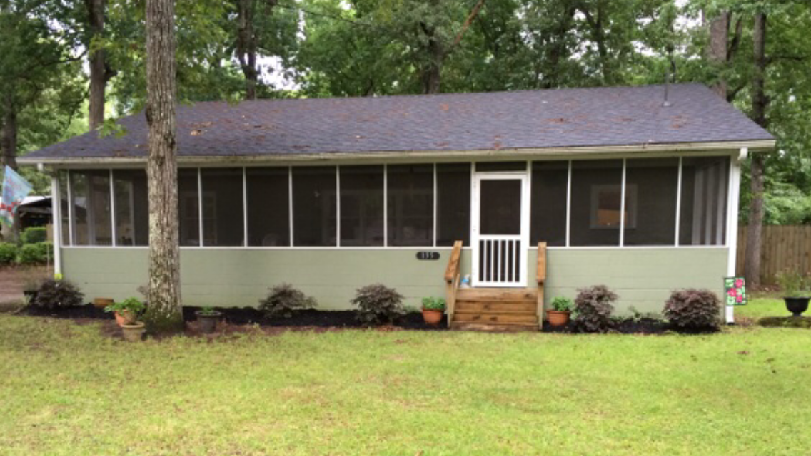
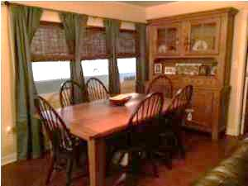
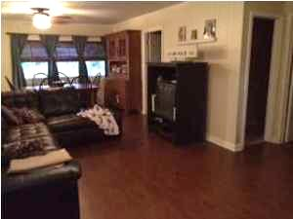
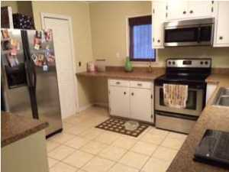
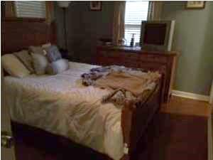
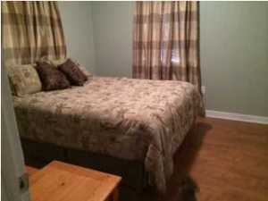
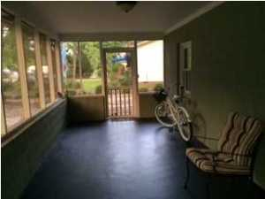
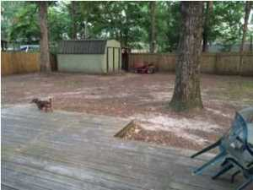

135 Sinkler Avenue
Eutawville, SC 29048 | MLS# 15012334 | $118,900
3 Beds | 2 Baths | 1,221 Square Feet
Well maintained home less than a block from Bells Marina, and just blocks away from two public boat landings. Home has three bedrooms, two bathrooms, large back yard and storage shed to store all of your outdoor toys! Large screened in porch across the entire length of front of home. Home has tile and laminate floors though out.
Carla C Davis
Mobile - (843) 437-4873
gaweber@tds.net
AgentOwned Premiere Group
141 A N. Main Street
Summerville, SC 29483

