Slide 1
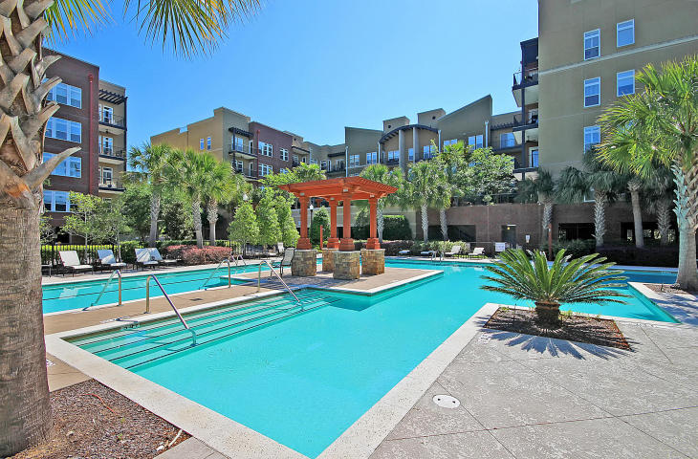
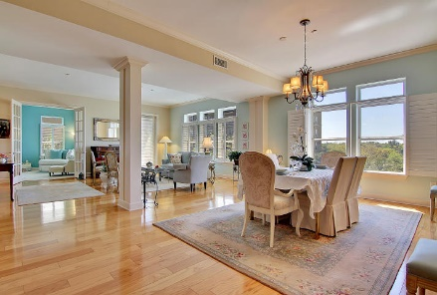
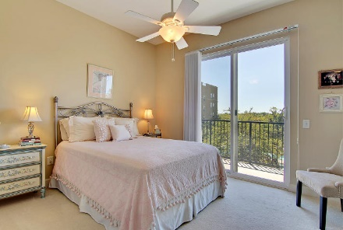
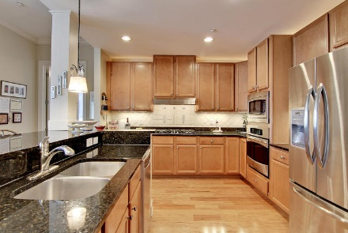
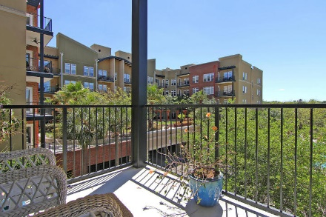
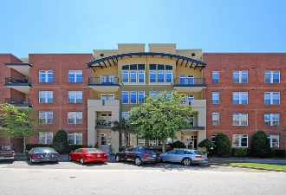
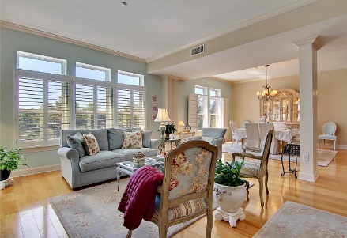


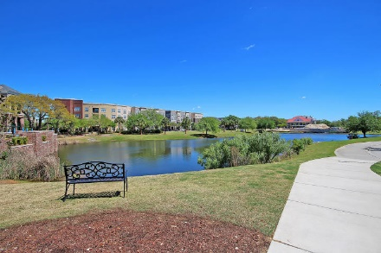

Easy Living In The Heart of Daniel Island
135 Pier View Street #208
Daniel Island, SC 29492 ~ MLS# 17010647 ~ $559,000
Maintenance-free living on Daniel Island awaits you from this meticulously maintained 2nd floor unit that overlooks the sparkling pool and the marsh beyond. This home boasts an open floor plan where the natural light pours into all of the rooms. This split floor plan has the master at one end & the other two bedrooms at the opposite side of the unit allowing maximum privacy for the owner and guests. The kitchen is top of the line w/granite counters, a breakfast bar, gas cooktop, built-in oven and microwave, tile backsplash, built-in wine cooler & all SS appliances. The owners retreat features a sitting room / office and a gorgeous master bath w/dual vanity, walk-in shower, soaking tub & walk-in closet. The outdoors can be enjoyed from two great balconies that look out to the pool.
Additional features include:
2 linen closets
Incredible location - just 2 blocks from the river and beautiful walking trails
Walkable to schools, churches, shopping and dining on the island
Conveniently located to beaches, Downtown Charleston, shopping, and dining
Book your showing soon!
Ben Laaper ben@mattoneillteam.com 843-642-3546

