Slide 1
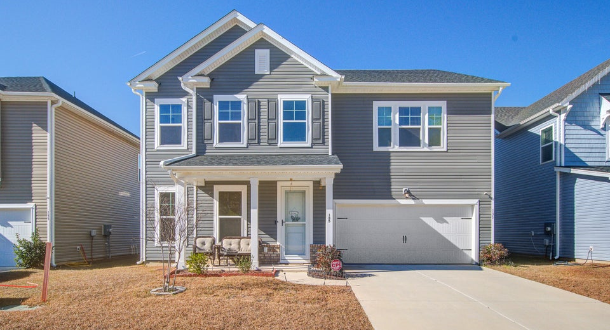
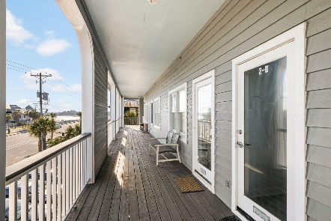
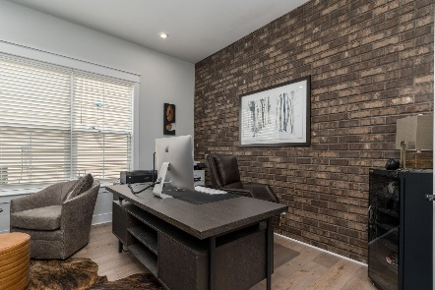
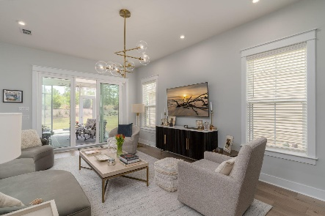

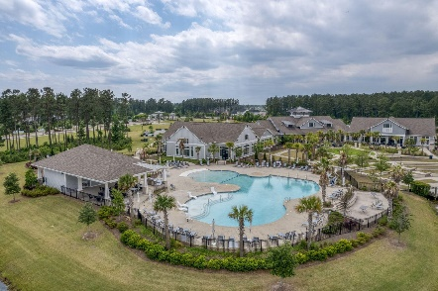
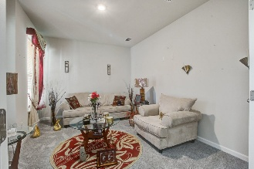
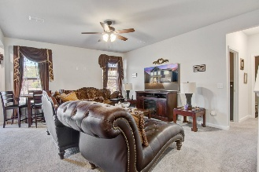
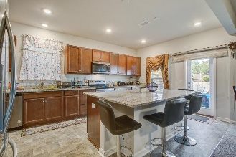
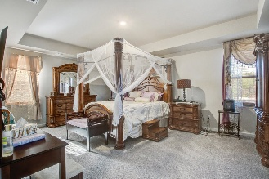
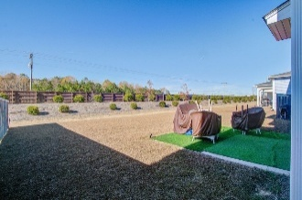
135 Winding Grove Lane
The Groves of Berkeley | Moncks Corner, SC 29461 | MLS# 25032963 | $465,000
Darrell Creek Elevated Home With Elevator & Salt Pool
Ready for Entertaining
Co-sponsored by
This Aspen floorplan by Beazer is just 1 year old. If entertaining is in your future, this home is ready. Enter into the 2 story foyer w/flex space that can be an office, or formal living, etc. Separate dining and a butler's pantry, walk-in pantry and large kitchen with ample granite counter space, large island and electric range, microwave, dishwasher and refrigerator. The great room is directly off the kitchen which allows open conversation and never missing a moment when entertaining.
Primary bedroom is upstairs with tub & separate shower, two walk-in closets & dual vanity . There is a loft and 3 more good sized rooms and two bathrooms. One Bedroom has its own ensuite bath. With plenty of space to spread out, or grow into, this home has so much to offer. With new restaurants, Publix, gas stations and a main thoroughfare within walking distance, what more could you ask for. Seller is open to concessions. Bring all offers.
Offering $3000
Lender Credit
Rochelle Rennert
843-847-9694 | rochellesellscharleston@gmail.com | www.theunlockingdreamsteam.com
AgentOwned Premiere Group, Inc. | 219 N Highway 52 Ste A | Moncks Corner, SC 29461-3926

