Slide 1
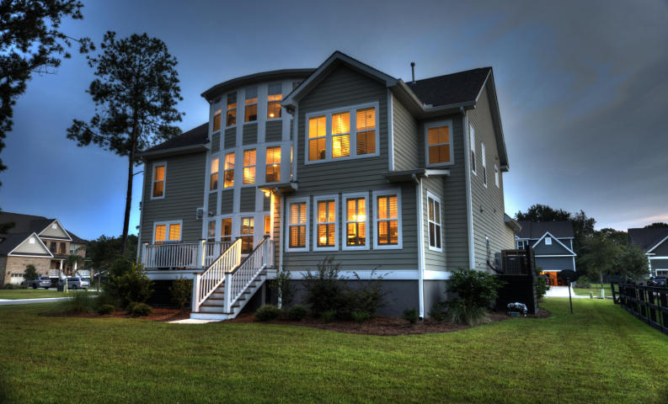
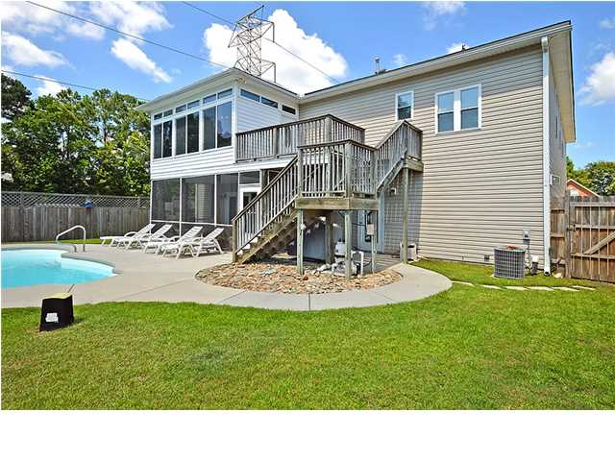
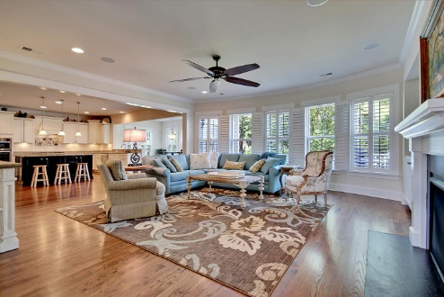
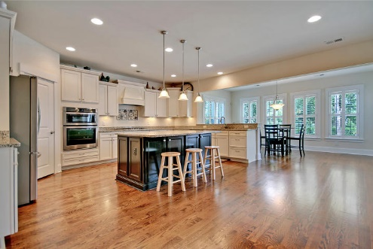
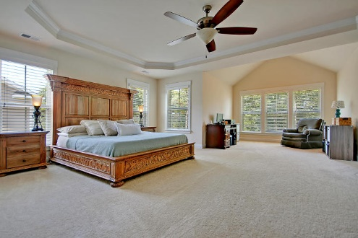
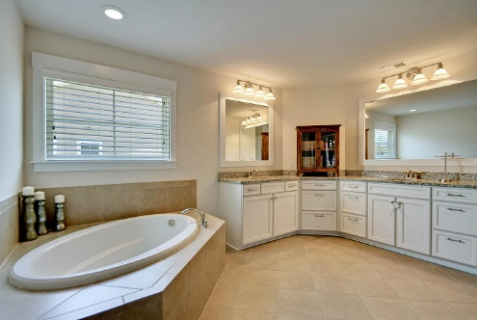
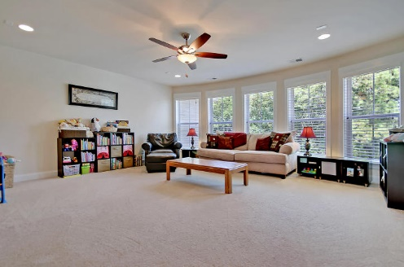
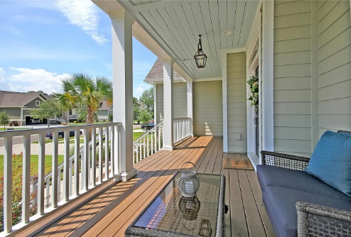
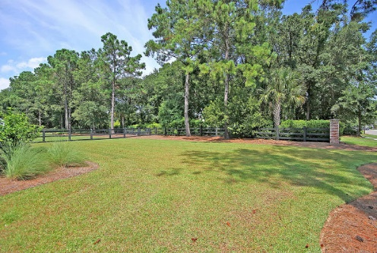
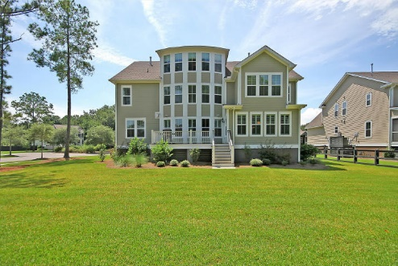

Price Reduced!
Huge Price Reduction!
1360 Scotts Creek Circle ~ Mt Pleasant ~ MLS# 15023332 ~ $799,999
Scott's Creek is Mt. Pleasant's most convenient location, located off Coleman Blvd & Rifle Range Rd. This Luxury, 5-Bedroom home has a HUGE lot and was just built in 2013. Enjoy lots of natural light with the open floor plan, high ceilings, & windows from floor to ceiling. The gourmet kitchen opens to the family room with a fireplace & has access to the deck which overlooks the huge backyard. The owner’s retreat is enormous w/a sitting area, tray ceiling, en-suite bath w/dual vanity, walk-in shower, and garden tub. The family room is on the second floor as well as a beautiful balcony off two of the bedrooms while the third floor boasts a kitchenette, a giant media room & full bath. Enjoy walking trails around the pond & close proximity to the dock.
Additional features include:
Wainscotting, tray ceiling and bar area in the dining room
First floor office with French doors
Kitchen has granite counters, a center island with breakfast bar, Whirlpool Gold appliances and walk-in pantry
Spacious eat-in area leads to the deck
Fireplace and built-ins in the living room
Plantation shutters
Upgraded and pre-wired for a sound system with built in speakers
Cable access in all bedrooms and living rooms
Three linen closets and temperature controlled crawl space for additional storage
Monkey bar storage system in the garage
Professional landscaping
One of the biggest yards in the neighborhood, room to put in a pool
Minutes from award winning schools
Book your showing today!
For more information, contact
Matt O'Neill | matt@mattoneillteam.com | 843-501-2900

