Slide 1
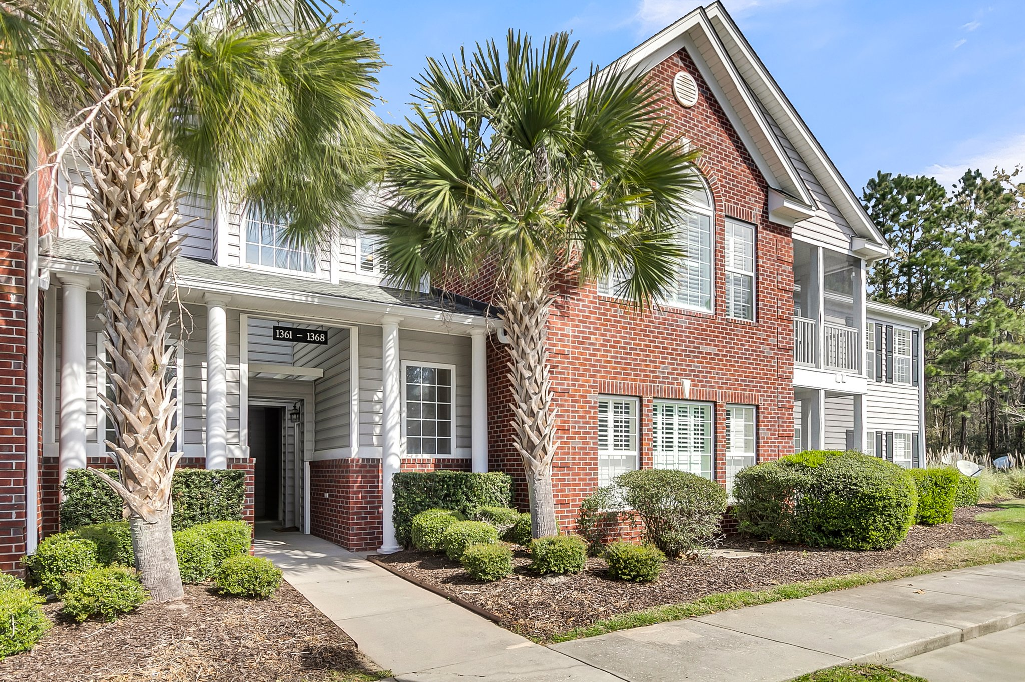
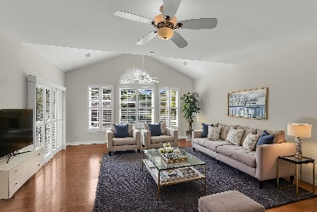
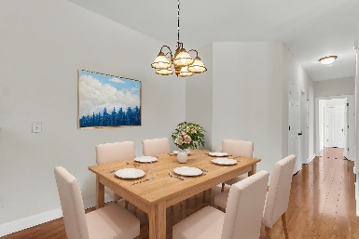
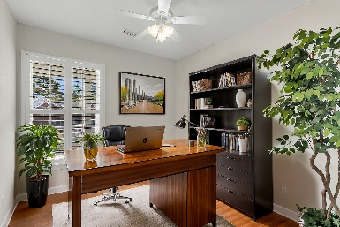
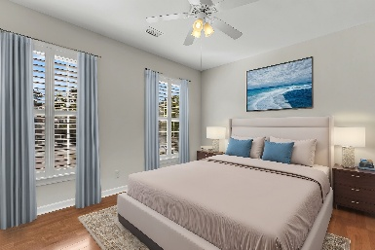
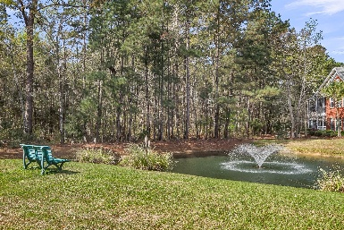


1362 Kingsford Lane Dunes West | Mount Pleasant, SC 29466 | $449,000
ELLINGTON WOODS - BROKER EVENT
Thursday, April 3rd, 10:30am-12pm | Light Lunch Provided
3 Bedroom | 2 Bath | 1,624 sf | Freshly Painted
Steve Kaul 843-817-5547
skaul@carolinaone.com
http://www.charlestonhousehunt.com/
Carolina One Real Estate
195 W Coleman Blvd
Mt Pleasant, SC 29464-3495

