Slide 1
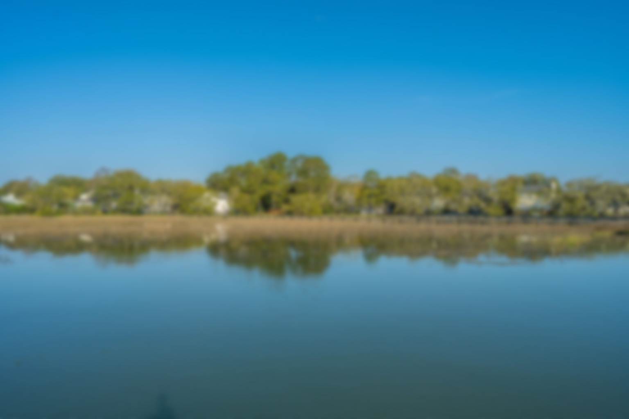
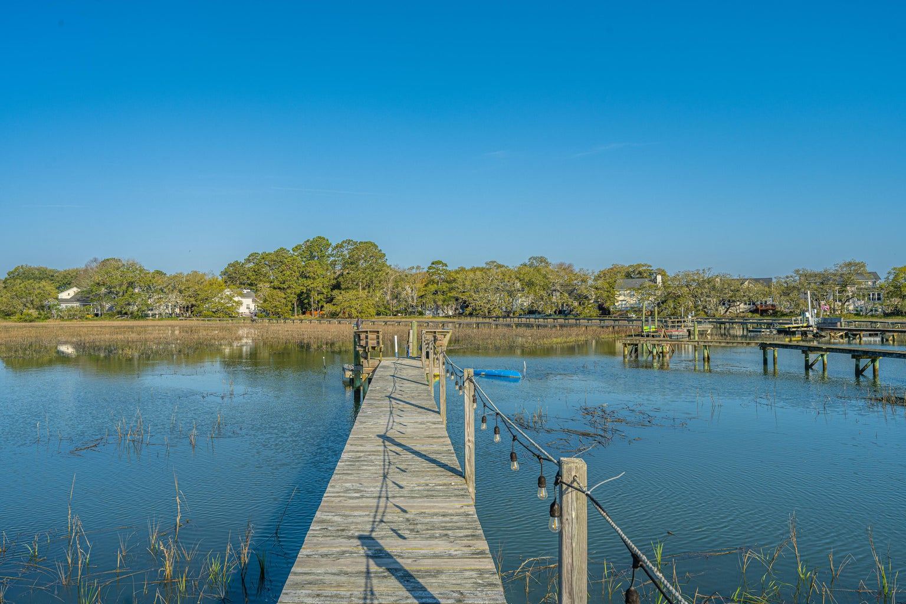

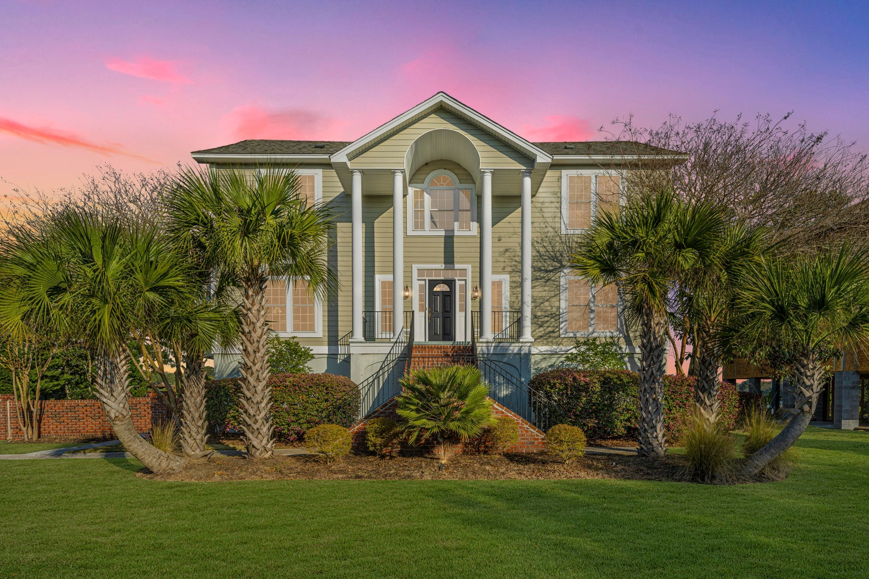
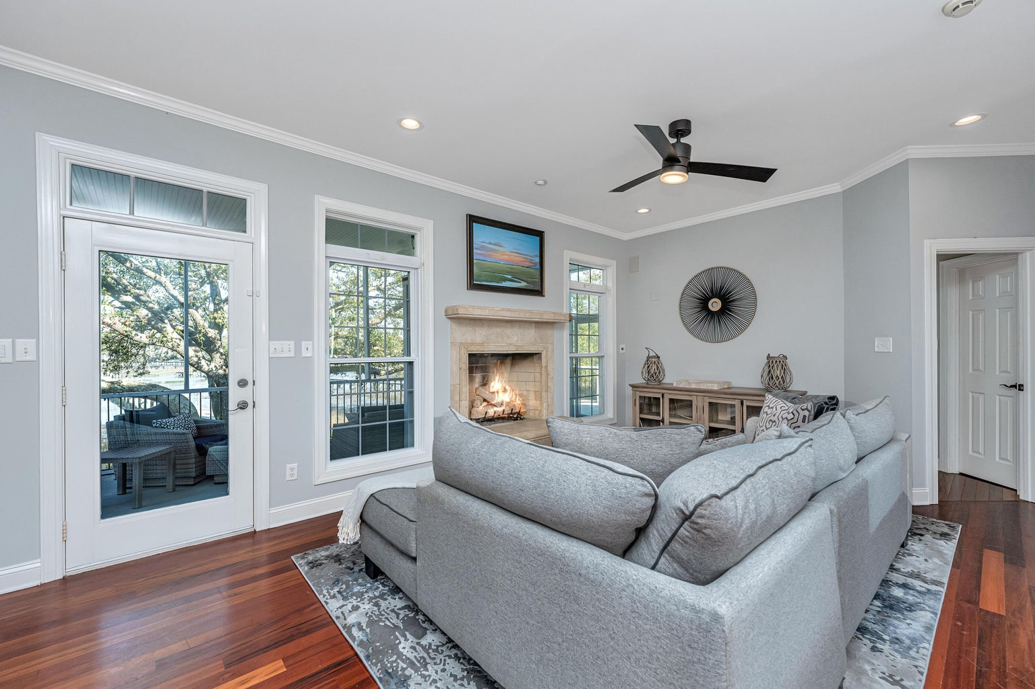
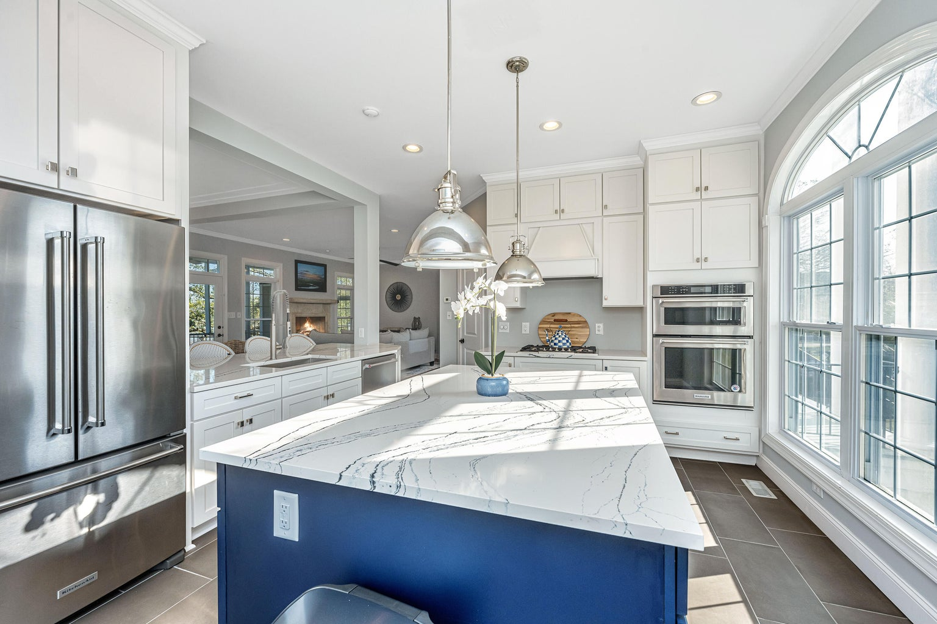
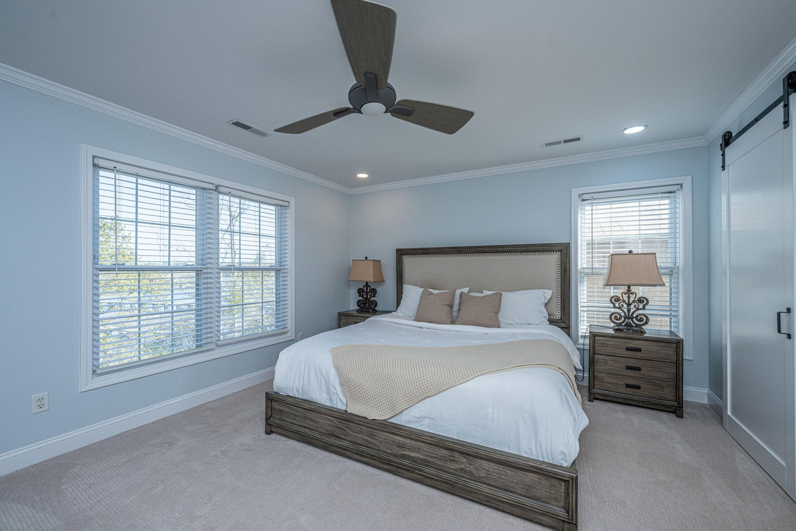
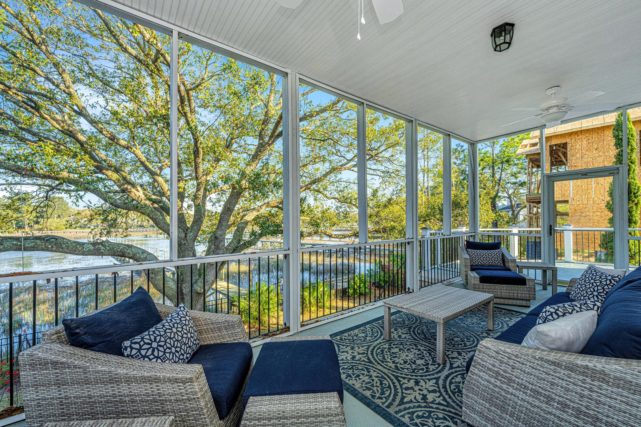
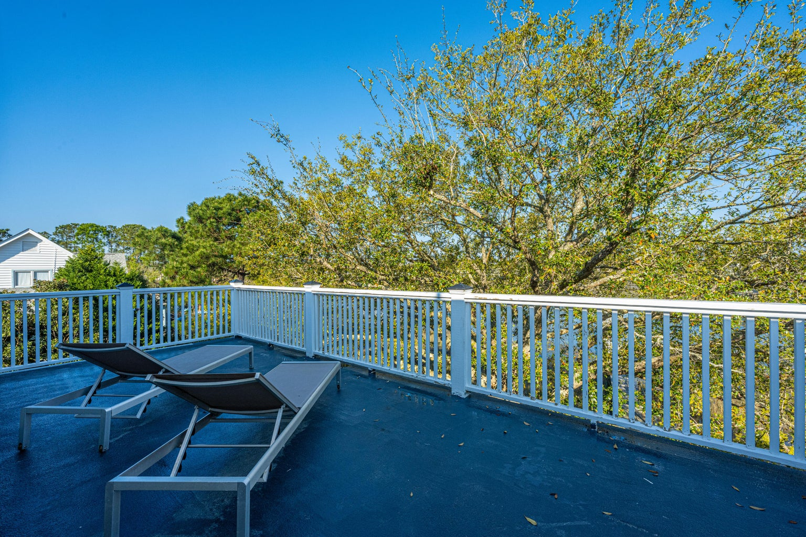

New to the market!
This home can be your own private paradise!
Mary Cederquist
843-666-7558
mary.cederquist@carolinaone.com
www.MaryCRealEstate.com
Open House This Weekend
Saturday from 11-1
Sunday from 1-3
1364 Tidal Creek Cove
Seaside Estates | Charleston, SC 29412 | MLS# 23005125 | $1,250,000
Don't miss out on this rare opportunity to own this incredible WATERFRONT home with a PRIVATE DOCK on the Clark Sound, Located in the sought after ESTATES section of Seaside Plantation. As you approach this stately home with it's well manicured landscaping you will drive through the iron gates and immediately take in the incredible view of the water and the grand Oaks dancing in the coastal breeze. Upon entering into the home you are greeted with a welcoming foyer, a half bath on the left and an Elevator on the right that takes you down to the 5 car garage or up to the second floor. As you proceed through the foyer it opens to a great room with a gas log fireplace that spills into a dining room that is great for entertaining and dining. Off the great room is a screened in porch that can be enjoyed all year round. To make your entertaining experience even more desirable, there is a renovated sun filled Navy and White kitchen that boasts Cambia Portrush Countertops throughout, Polished Nickel Hardware, Bosch Gas Cooktop, Refrigerator, Kitchen Aid built in oven and Viking Wine / Beverage refrigerator Located in the Large Navy Island! Off the great room is the first floor Master with it's own private entrance to the screened in porch. The bedroom has a private full bath with dual vanities, separate shower and tub, and two closets. The second floor includes another completely renovated master suit and bath. The private bath has Dual vanities, Kohler fixtures throughout, custom shower and separate tub. The master suite also has his and hers closets and a private entrance to a second floor deck, a perfect place to stargaze in the evenings while enjoying the coastal breeze. Off the master suite is a bonus/ flex room that can have multiple uses, an office, a play room or TV room just to name a few. There are two additional light filled bedrooms and third full bath with a shower and tub. A dumbwaiter is located outside the master suite and can make a stop at every floor down to the five garage with ample storage. Don't miss out on taking a stroll down the dock to the water where you can fish or take a boat ride just minutes from Charleston Harbor. This is an experience you don't' want miss out on!
Carolina One Real Estate
628 Long Point Rd
Mt Pleasant, SC 29464-3032

