Slide 1
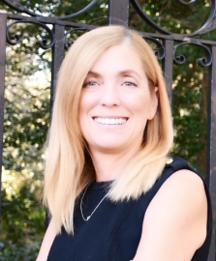
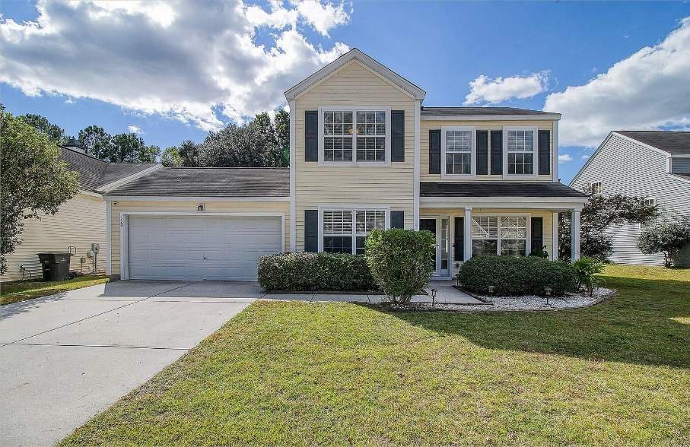
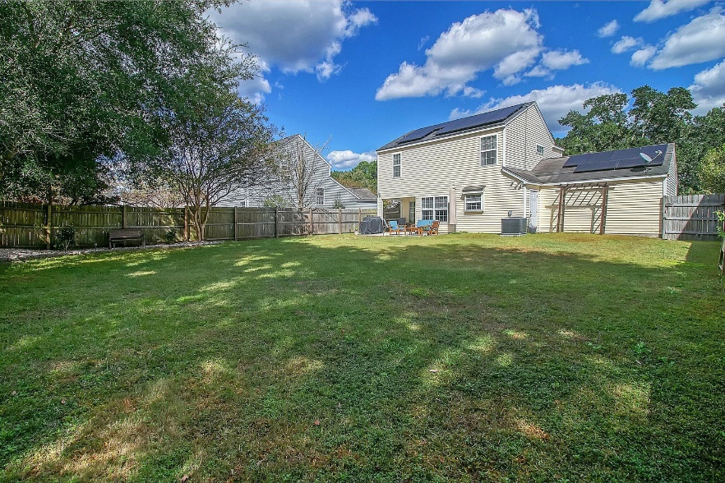
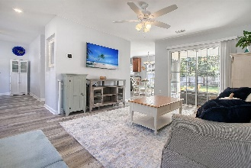
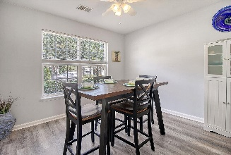
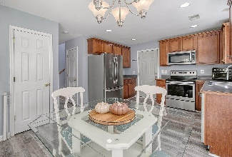
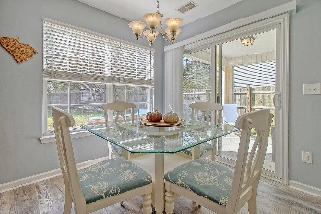
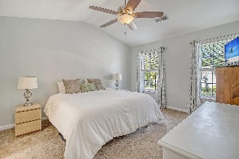

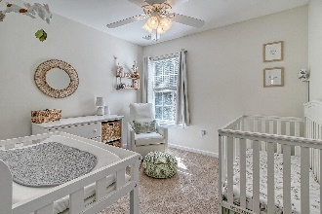
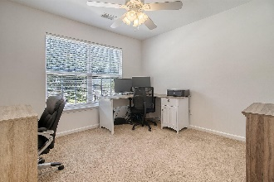
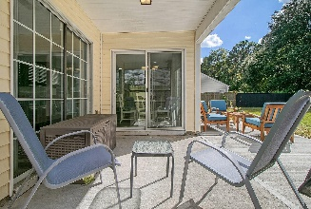
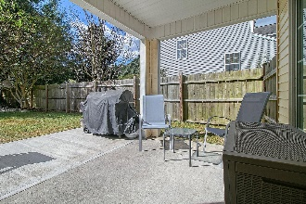
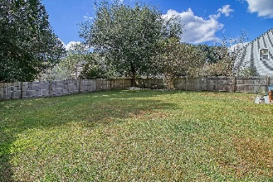
Seller Offering A 2/1 Buydown
With Full Price Offer
Debbie Cromer
ABR, RSPS, REALTOR, CRS
(843) 437-6342
debbie@debbiecromer.com
www.debbiecromer.com/
1365 Palm Cove Drive
The Peninsula | Charleston, SC 29492 | MLS# 23023994 | $425,000
Ask about the special financing offer.
Great new price on this rare gem in the Peninsula Subdivision!
This move-in ready home boasts new flooring on the ground level and a fresh coat of paint, ensuring a bright and cozy space to call your own. With 3 spacious bedrooms and 2 baths, this home is perfect for families and guests alike. T
he expansive fenced yard offers peace of mind and room for outdoor fun, while the eco-friendly, paid off solar panels give you an edge on energy savings. Don't miss out on this charming find!
Video Tour
Century 21 Properties Plus | 1090 Park West Blvd; Ste 103 | Mount Pleasant, SC 29466

