Slide 1
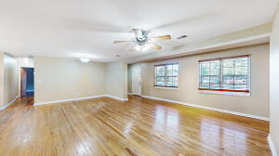
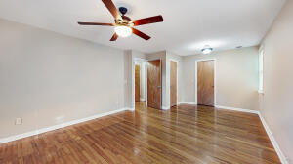
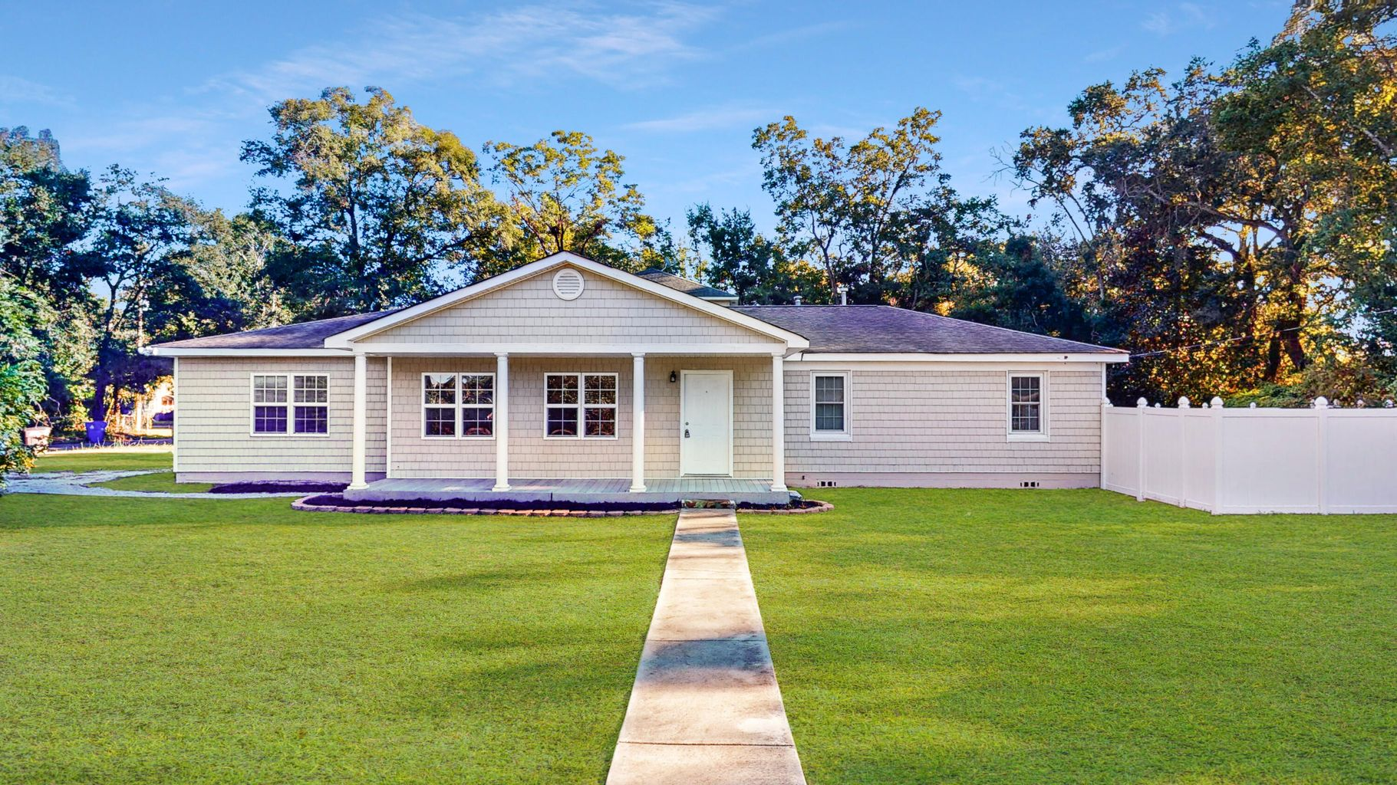
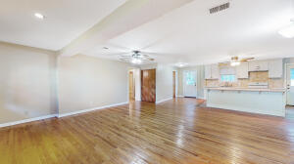
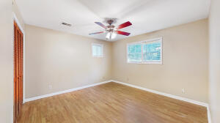
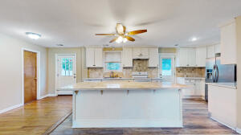
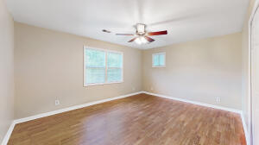
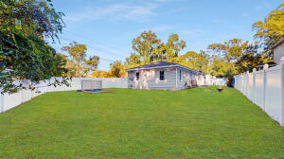
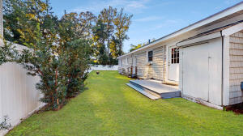
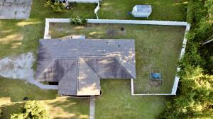
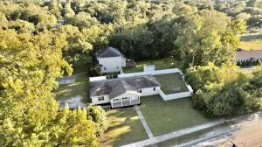
Nice Family Home or For Investment
1367 Fort Johnson Road
Kings Acres | Charleston, SC 29412
MLS# 21028512 | $425,000
Nicely renovated 4 bedroom one-story home at Outstanding Location on James Island!
Lovely hardwood floors, newly painted inside, and large fenced in backyard.
Home features a very open floor plan, with 2 bedrooms and 1 full bath on each side of the home.
All appliances convey (as is), All new windows in 2018, and roof replaced in 2009 and 2017 (25 year Architectural shingles). New back door in 2021. Microwave is on counter not built in.
Randy Espeseth
843-743-1025 | Randy@RandyEHomes.com | Carolina Elite Real Estate

