Slide 1
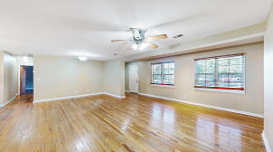
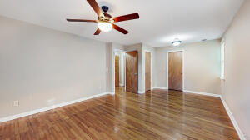
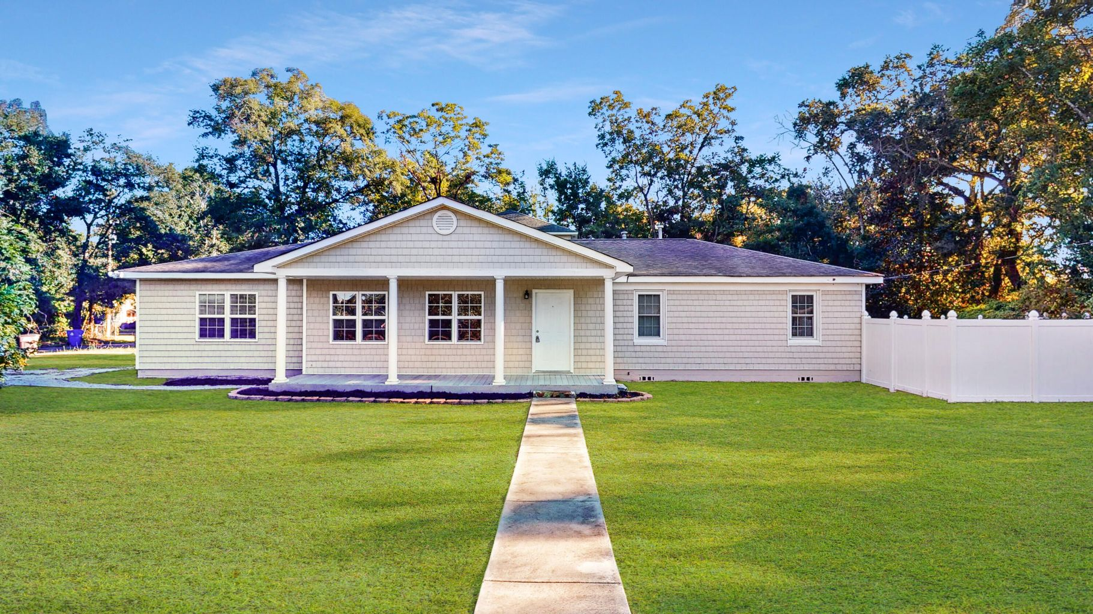
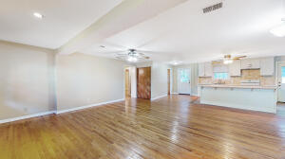
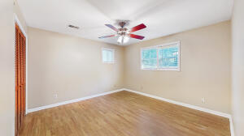
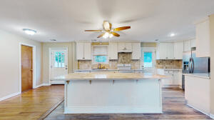
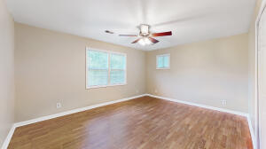
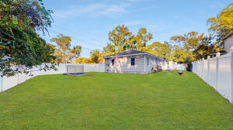
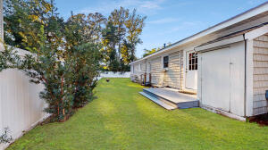
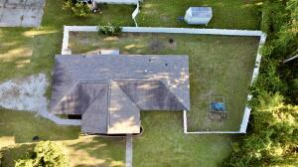
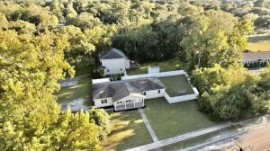
OPEN HOUSE - SATURDAY 11-1 & SUNDAY 1-3
1367 Fort Johnson Road
Kings Acres | Charleston, SC 29412
MLS# 21028512 | $425,000
Nicely renovated 4 bedroom one-story home at Outstanding Location on James Island!
Owner purchased in 2004, and almost doubled the size of the home. Lovely hardwood floors, newly painted inside, and large (.38 acres) fenced in backyard.
Home features a very open floor plan, with 2 bedrooms and 1 full bath on each side of the home. All appliances convey (as is), All new windows in 2018, and roof replaced in 2009 and 2017 (25 year Architectural shingles).
Randy Espeseth
843-743-1025 | Randy@RandyEHomes.com | Carolina Elite Real Estate

