Slide 1

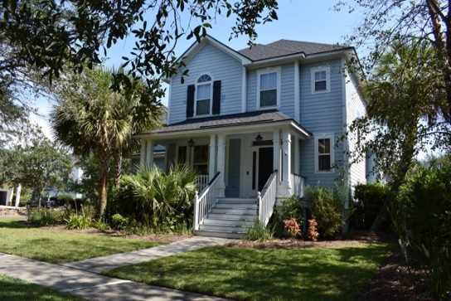
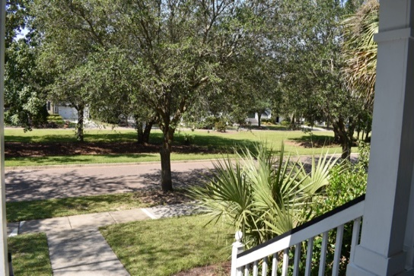
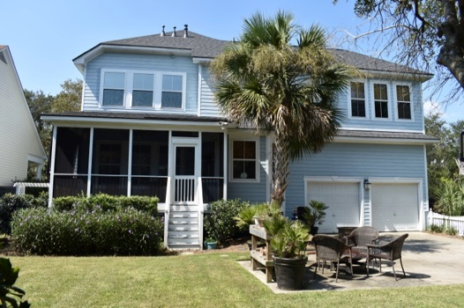
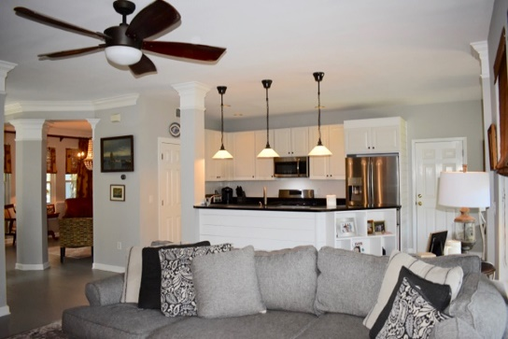
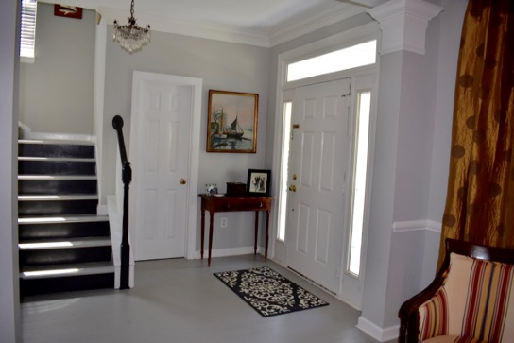
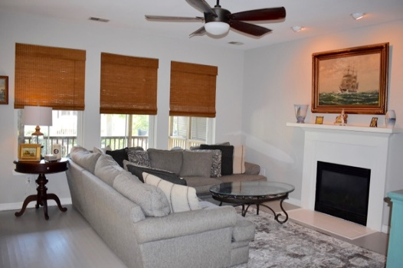




Beautiful Home On Desired Street!
PRICED TO SELL AT $629,900 – DANIEL ISLAND
136 Bounty Street, Daniel Island, SC
Beautiful 4BR on corner lot with fenced in backyard!
Beautiful 4BR corner lot home situated on desirable street across from passive park & walking distance to Bishop England. Home features include open floorpan w/separate Dining Rm, Powder w/ shiplap, painted hardwood flooring, Family Room w/fireplace, Eat-In-Kitchen which boasts new stainless steel gas oven range & dishwasher, new Roof-2017 & Nest Thermo, & Tankless Water Heater. Upstairs, find four bedrooms w/brand new carpeting throughout as well as newly installed custom closets in all three secondary bedrooms. Master suite is huge & offers a large walk in closet & beautiful master bath with double sinks, frameless shower and separate tub. Spacious screened in porch off the Kitchen with access to large backyard with beautiful palms & plantings
Margaret Hekker
BIC/REALTOR
843-296-7520

