Slide 1
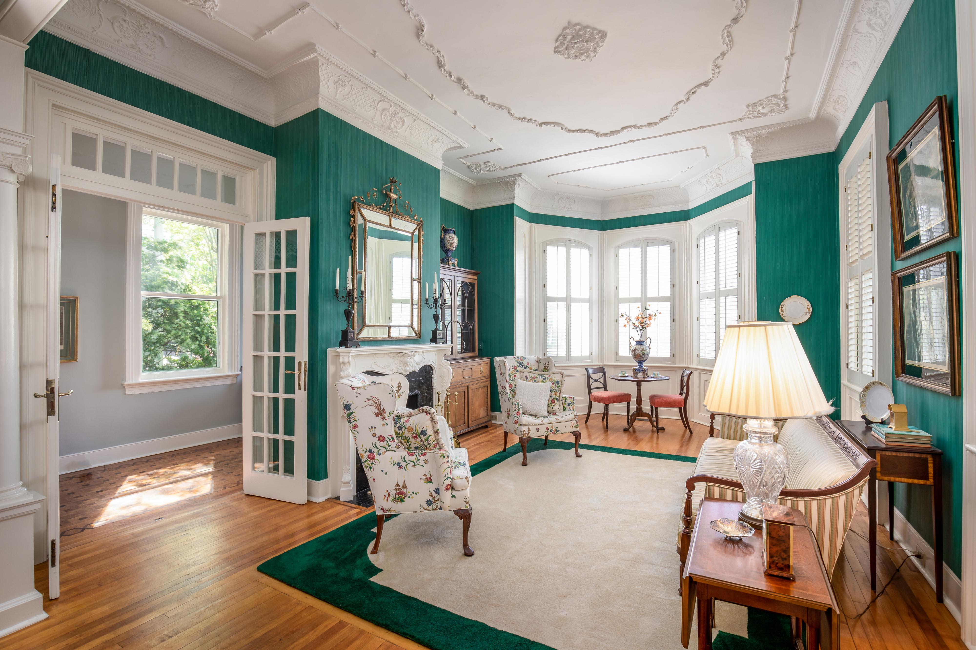
Agent Open House
136 Broad Street
MLS# 19012947:: $1,825,000
Tuesday, May 21, 2019 :: 11:30a-1p
DRAFT
Join us for an Architect Lecture beginning at 12:15 PM
“Charleston 1865 TO 1895”
Presented by
Julie O’Connor, AID
American Vernacular
Queen Anne and Victorian
Within a decade after the Civil War, a new neighborhood rose from the ashes of the Great Fire of 1861 on the western end of Broad Street. New construction began on parts of Broad, Legare, New, Savage and Queen Streets. The house designs were also new. The Queen Ann style prevailed with many of the fashionable houses designed with bay windows, side hall entries, double parlors and double piazzas.
136 Broad is an excellent example exhibiting these features in its design along with its exuberant plaster embellishments on the ceilings and cornices.
Kay E. Kennerty · Kay@AgentOwnedRealty.com · 843.345.5011

