Slide 1

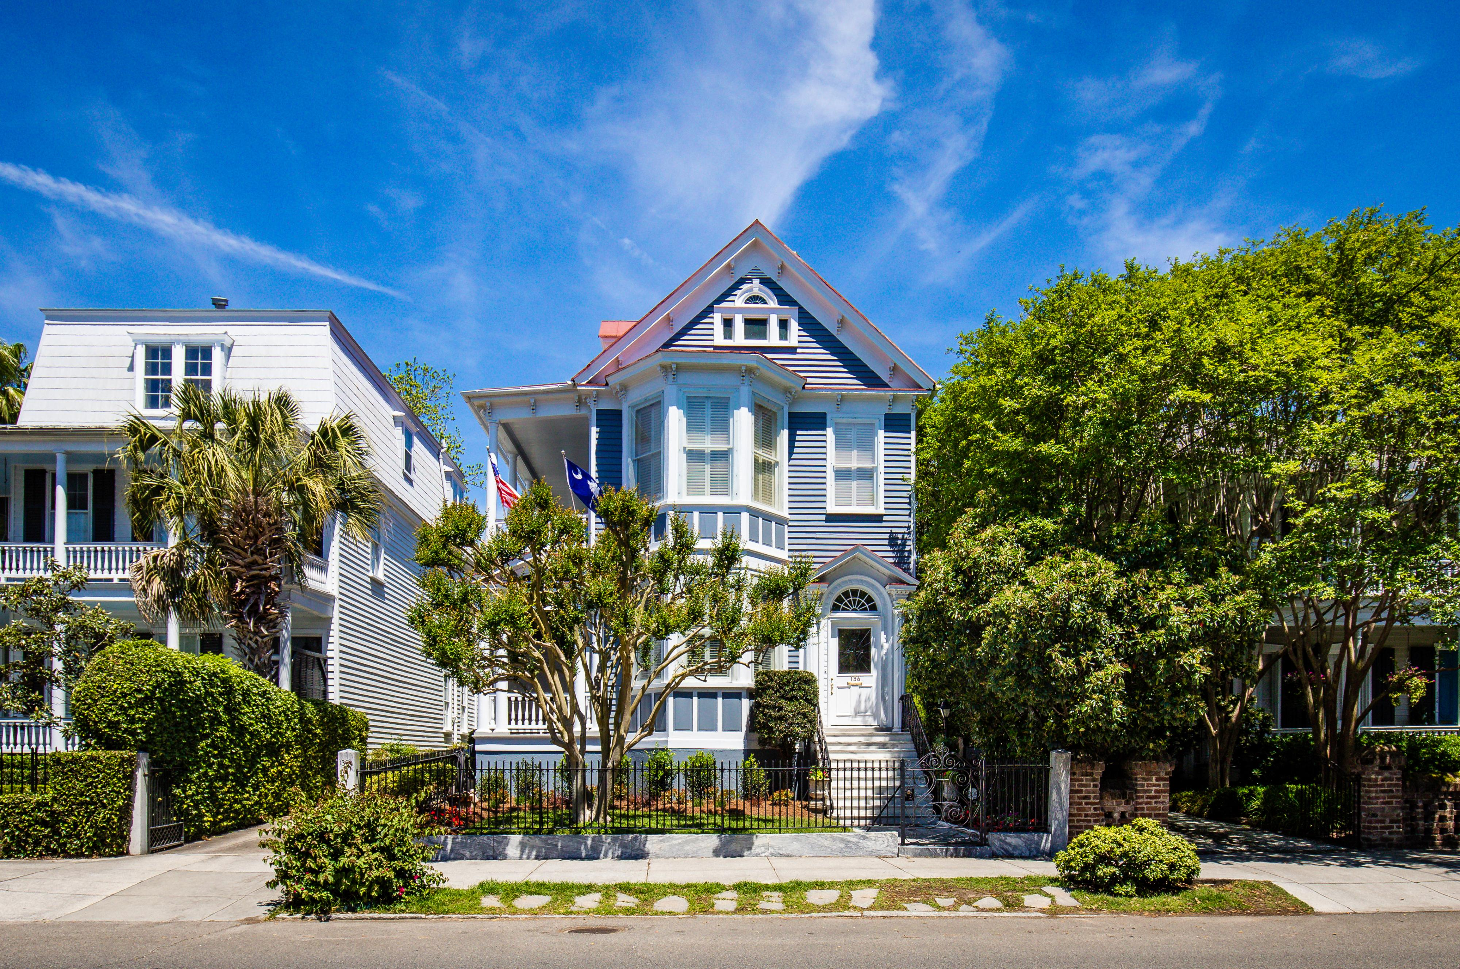


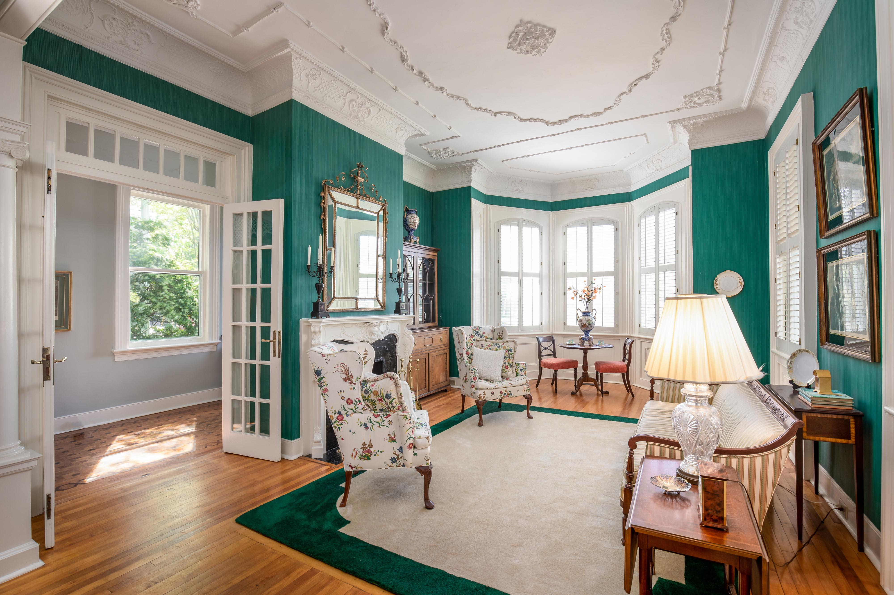

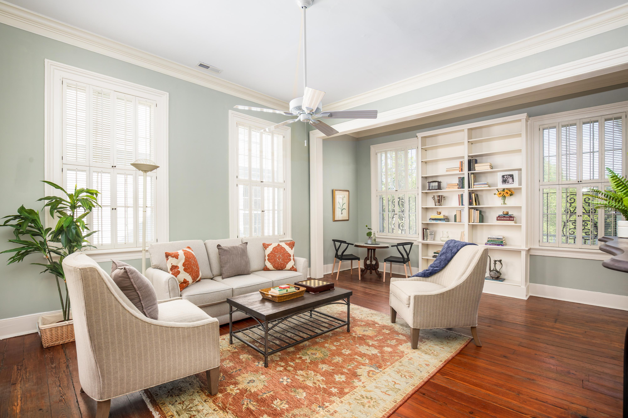

136 Broad Street In Historic Charleston
DRAFT
$1,575,000
Unique & Beautiful
Built 1875
High Ground
4 Bedrooms/3.5 Baths
3-4 Parking Spaces
12' Ceiling 1st Floor
11' Ceilings 2nd Floor
3,500sf On 1st & 2nd
750sf On 3rd
Imagine Living at 136 Broad!
Kay E. Kennerty Kay@AgentOwnedRealty.com 843.345.5011

