Slide 1


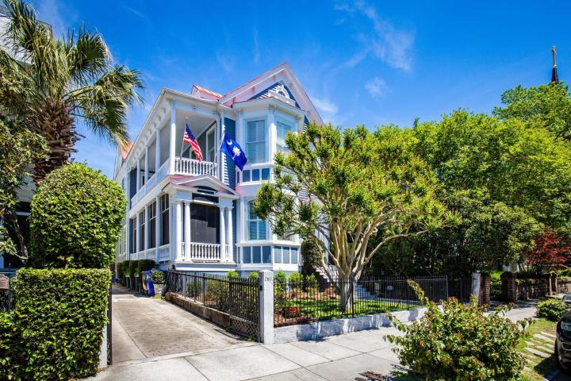
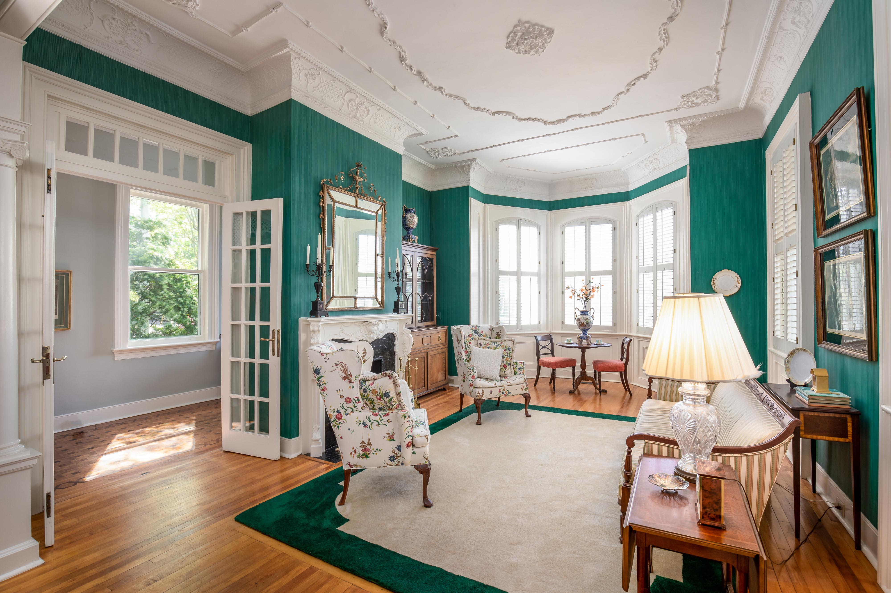

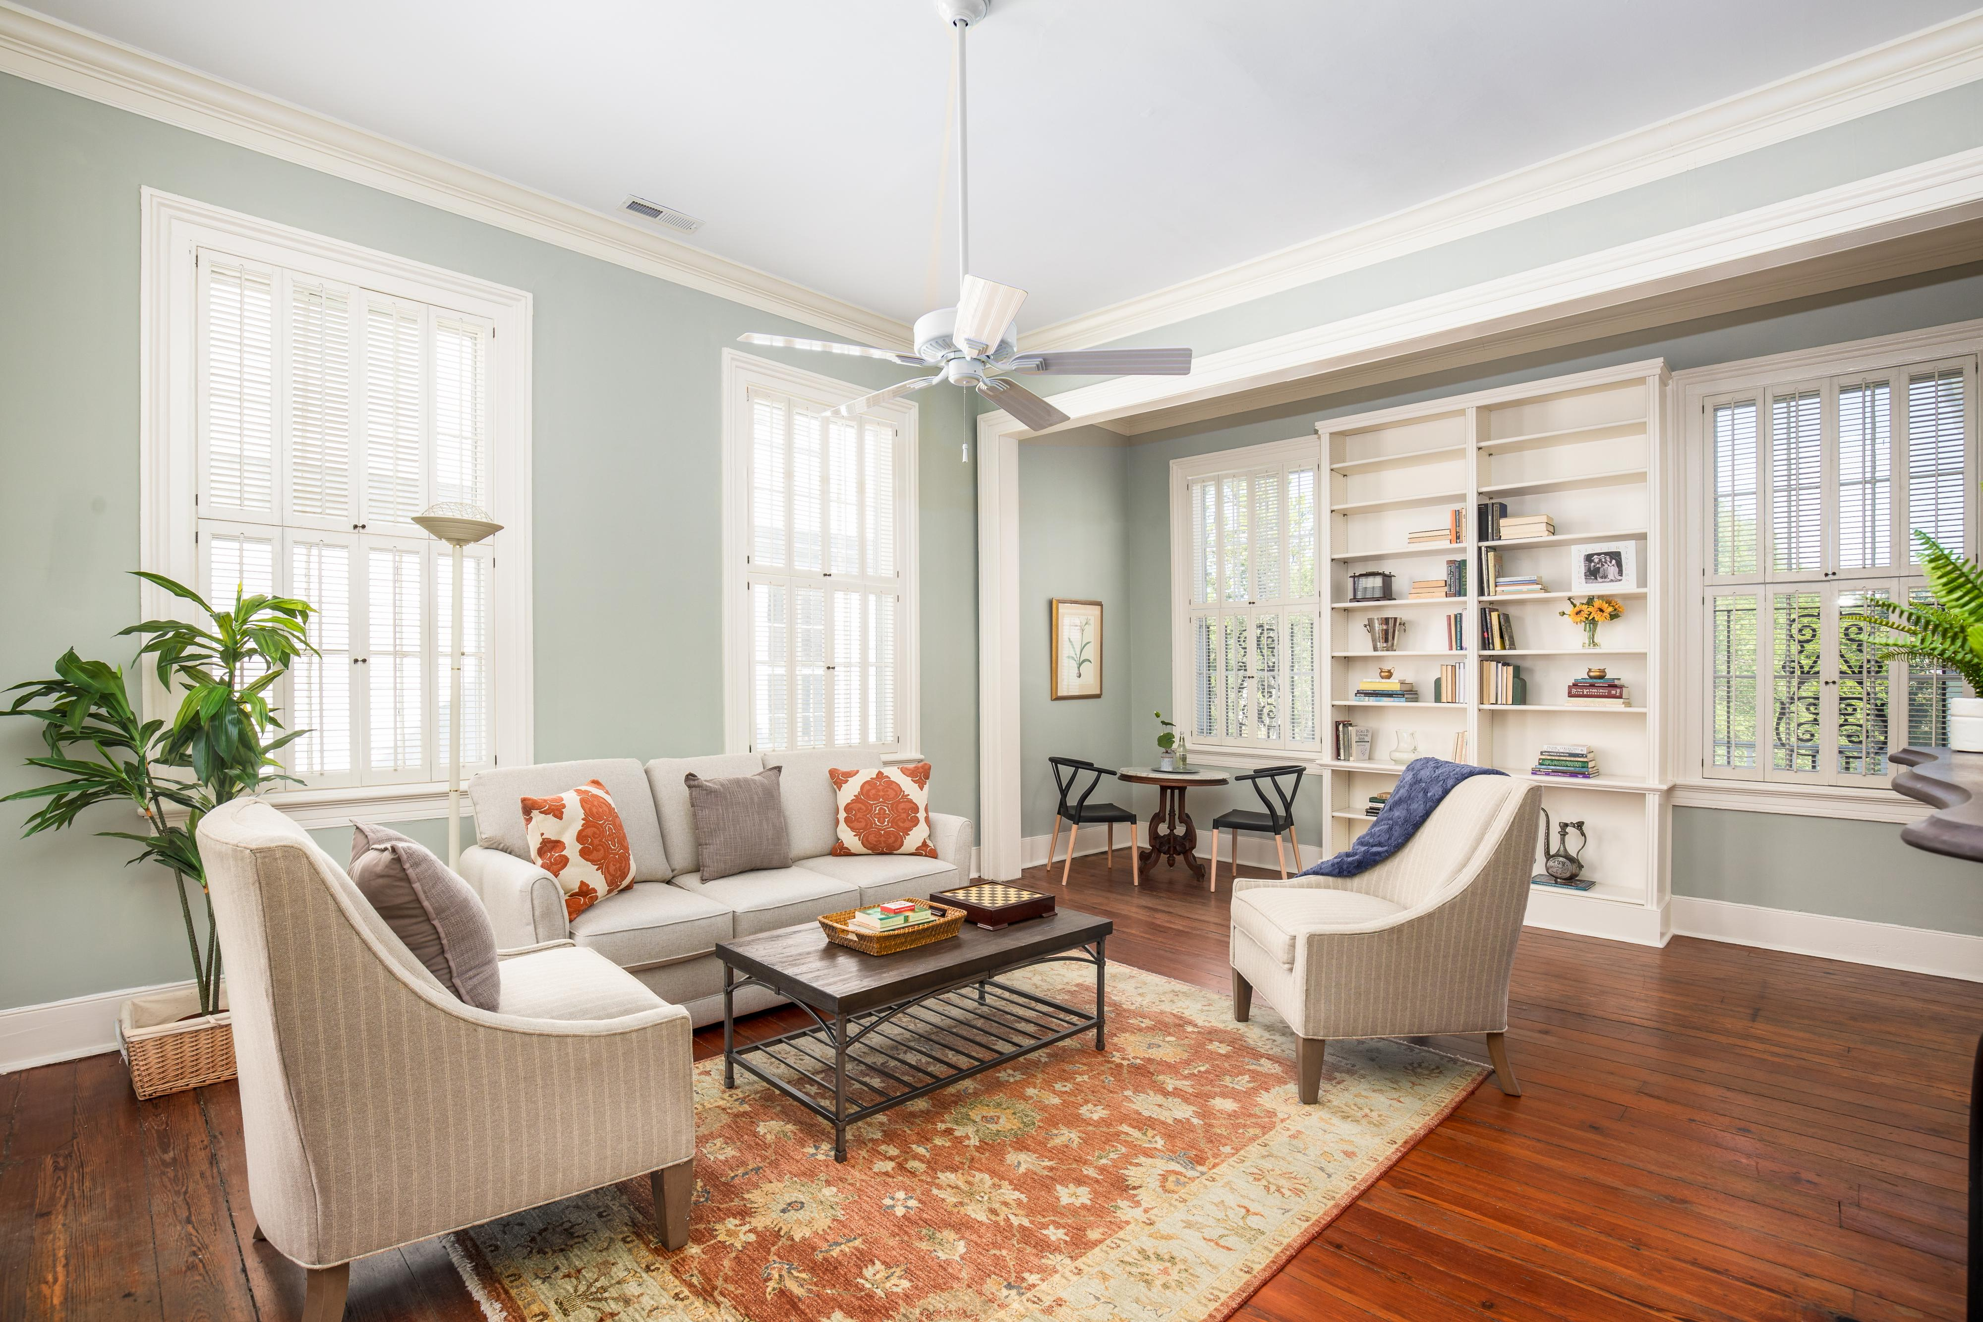
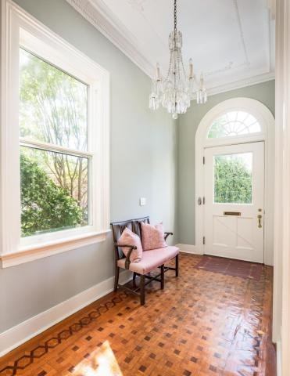
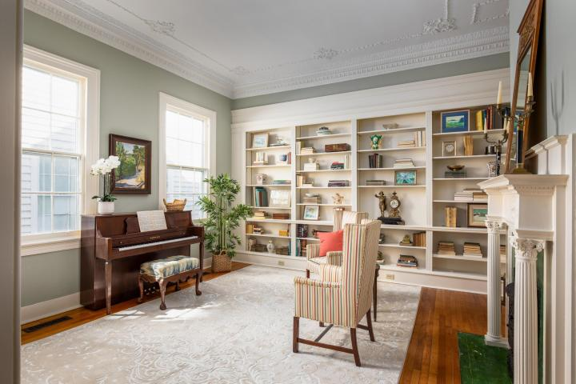
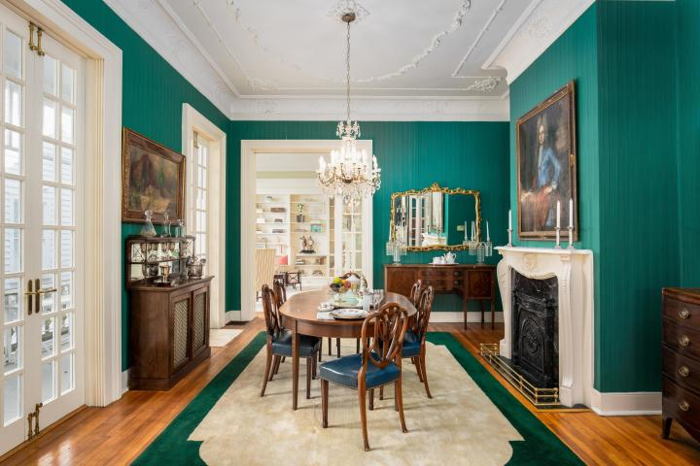
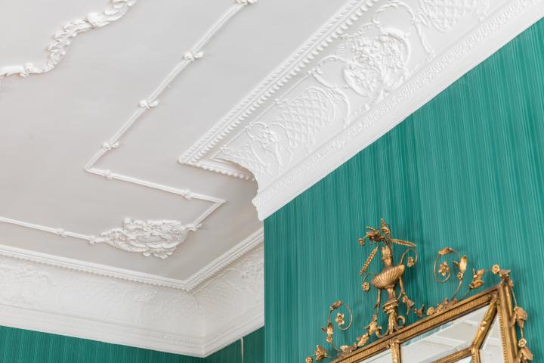

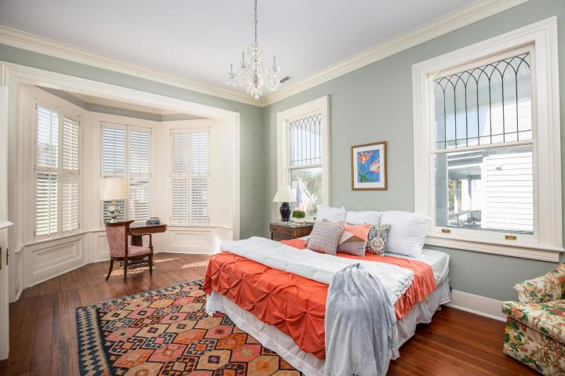
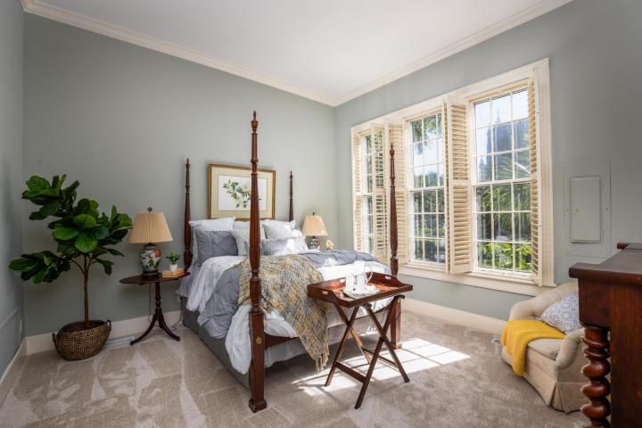
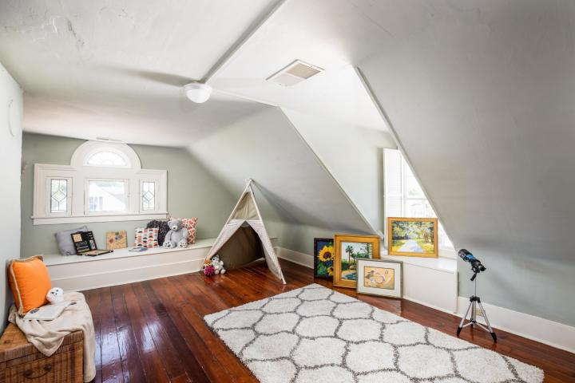
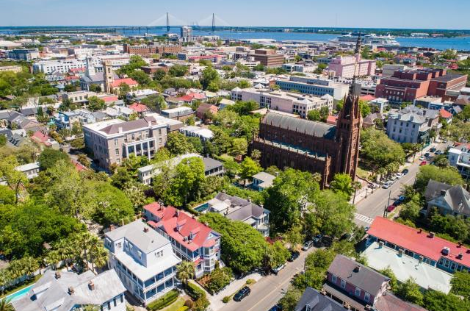

Priced to Sell In The Heart of Historic Charleston
DRAFT
Priced To Sell!
136 Broad Street
$1,245,000
4 Bedrooms | 3½ Baths | Est. 3,500sf on Floors 1 + 2 | 750sf Floor 3
Built 1875
High Ground
4 Bedrooms/3.5 Baths
3-4 Parking Spaces
12' Ceiling 1st Floor
11' Ceilings 2nd Floor
3,500sf On 1st & 2nd
750sf On 3rd
Imagine Living at 136 Broad!
Kay E. Kennerty
843.345.5011 Kay@AgentOwnedRealty.com

