Slide 1
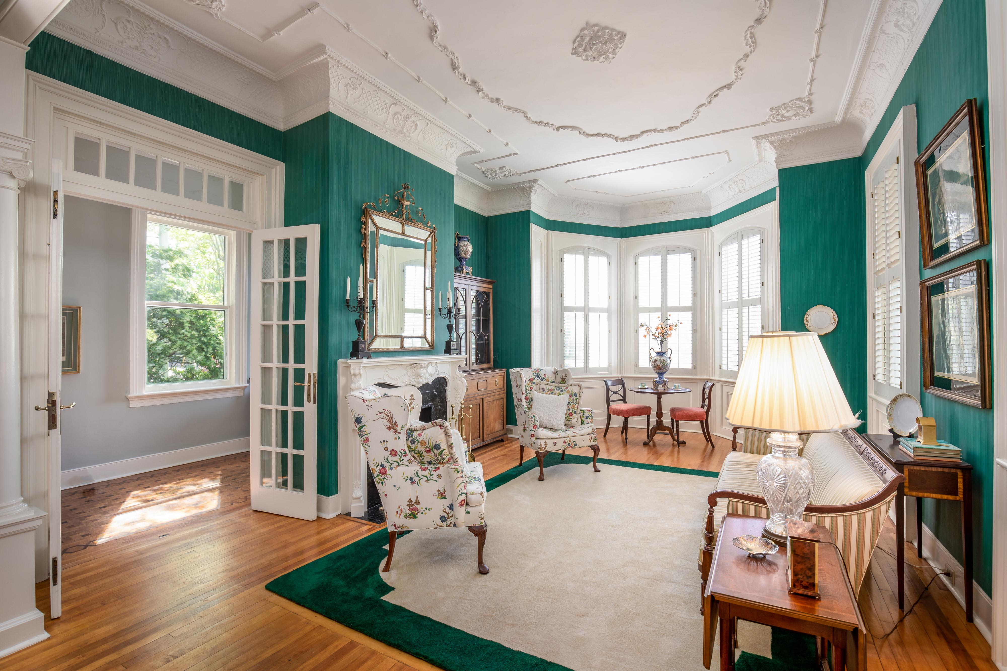
Historic District Gem 136 Broad Street MLS# 19012947:: $1,690,000
DRAFT
Built 1875, Queen Anne Style
Original architectural fabric
Bay window, double piazzas
Heavily beveled glass-front door
Side-hall entry design
Double parlors, library
12" Plaster cornices, swags, medallions on ceiling in Foyer, LR, DR, Library/Family Rm
Ornamental ½ Iconic columns/period lattice
6 fireplaces, 3 embellished
Wrought iron fence
Prince of Persia marble stairs and walkway
2 French doors to piazza 1st floor
High ground
3-4 off-street parking spaces
Possible to design 2ndfloor luxury Master Suite
3-4 bedrooms, 3.5 baths,
Master-1, possibility on 2
12' ceiling-1st floor, 11' ceiling-2nd floor
4294SF = 1824SF1st + 1719SF2nd + 751SF 3rd
Kay E. Kennerty · Kay@AgentOwnedRealty.com · 843.345.5011

