Slide 1
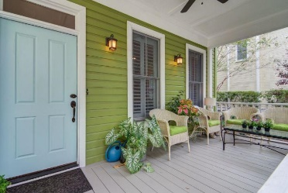
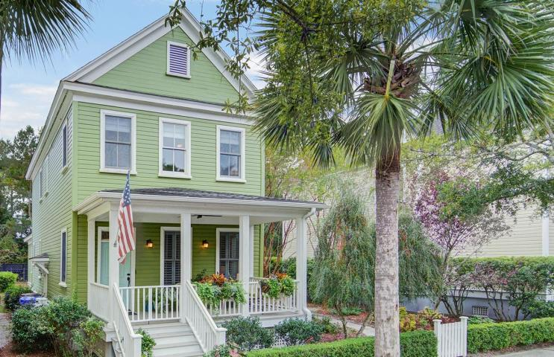
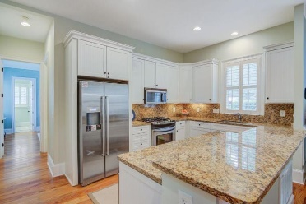
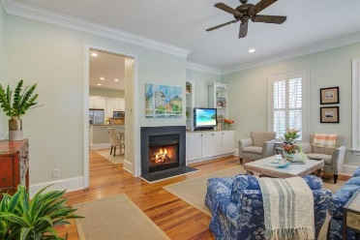
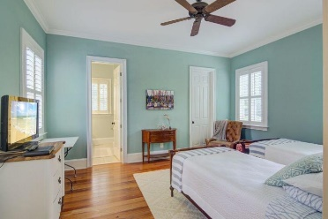
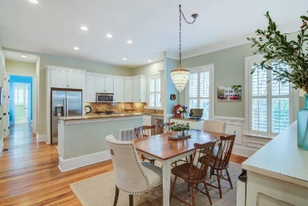
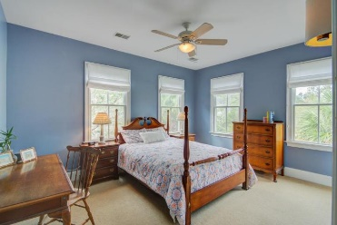
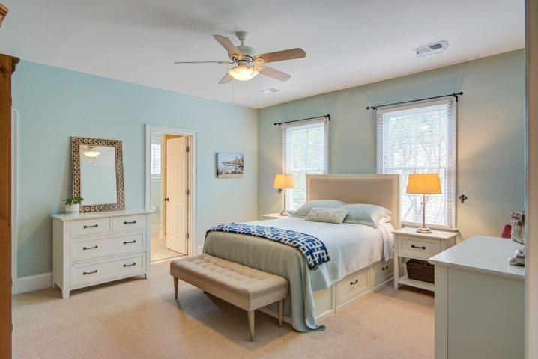
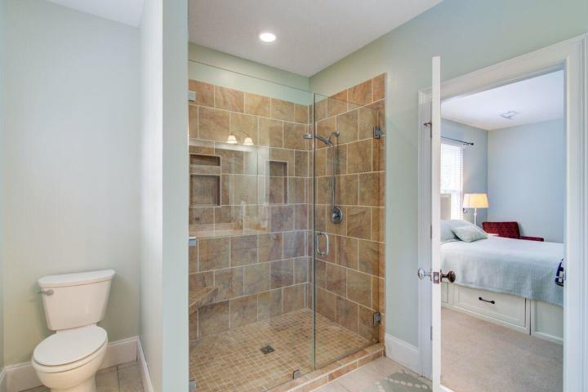
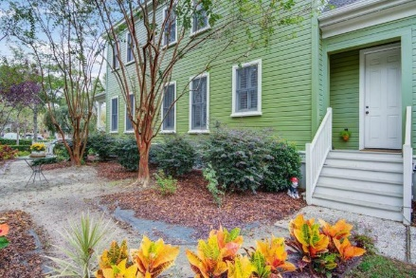
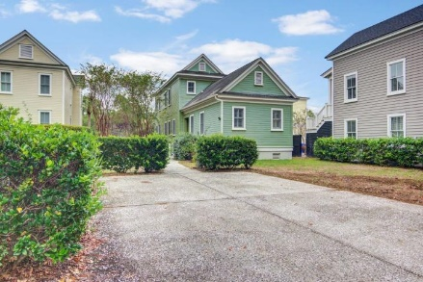


Brokers' Open Tuesday, Nov 27th from 11-1 Drawing for a $50 gift card to the store of your choice!
Starbucks card to first 10 agents
136 Civitas Street
I'On ~ Mount Pleasant, SC 29464 ~ MLS# 18030965 ~ $700,000
Beautiful, bright home with lots of windows and two masters.! Climb the steps to a full front porch with plenty of room for furniture and friends. Enter the living room with a fireplace/ built in book/tv shelves and high ceilings. Walk down the hall to a huge kitchen/dining room area with a bar/island, stainless appliances, hardwood floors throughout main floor. Bedroom on the main with a new walk-in shower, dual vanities and large walk-in closet. Upstairs boasts a nice big master bedroom, large walk-in closet, and a good-sized bedroom with its own bath. Carpet upstairs. Largest lot on the street that will accommodate a multicar garage and upstairs apartment. Great convenient neighborhood close to downtown, shopping/dining. Heart of pine floors and 10' ceilings on main.
Susan Kraber
(843) 779-9655
susankraber1@gmail.com
The Boulevard Company, LLC | 35 Broad Street | Charleston, SC 29401

