Slide 1
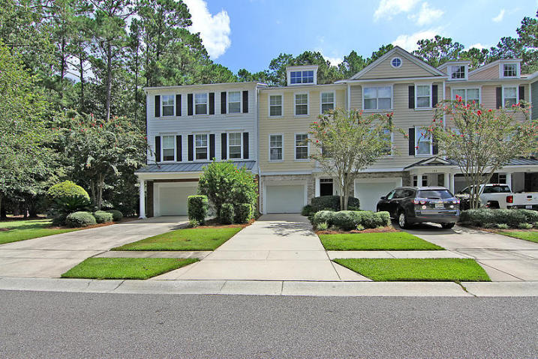
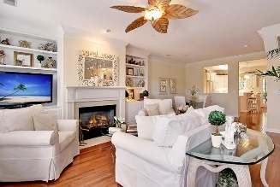
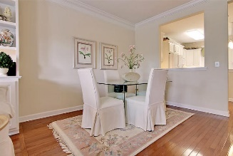
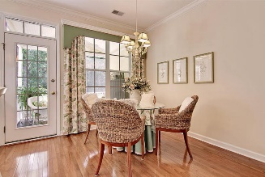
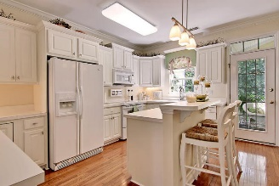
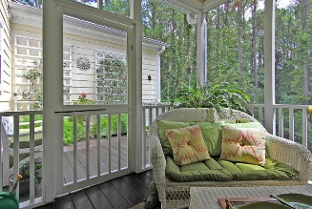
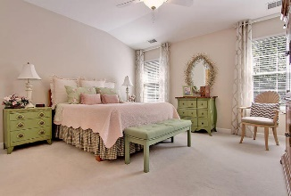
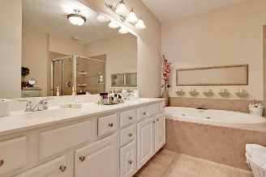
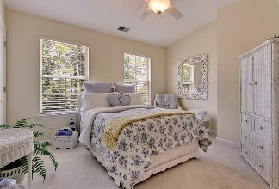
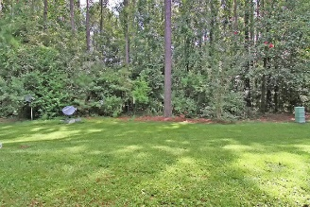
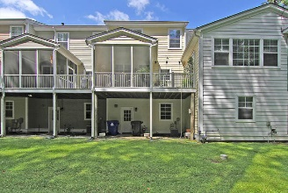
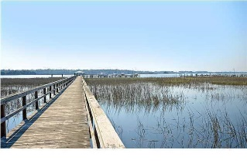

136 Fair Sailing Road Dunes West | Mount Pleasant | MLS# 16023182 | $269,000
Shows Like a Model Home!
Loaded with Updates
BEAUTIFUL 2 bedroom 2.5 bath townhouse-shows like a model! Handsome hardwood floors on first, second, stairs, and loft. The abundance of natural light makes this home sparkle. The family room is over-sized, has large windows, a fireplace and is open to the bright and airy kitchen. The kitchen is perfect for entertaining with an island, tons of prep-space, lots of cabinets, and leads to the screen porch and deck. Upstairs is a loft area, master bedroom with walk-in closets, spa-like bath with double vanities, separate shower, and soaking tub! Across the hall is the second bedroom with large closet and private bath. This town home has storage and parking for 2 vehicles on the main level and access the private backyard that backs up to woods. Dunes West in Mount Pleasant, SC is a wonderfully landscaped gated community with large wooded landscaped lots and community dock, play park, walking trials, golf and pool memberships available and a clubhouse! The neighborhood is close to local shopping and grocery stores and is a short drive to downtown Charleston with 5-star restaurants, world class shopping and iconic history as well as a short drive to the beaches, the airport, Boeing and Daniel Island. Come take a look because you will not find another community that offers as much as Dunes West. This home is perfect for entertaining and still providing a private lifestyle!
Stan Huff
843-670-2835 stan.huff@agentowned.com
Jill Marcacci
843-297-5590 jill@agentowned.com
www.agentownedrealty.com
AgentOwned Realty Co. Preferred Group, Inc. | 824 Johnnie Dodds Blvd | Mt Pleasant, SC 29464

