Slide 1
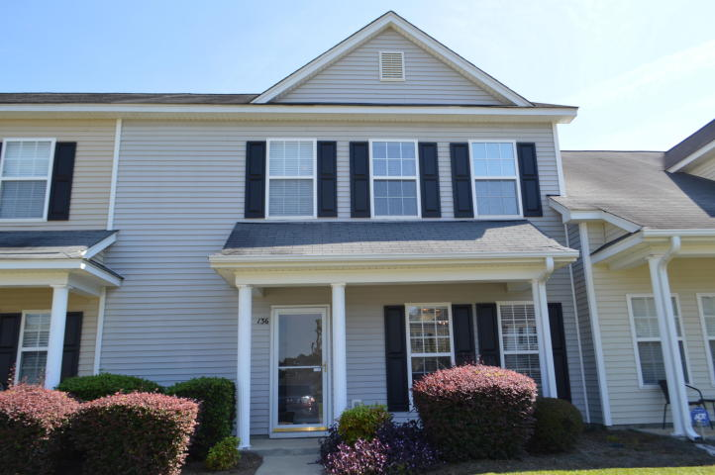
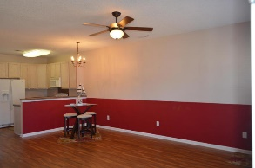
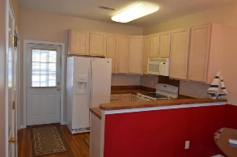
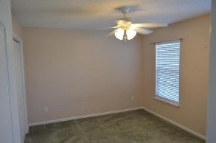
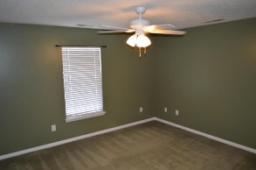
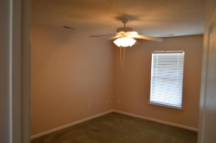
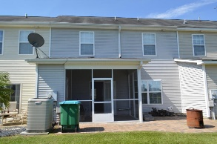
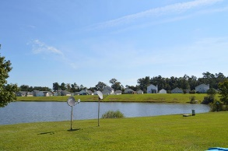
New Listing
Open House 2/11/17 1-4pm
136 Lake Jogassee Drive
Lakes of Summerville
Summerville, SC 29485
MLS# 17003039
$147,500
Fantastic 4 bedroom townhouse available now! Downstairs you'll find brand new flooring in the open floor plan, along with the laundry room and half bath for guests. All appliances stay, including the washer and dryer! The master bedroom is downstairs, overlooking the largest pond in the subdivision. Take some sweet tea out the screened in porch out back and enjoy the serenity the pond view has to offer. Upstairs you'll find three equally oversized bedrooms and 3rd bathroom. Conveniently located close to everything, including Bosch, Boeing, the Joint Air Force Base, Mercedes and many more! Regime does all lawn care so you don't have to! There aren't too may 4bedroom townhomes out there in this price range! Don't miss this one!
Brooke Madsen | (843) 834-1241 | brookemadsen.realtor@gmail.com | www.truecarolinarealty.com
True Carolina Realty | 7836 High Maple Circle | Charleston, SC 29418

