Slide 1
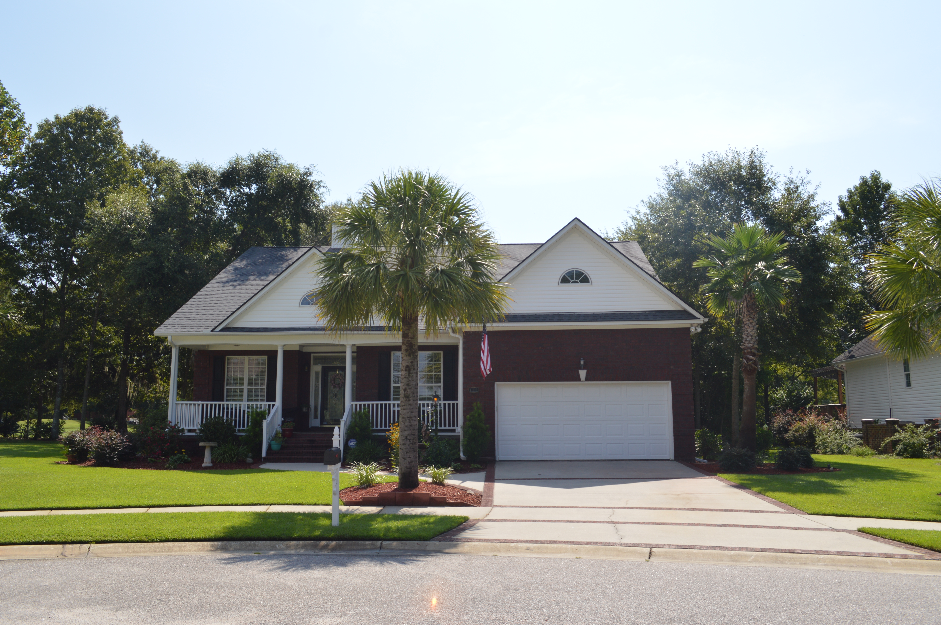

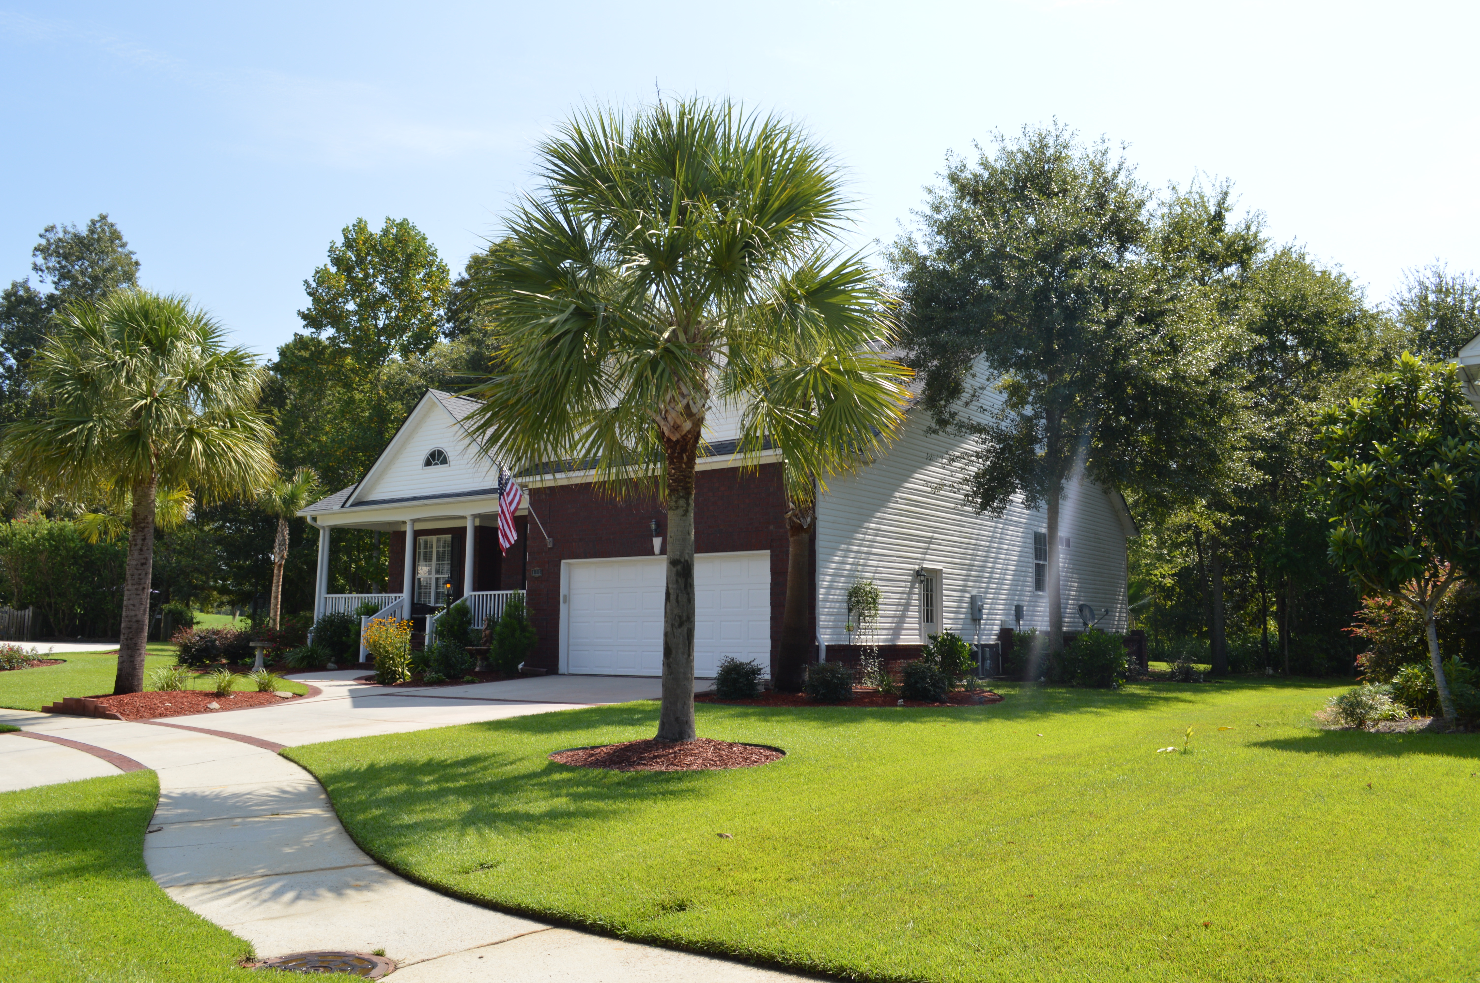
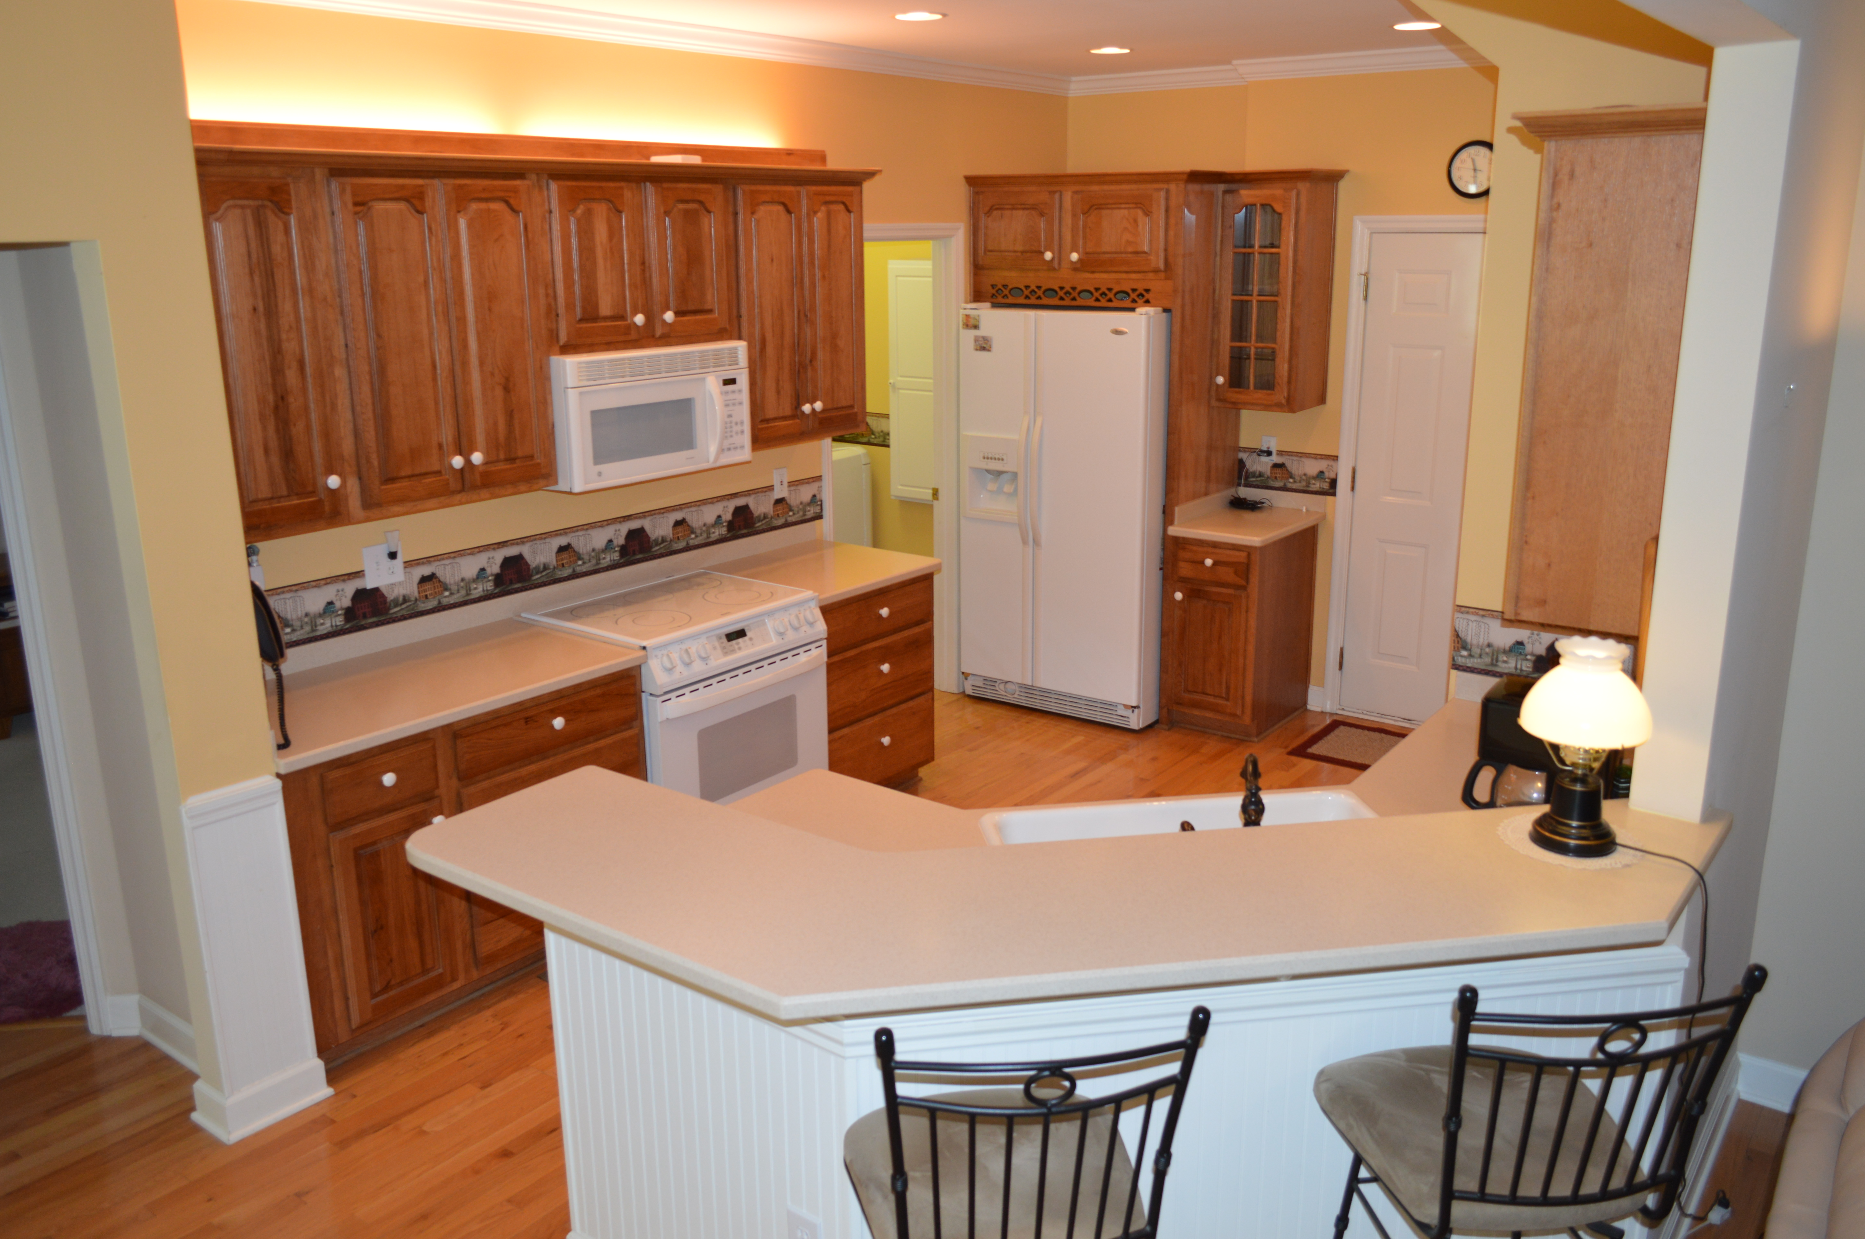
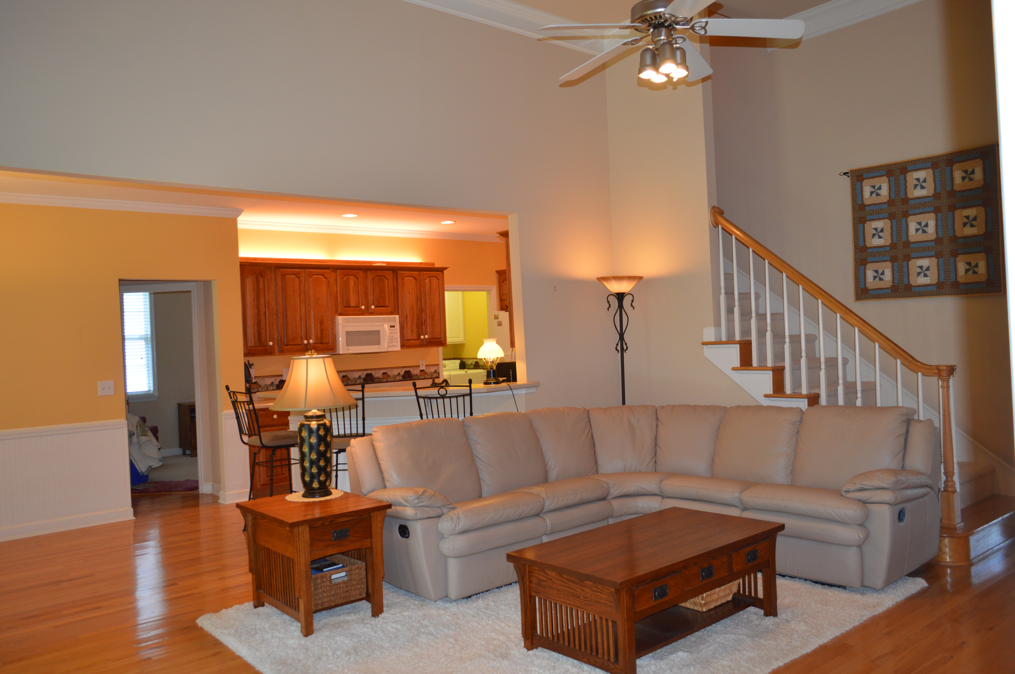
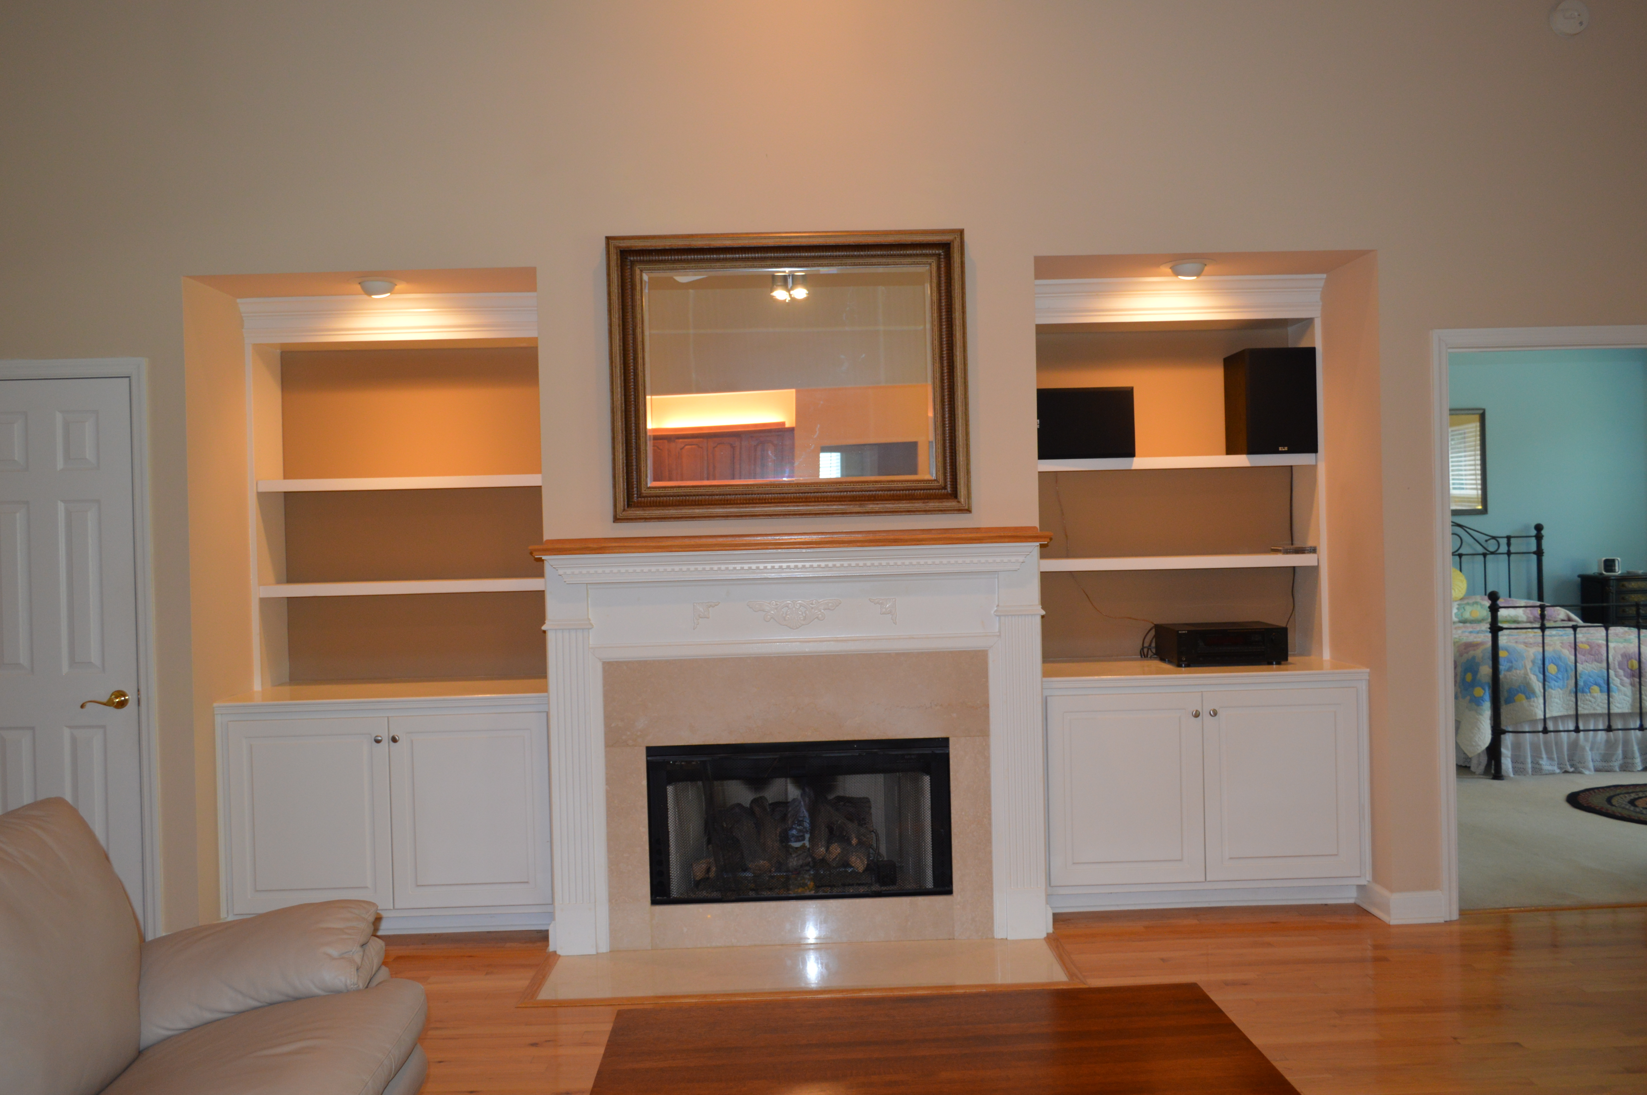
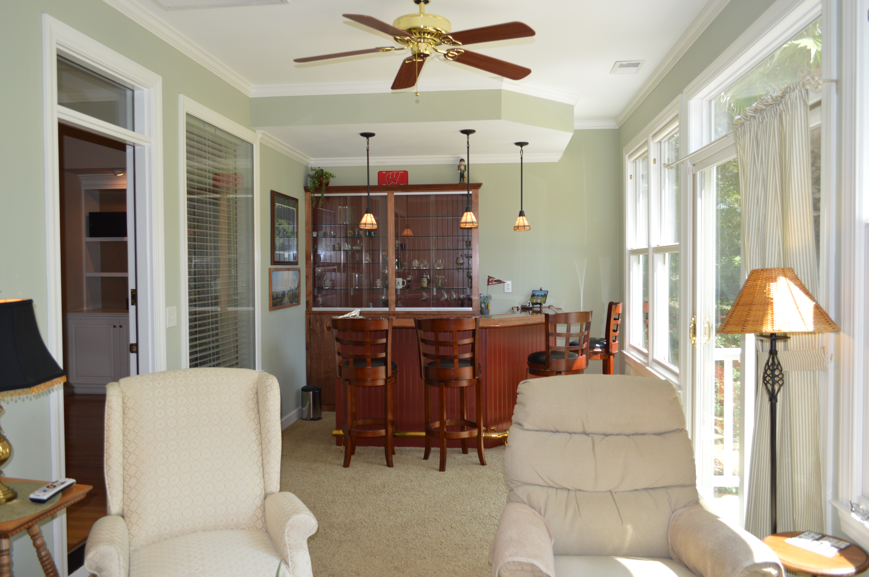
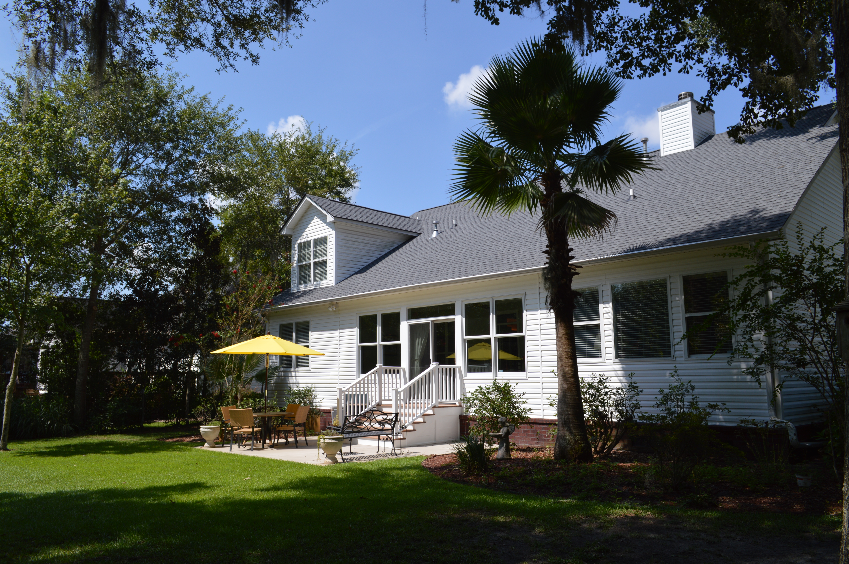
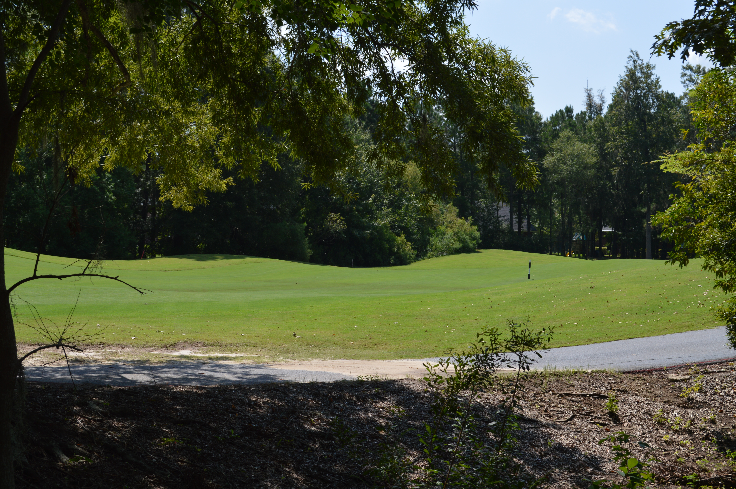

Country Club Living
136 Spalding Circle
Crowfield Plantation
Goose Creek, SC 29445
MLS# 15022257
$414,999
Gorgeous custom ranch home located on the 9th hole fairway with stunning views of the course!!! As you enter the home you are greeted with gleaming hardwood floors throughout the home (except for bedrooms). Off the foyer is a versatile room, perfect for a sitting area, study or home office. The formal dining offers tray ceiling and wainscoting. The eat-in kitchen has beadboard, custom cabinets, large pantry, accent lighting, Corian countertops, upgraded fixtures and is open to the great room. The great room has gorgeous built-ins, soaring ceilings and gas fireplace. The sunny master has views of the golf course. Master bath with dual vanities, jetted tub and separate walk-in shower, water closet and huge walk-in closet. The two guest bedrooms are located on the opposite side of the home with bath located in between. As you travel upstairs you will find an expansive frog with a full bath. Also upstairs is an unfinished room over the garage with tons of storage room. The garage has overhead storage, storage cabinets and a sink. The heated and cooled sunroom with a custom built bar has surround sound, hot/cold sink, fridge, icemaker and shelving for glassware. The windows are hurricane resistant by the Hurd Company. This home offers extensive, professional landscaping with irrigations system. The crawlspace has a commercial de-humidifier, new liner and sealed vents. Roof was replaced in 2015. Transferrable termite bond.
Lisa Powell-Berenyi | 843-568-6608 | powell_l@hotmail.com | www.omnicarolinarealestate.com Omni Carolina Real Estate | 126 Eston Dr | Goose Creek, SC 29445

