Slide 1
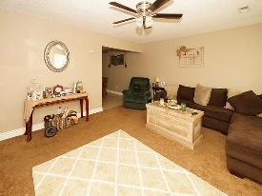
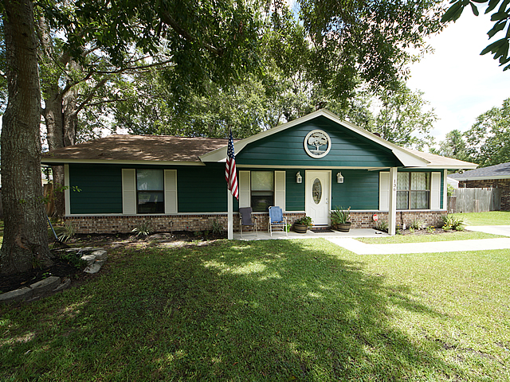
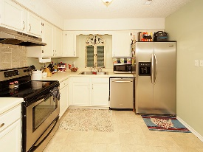
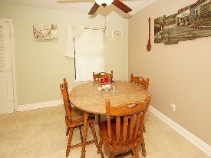
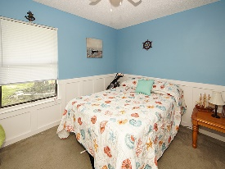
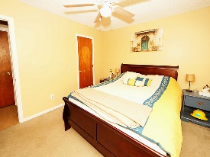
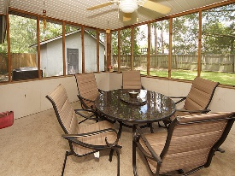
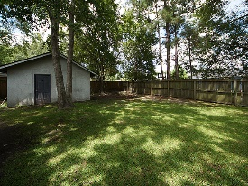


This Home Is Ready And Waiting For You!
136 White Pine Ct
Conifer Hall
Moncks Corner, SC 29461
Open House Canceled!
Under Contract In 3 Days!
MLS# 17019714 | $145,000
3 Bed / 2 Bath
Spectacular 3 bedroom 2 bath ranch style house.
Owners flare in design shows through the stylish paint colors, carpet and decor.
Stainless appliances, NEW AC Unit and screen porch make this home move in ready waiting for the next owner!
Connie White, Broker
C: 843-532-3356
conniesyouragent@gmail.com
Charleston Homes
597 Old Mt. Holly Road
Suite 301
Goose Creek, SC 29445

