Slide 1
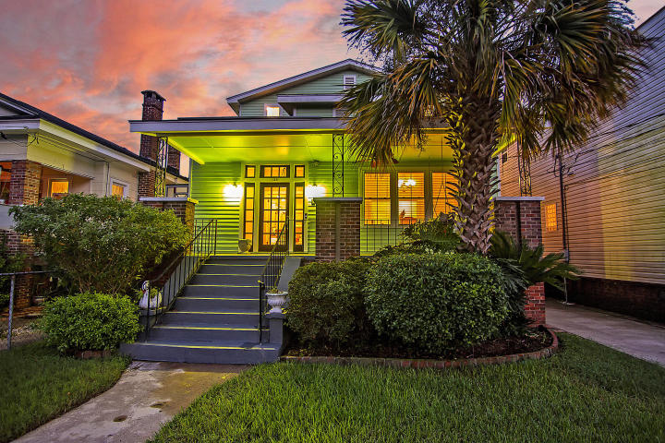

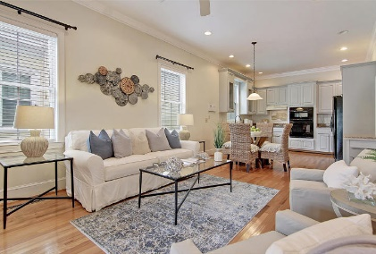
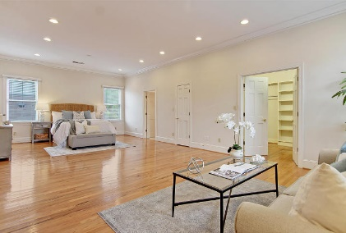
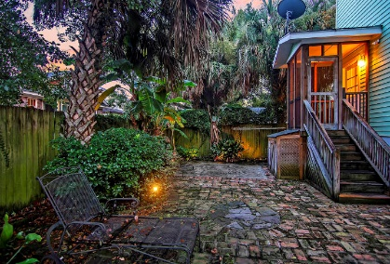
Modern Conveniences
Plus Historic Charm
136 Darlington Avenue
Wagener Terrace ~ Charleston, SC 29403 ~ MLS# 20025977 ~ $699,000
Situated in the desirable Wagener Terrace section of downtown Charleston, this sprawling two story home has so much to offer! Modern conveniences and historic charm collide here with a roomy covered front porch, columns and a fireplace in the dining room, hardwood floors, a gorgeous eat-in kitchen and a massive master suite on the 2nd floor. A spacious loft is lined with a wall of built-in book shelves and room for an entertainment center. A floored attic area provides amazing storage. Two of the four bedrooms and a full bath are located on the first floor. The brick paver driveway and backyard patio offers great off-street parking and outdoor living space. This home is incredibly close to I-26, Hampton Park and great dining like the Rutledge Cab Company and Tattooed Moose.
Additional features include:
Wide oak floors
10 foot ceilings
6.5 inch crown molding and baseboards
Intercom system
Kitchen features glass front cabinets, granite countertops, a gas stove and tile backsplash
Master bedroom has a sitting area and a walk-in closet with built-ins
Master bath has a dual vanity, jetted tub and walk-in shower
Terminex moisture barrier on the crawl space
Book your showing today!
Nate Gainey 843-513-2038
nate@mattoneillteam.com
Christopher Smith 843-267-0735
christopher@mattoneillteam.com

